Slide 1
The Impact of Structural Vibration on Flying Qualities of a High Speed Civil Transport
AIAA 2001-4006
David L. Raney, E. Bruce Jackson,
Carey S. Buttrill, William M. Adams
NASA Langley Research Center
Hampton, VA
NASA Aeroservoelastic Real-Time Simulation Workshop
18-19 April 2012
Originally presented at:
AIAA Atmospheric Flight Mechanics Conference
6-9 August 2001
Montreal, Canada
Langley Research Center
High Speed Research
Notes:
HSR Parametric Dynamic Aeroelastic Simulation Experiment (LaRC.3)
As technologies are developed which allow aircraft structures to become lighter and more flexible, the impact of dynamic aeroelastic modes on aircraft flight dynamics, flight control, and flying qualities increases in prominence. The consideration of such effects is likely to assume unprecedented significance in the design of the proposed High Speed Civil Transport (HSCT). Constraints imposed by flight at supersonic speeds and the need for economic commercial operation will result in a relatively light and slender HSCT design that will exhibit unusually low-frequency elastic modes.
Several maneuver tasks that included dynamic aeroelastic effects for the Reference-H configuration were evaluated by test pilots in an earlier (LaRC.1) investigation conducted in the Langley Visual/Motion Simulator facility during January and February of 1997 [1], [2]. Those preliminary evaluations revealed that flexible modes profoundly reduce the ease with which approach and landing tasks are performed.
A piloted simulation experiment, designated as LaRC.3, was performed to further investigate the impact dynamic aeroservoelastic effects (DASE) on flying qualities of the High-Speed Civil Transport. The intent of the LaRC.3 investigation was to generate information regarding measures which can be taken to reduce the impact of aircraft flexibility on piloting tasks. The experiment was performed in the Langley Visual/Motion Simulator facility during October through December of 1997. A total of six test pilots representing Boeing, NASA, Calspan and the FAA participated in the experiment. This document summarizes the objectives, approach and results of the LaRC.3 investigation.

Slide 2
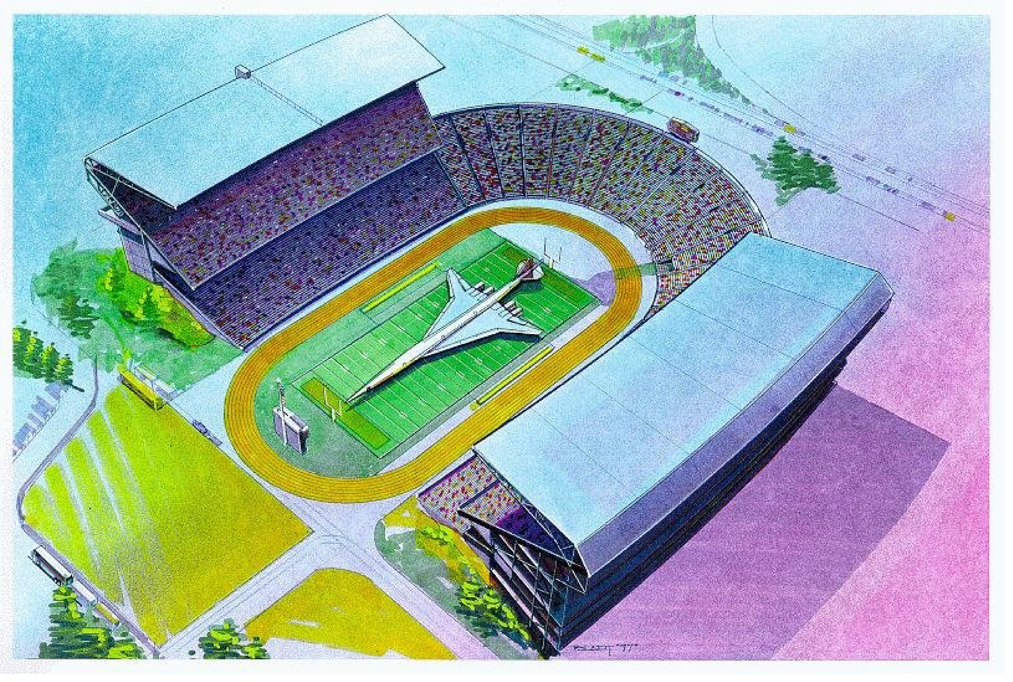
It’s BIG ...
- 100 ft longer than a 747-400
Notes:
I believe the stadium shown is the University of Washington. A VTOL capability is not envisioned.
One side of the horizontal tail is as big as the entire F18 wing.

Slide 3
HSCT Size + Slenderness = Aeroelastic Problems
HSCT is ~ 330 ft long with first elastic mode frequency of 1.25-1.45 Hz; typical subsonic transport is twice that.
Simulations suggest that active structural control will be required for acceptable flying and ground handling qualities.
Vibration environment at pilot station is dramatic
What are the requirements for a Structural Mode Control system?
Notes:
The HSCT is over 300 feet long with a symmetric first mode frequency below 2 Hz. Ride quality for the pilot and passengers is an issue. The lateral ride at the pilot station in light turbulence is violent during aggressive maneuvers. The pilot can interact both cognitively and biodynamically with the elastic motion. Airplane/pilot/inceptor biodynamic coupling has been observed in aeroservoelastic motion-base simulation. Video footage of the pilots being thrown about the simulator cab is very compelling.
As a point of reference, the Concorde about 204 feet long. The Tu-144 is about 215 ft. and the B1, whose planform is shown in the figure, is about 135 ft. long.
While notching the pilot command path could prevent pilot excitation of the aeroelastic modes, preliminary studies on TIFS and experience predict that the resulting flying qualities would be unacceptable. Notching control law feedback paths would eat up phase margin for the augmentation loops that stabilize the pitch axis. In either case, response to turbulence would be undiminished and unpleasant.

Slide 4
Approach & Objectives
Parameterize Aeroelastic Model: Directly manipulate model’s dynamic characteristics to approximate the effect of various means of dealing with DASE*
Structural stiffening, Active mode suppression
Perform piloted evaluation maneuvers in simulator
Collect pilot ratings, cockpit vibration data, and simulation time histories for each parametric configuration
Examine effectiveness of various means of addressing DASE
Generate design insights
Prescribe damping objectives for active mode control
*DASE: Dynamic AeroServoElasticity
Notes:
LaRC.3 Objectives & Approach
The objective of the LaRC.3 investigation was to investigate the effectiveness of various means of reducing the impact of aircraft flexibility on piloting tasks. The real-time implementation of the Boeing Ref-H aeroelastic model that had been used in the LaRC.1 piloted simulation assessment in early '97 was parameterized to represent each of the potential DASE solutions described thus far. It is important to emphasize that no active mode suppression control system was present, but that the model was directly manipulated to approximate the effect of the various means of addressing dynamic aeroelasticity which have been discussed.
The impact of structural stiffening was represented in the investigation by parametrically varying the frequencies associated with the dynamic aeroelastic modes. The impact of an active mode suppression control system was represented in the investigation by independently varying the damping level associated with different combinations of elastic modes. The impact of an idealized mode-cancelling multi-surface control system (using canard and elevator to pitch the vehicle without exciting the first fuselage bending mode, for instance) was represented by simply eliminating the elements of the B matrix which represent the control effector excitation inputs to the first fuselage bending mode. By exploring each of these three parametric variations, information was gained regarding the effectiveness of each approach, and the degree to which it must be exercised in order to achieve the desired flying qualities. The impact of an idealized display compensation for dynamic aeroelastic effects was also evaluated. The approach to representing the various DASE solutions was clearly approximate, but it has allowed timely execution of an experiment that captures the fundamental effects of interest. It should be noted that the simulation used a sidestick control inceptor with the Boeing gamma-dot/V and p-beta control response types. The experimental setup in terms of displays, control inceptor and control response types was identical to that used in the LaRC.1 piloted simulation assessment and is further documented in references which describe the LaRC.1 results [1], [2].

Slide 5
HSCT Real-Time Dynamic Aeroelastic Model
Symmetric Modes (Side View)
Antisymmetric Modes (Top View)
Mode 1: 1.25 Hz
Mode 2: 1.39 Hz
Mode 3: 2.01 Hz
Mode 4: 2.13 Hz
Mode 5: 2.70 Hz
Mode 6: 2.82 Hz
3 Symmetric + 3 Antisymmetric Modes
Parameterized Modal Frequencies & Damping
Turbulence Inputs + Control Effector Inputs
Attitude Perturbations Represented in Visual Cues
Notes:
Model for LaRC.3
The simulation model that was used for the LaRC.3 experiment contained six dynamic elastic modes: 3 symmetric and 3 antisymmetric shapes as shown in the figure. The elastic modes could be excited by turbulence or by control effector deflections. The model was similar to that used in the preliminary LaRC.1 configuration assessment with the exception of added features that allowed the parametric variation of frequency and damping for the particular modes, or the elimination of control effector excitation of a particular mode. Details regarding the design and implementation of the dynamic aeroelastic model are presented in [6] and [7]. The simulation used the same control laws that were used in the Ames.5 assessment using mean body axis feedbacks. Control inceptor and display characteristics were also identical to those used in the LaRC.1 configuration assessment. But two differences between the LaRC.1 model and the LaRC.3 baseline model should be mentioned.
The first is the use of faster flaperon actuators. During the LaRC.1 configuration assessment, several incidents of PIO were encountered during tasks that were executed without dynamic aeroelastic effects present. The data indicated that flaperon rate limiting was probably the cause of these incidents. Flaperon actuator rate limits of 50 deg/sec were used during the LaRC.1 assessment, and it has been suggested by the Guidance and Flight Control Integrated Technology Team that a rate limit of 90 deg/sec might eliminate the PIO difficulty. Therefore, the LaRC.3 assessment used the faster flaperon actuator rates.
The second difference would be the use of a modified integration algorithm. The LaRC.1 assessment of the dynamic aeroelastic model was optimistic in that the AB2 integration algorithm (which was required to allow the simulation to operate in real-time) resulted in greater damping of the aeroelastic perturbations than that which was predicted by the model. The LaRC.3 revised implementation of the simulation used a more sophisticated integration algorithm but divided the workload among multiple CPUs to achieve real-time operation, so that the effective aeroelastic damping was no longer optimistic.

Slide 6
Potential Solutions to Examine using Parameterized Model
structural stiffening: increase modal frequencies
display compensation: eliminate impact of visual cues by fixing CGI relative to HUD
active suppression: increase modal damping
active suppression; mode-cancelling control: eliminate modal excitation due to surface deflections (multi-surface mode suppression)
Notes:
Questions of Interest (continued)
Another relevant research issue was posed by B. Newman in a paper entitled, “Proposed Flying Quality Metrics and Simulations Studies for Elastic Vehicles” (AIAA GFC, ‘96 [4]). This issue involves the significance of the pole/zero constellation in the pitch rate to elevator transfer function, which greatly influences the nature of the transient aeroelastic response to control inputs. This issue would be more difficult to address parametrically using the existing real-time dynamic aeroelastic model. But the geometry of q/δe poles and zeros can at least be documented for each of the configurations that are evaluated in the LaRC.3 experiment, and this area should be highlighted as an important topic for further investigation.
Potential Solutions to Examine
So several potential solutions that were considered in the LaRC.3 experiment on the Langley VMS include structural stiffening to increase modal frequencies, active mode suppression to increase modal damping, and active mode cancellation to prevent excitation of particular elastic modes. An additional factor that was examined by Schmidt, Waszak and Davidson (NASA CDTR 4102 [5]) was the compensation of visual cues to eliminate bouncing of the HUD relative to the horizon due to dynamic elasticity. Such compensation was found to have a positive effect on the pilots’ opinion of a flexible B-1 aircraft simulation. A similar approach was represented in the existing aeroelastic Ref-H simulation by eliminating the display perturbations due to aeroelasticity that were present in the simulation. The condition was intended to represent an idealized compensation of an external vision system (XVS) for dynamic elastic effects.
Due to various limitations inherent in ground-based simulations and limitations regarding the size of the experimental test matrix, the LaRC.3 investigation cannot provide complete answers to each of these issues, but it does provide insight into the potential effectiveness or difficulties associated with the various approaches.

Slide 7
Variation of Structural Stiffness
Configuration Frequency Stiffness 1st SY Mode
Ratio Increase Frequency
baseline 1.00 -- 1.25 Hz
stif1 1.16 ~35% 1.45 Hz
stif2 1.36 ~85% 1.80 Hz
stif3 1.60 ~150% 2.00 Hz
-- damping ratio
Directly manipulate model to simulate frequency increases due to stiffer structure
All structural modes are lightly damped
No consideration of associated weight penalties
X
X
Mode 5 (SY)
X
X
Mode 6 (AN)
X
X
X
X
X
X
Mode 4 (AN)
X
X
X
X
IMAGINARY AXIS
X
Mode 3 (SY)
X
X
X
X
Mode 2 (AN)
X
X
X
X
Mode 1 (SY)
X
X
X
X
X
X
X
X
X
X
REAL AXIS
Notes:
Variation of Structural Stiffness
The variation of structural stiffness was represented by multiplying the frequencies of all six dynamic elastic modes included in the model by a given frequency ratio. The representation of structural stiffening by directly manipulating the model in this fashion is clearly approximate, but should be sufficient to capture the basic effect. Frequency ratios of 1.0 (baseline), 1.16 (“stif1” configuration), 1.36 (“stif2”) and 1.60 (“stif3”) were chosen. This selection produced frequencies for the first symmetric bending mode of 1.25 Hz, 1.45 Hz, 1.80 Hz and 2.0 Hz. Linearized models of the dynamic aeroelastic simulation were produced at each of these conditions. The figure illustrates the migration of the dynamic elastic poles that occurred as the stiffness level was varied. The total range of variation probably extends beyond the conditions that would be physically practical for this design because of the weight penalties associated with producing the stiffer structure. In this representation of structural stiffening, the aircraft weight was not increased in the simulation as the modal frequencies were increased. The “stif1” condition of 1.45 Hz for the first symmetric mode was considered to be most representative of the TCA configuration, and so was used as the modified baseline configuration for all other parametric variations. Time histories from the real-time simulation were used to verify that the parameterization method produced the desired effect.

Slide 8
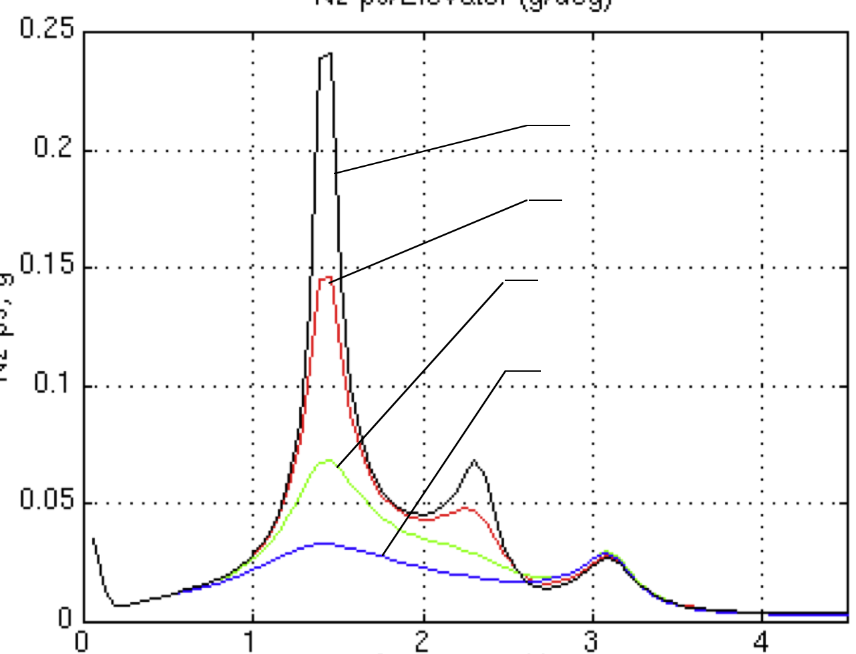
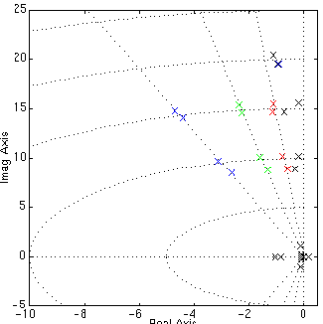
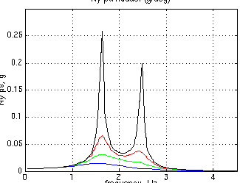
Variation of Modal Damping
Examine effect of Damping Level, Frequency Range, Symmetric vs Antisymmetric
Configuration Damping Ratio Modes
stif1 nominal ––
damp1 0.07 SY1, AN1
damp2 0.15 SY1, AN1
damp3 0.30 SY1, AN1
damp4 0.30 SY1
damp5 0.30 AN1
damp6 0.07 SY1-2, AN1-2
damp7 0.15 SY1-2, AN1-2
damp8 0.30 SY1-2, AN1-2
damp9 0.30 SY1-2
damp10 0.30 AN1-2
Nz ps / Elevator (g/deg)
baseline
0.07
0.15
0.30
0.15
0.07
0.30
Mode 6 (AN)
0 1 2 3 4
Frequency, Hz
X
Mode 5 (SY)
X
Ny ps / Rudder (g/deg)
X
X
X
Mode 4 (AN)
X
X
X
X
X
Mode 3 (SY)
IMAGINARY AXIS
X
X
X
Mode 2 (AN)
X
X
X
X
X
Mode 1 (SY)
X
X
X
X
X
X
X
X
0 1 2 3 4
REAL AXIS
Frequency, Hz
Notes:
Variation of Modal Damping
The portion of the test matrix which varied the modal damping level actually targeted several issues. The first issue was the effect of the amount of damping that was applied to the dynamic elastic modes. Damping ratios of 0.07, 0.15, and 0.30 were selected based on feedback obtained during the Dynamic Aeroelastic Model Working Group meeting in August of ‘97.
The second issue dealt with the frequency range of the modes to which damping was applied. In the first variation, damping was applied only to elastic modes with frequencies less than 2 Hz. This range included the first symmetric mode at 1.45 Hz and the first antisymmetric mode at 1.62 Hz. In the second variation, damping was applied to elastic modes with frequencies less than 3 Hz. This range included the first two symmetric and the first two antisymmetric bending modes. The intent was to gain insight into the relative importance of suppressing only the first fuselage bending modes as opposed to the first and second fuselage harmonics. The figure illustrates the pole migrations of the dynamic elastic modes as the various damping levels were applied in these two frequency ranges. The frequency response plots illustrate the attenuation of the elastic response to control inputs that results from the increased damping levels.
A third issue that was addressed by this portion of the test matrix was the relative importance of suppressing the symmetric modes as compared to the antisymmetric modes. In both frequency ranges, a damping ratio of 0.3 was applied to the symmetric modes alone and then the antisymmetric modes alone. A total of 10 parametric conditions were included in the damping portion of the test matrix. Again, since the model was directly manipulated to produce the desired damping levels, the representation of an active mode suppression system is approximate and lacks nonlinearities and additional filter dynamics which might be present in the actual system.

Slide 9
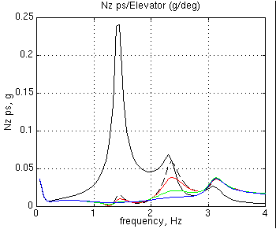
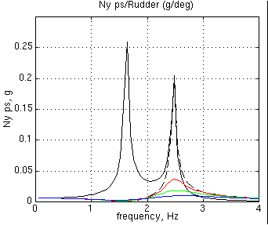
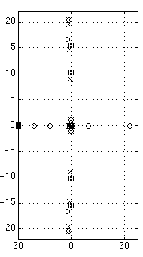
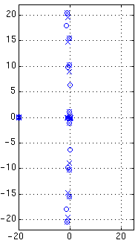
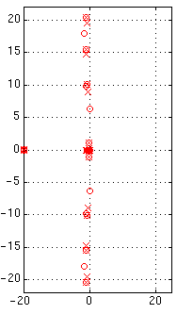
Impact of Modal Cancellation*
Examine effect of Cancellation at each Damping Level
*Cancellation: Eliminate control effector excitation of 1st SY & 1st AN modes
Probably requires distributed effectors: canard and chin fin
Nz ps / Elevator (g/deg)
Nz ps, g
Configuration Modes Canceled Modes Damped
stif1 none none
canc1 SY1, AN1 none
canc2 SY1, AN1 1-4 @ 0.07
canc3 SY1, AN1 1-4 @ 0.15
canc4 SY1, AN1 1-4 @ 0.30
Frequency, Hz
Ny ps / Rudder (g/deg)
stif1
canc1
q ps / elevator transfer function poles & zeros
Ny ps, g
Frequency, Hz
Notes:
Impact of Modal Cancellation
Another portion of the test matrix examined the impact of modal cancellation. Here, the term "Modal Cancellation" refers to the elimination of the control effector excitation of a particular DASE mode or modes. It will allow the control system to pitch, roll, or yaw the aircraft without exciting the specifically targeted modes. It is intended to represent the effect that would be produced by using multiple control effectors (canard and elevator for instance) to pitch the vehicle without exciting the first fuselage bending mode. In the lateral case, it would represent the use of rudder and chin fin in combination to avoid excitation of the first antisymmetric mode. The effect was achieved by eliminating the elements of the B matrix in the dynamic aeroelastic model which represent the control effector excitation inputs to the first symmetric and antisymmetric fuselage bending mode. Mode-cancelling configurations were generated for each of the three damping levels so that the test matrix would include direct comparisons of cancellation on and off for each of these damping conditions.
The figures illustrate the migration of transfer function zeros that result from the elimination of the control effector excitation elements of the B matrix in the dynamic aeroelastic model. Zeros associated with the canceled modes in the pitch-rate-to-elevator transfer function move very near the poles. The modal dynamics remain, however, and are subject to excitation by turbulence or by coupling from other elastic modes. The frequency response plots show that the first symmetric and first antisymmetric modes can no longer be excited by control effectors for the canceled configurations. Only the first symmetric and first antisymmetric modes were canceled in this way, since cancellation of higher fuselage harmonics would probably require more control effectors. It should be emphasized that the approach is inherently approximate since it cannot represent nonlinearities in the actual mode suppression system such as control saturation or rate limiting.

Slide 10
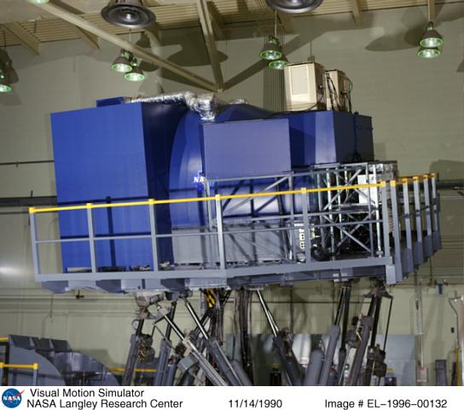
NASA LaRC Visual Motion Simulator (VMS)
Acceleration Capabilities
(Single-Axis )
Surge:
+ 0.6g
Sway:
+ 0.6g
Heave:
+ 0.8g
Roll:
+ 50 deg/s ²
Pitch:
+ 50 deg/s ²
Yaw:
+ 50 deg/s ²

Slide 11
Cooper-Harper Rating Scale
Level 1
Level 2
Level 3
Notes:
Cooper-Harper Rating Scale
The familiar Cooper-Harper rating (CHR) scale shown in this figure was used during pilot evaluations of the LaRC.3 parametric configurations. After completing a sufficient number of runs to rate a particular task, the test pilot's verbal responses to the Task Rating Card were taped using a hand-held microcassette recorder in the cockpit. These verbal responses have been transcribed and will be made available as a separate HSR CDTM. The pilot’s task performance, in terms of touchdown parameters or flight-director tracking accuracy, was indicated on a CRT display in the cockpit immediately following each task. This information provided a basis for assessing whether or not desired or adequate performance tolerances were achieved, which helped the pilot to navigate through the Cooper-Harper decision tree.

Slide 12
Ride Quality Rating Scale
RQR targets degradation of general comfort level due to cockpit vibration
Acceptable - No Improvement Necessary
Marginal - Improvement Desired/Warranted
Unacceptable - Improvement Required/Mandatory
Notes:
DASE Influence Rating Scales
In addition to the standard Cooper-Harper Ratings, the pilots were asked to provide a numerical assessment of the extent to which dynamic elastic effects adversely impact their control inputs and comfort (ride quality). The rating scales for these assessments are shown in the figure. The supplemental rating scales were designed for this experiment and are intended to target the acceptability of a particular aeroelastic configuration independent of deficiencies that the pilot may perceive in the SCAS. For instance, if a pilot awards the nominal landing task a CHR of 4, but provides a DASE Control Influence Rating (CIR) of 1 and a DASE Ride Quality Rating (RQR) of 1, then we might conclude that the deficient CHR is due to pilot dissatisfaction with the SCAS and not with the aeroelastic characteristics of that particular configuration.
The Control Influence Rating Scale bears further discussion. The scale was developed based on pilot comments from the earlier (LaRC.1) preliminary piloted assessment of dynamic aeroelastic effects. Pilots sometimes indicated that they were “reducing the gain” or “backing off” on their control inputs to avoid excitation of the dynamic elastic modes [2]. Several time histories from the LaRC.1 test suggested that the cockpit vibration environment had sometimes corrupted the precision of pilot control inputs, or even caused occasional involuntary stick inputs. For this reason, the Control Influence Rating Scale was developed to specifically address this issue in addition to the pilot comfort or ride quality issue. Pilot feedback regarding the design of these scales was incorporated during the development of the LaRC.3 experiment test plan.

Slide 13
Control Influence Rating Scale
CIR targets voluntary/ involuntary modification of pilot’s control inputs due to cockpit vibration
Acceptable - No Improvement Necessary
Marginal - Improvement Desired/Warranted
Unacceptable - Improvement Required/Mandatory
Notes:
DASE Influence Rating Scales
In addition to the standard Cooper-Harper Ratings, the pilots were asked to provide a numerical assessment of the extent to which dynamic elastic effects adversely impact their control inputs and comfort (ride quality). The rating scales for these assessments are shown in the figure. The supplemental rating scales were designed for this experiment and are intended to target the acceptability of a particular aeroelastic configuration independent of deficiencies that the pilot may perceive in the SCAS. For instance, if a pilot awards the nominal landing task a CHR of 4, but provides a DASE Control Influence Rating (CIR) of 1 and a DASE Ride Quality Rating (RQR) of 1, then we might conclude that the deficient CHR is due to pilot dissatisfaction with the SCAS and not with the aeroelastic characteristics of that particular configuration.
The Control Influence Rating Scale bears further discussion. The scale was developed based on pilot comments from the earlier (LaRC.1) preliminary piloted assessment of dynamic aeroelastic effects. Pilots sometimes indicated that they were “reducing the gain” or “backing off” on their control inputs to avoid excitation of the dynamic elastic modes [2]. Several time histories from the LaRC.1 test suggested that the cockpit vibration environment had sometimes corrupted the precision of pilot control inputs, or even caused occasional involuntary stick inputs. For this reason, the Control Influence Rating Scale was developed to specifically address this issue in addition to the pilot comfort or ride quality issue. Pilot feedback regarding the design of these scales was incorporated during the development of the LaRC.3 experiment test plan.

Slide 14
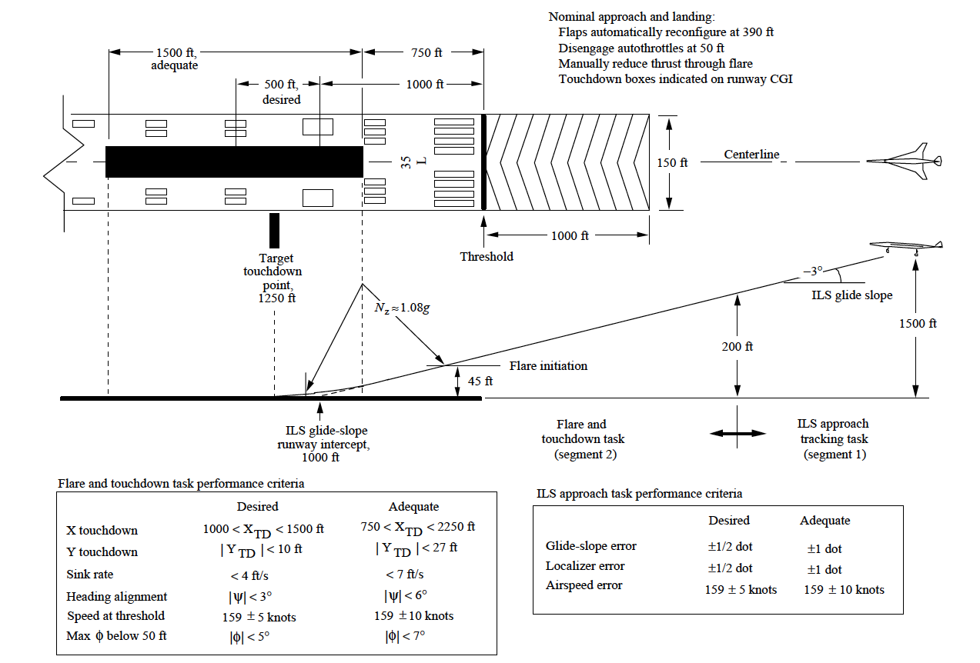
Evaluation Maneuvers
Straight-in (Nominal) Approach and Landing
Offset Approach and Landing
Composite Flight Director Tracking Task
(2) and (3) were fairly aggressive, high-gain tasks
Six evaluation pilots participated representing NASA (2), Calspan (1), FAA (1), Boeing Seattle & Longbeach (2)
Notes:
Evaluation Maneuvers
The tasks that were evaluated during this investigation included an up-and-away flight director tracking task, a nominal approach and landing, and a lateral offset landing task. The offset landing was the most challenging of the three evaluation maneuvers. This task is initiated at an altitude of 750 ft with a 300-ft lateral offset and 580 ft longitudinal offset of the ILS approach glideslope from the nominal approach path. The pilot was directed to fly down the offset ILS glideslope to an altitude of 250 ft. At this point, the test conductor called "Correct," and the pilot executed a lateral jog and duck-under to re-acquire the runway centerline. The pilot then executed a flare and attempted to achieve touchdown within the tolerances required for desired performance. The task required an aggressive lateral maneuver due to the low altitude at which the correction is initiated. The lateral offset landing is the standard evaluation maneuver that is used in Calspan’s TIFS aircraft flight tests.
The intent of the flight director tracking task is to cause the pilot to exercise a wide range of control input frequencies. The flight director was path-oriented rather than attitude-oriented, and was driven with a signal containing segments from various maneuvers that have been examined in previous Ref-H simulations. These maneuver segments include a localizer capture from the nominal approach, glideslope capture, a descending turn, and a rapid pull-up as found in the landing go-around tasks. Flight path and track angle command segments from these tasks were combined with varying order and sign to produce a flight director behavior that was not easily anticipated, but which was still representative of actual flight maneuver tasks.
Each of the 20 configuration data points from the test matrix shown in the earlier figure were evaluated using each of the 3 maneuver tasks described above. All tasks were performed in mild turbulence (with the exception of the turbulence-variation segment of the test matrix, which followed the 20 configuration evaluations.)

Slide 15
Configuration Descriptions Ranked in Order of Pilot Preference Based on Average of DASE Ratings
cancellation& damping
max
baseline
Average of DASE Ratings
min
stiffening
Extremes √
Damped SY vs. Damped AN
Standard Deviation
rigid
Best
Pilot Preference Ranking
Worst
Notes:
Configuration Descriptions Ranked in Order of Pilot Preference Based on Average of DASE Ratings
This figure presents a ranking of the 20 parametric configurations based on the average of the DASE Control Influence Ratings and Ride Quality Ratings that were assigned by all the pilots for all three maneuver tasks performed with a given configuration. (Cooper-Harper Ratings did not seem to discriminate among configurations as clearly as the CIR and RQR ratings which specifically targeted DASE effects, and their impact has not been included in this ranking.) The ranking exhibits a number of trends which seem to make intuitive sense. First, the Ref-H baseline aeroelastic configuration (base0), with no structural stiffening or active mode suppression, was ranked as the worst configuration. Also reassuringly, the rigid (quasi-static effects only) configuration without any dynamic aeroelastic effects (qsae0) was ranked the best. Differentiation among configurations is greatest at the start of the ranking, in the most desirable region, and tapers off to near-ties at the undesirable end of the spectrum. The stiffened cases without active mode suppression were all ranked poorly, suggesting that this approach was not effective at reducing the severity of dynamic elastic effects on the piloting tasks. The configuration with the greatest number of modes (4) damped at the greatest level (0.3) and with modal cancellation (canc4) was rated the best of the aeroelastic configurations, but was still very noticeably different from the rigid aircraft. The next best configuration was identical to this one with the exception of damping level, which was reduced to 0.15 (canc 3). The fourth ranked configuration had 0.3 damping on 4 modes, but had no cancellation (damp8). The order of ranking provides some interesting insights regarding potential trades between mode-cancelling control and additional damping. Another insight is gained when we compare the rankings of the configuration which had only symmetric modes damped (damp9, ranked 18th) with the configuration which had only antisymmetric modes damped (damp10, ranked 9th). It is clear that the pilots found the undamped antisymmetric motions to be more problematic than undamped symmetric motions. Many other interesting comparisons can be drawn from this configuration ranking chart, which represents the most fundamental summary of the LaRC.3 experiment results.

Slide 16
Ride Quality Ratings vs Pilot Preference
DASE INFLUENCE ON RIDE QUALITY
Cockpit vibrations do not impact ride quality
rigid
Acceptable
Perceptible but not objectionable
Mildly objectionable
- improvement desired
min
Marginal
Moderately objectionable
- improvement warranted
Highly objectionable
- improvement required
max
base-line
Task abandoned
- improvement mandatory
Unacceptable
Pilot Preference Ranking
Subjective measure of acceptability based on pilots’ assessment of ride quality
Tasks were performed in mild turbulence (σ = 3 ft/s)
Notes:
DASE Ride Quality Ratings vs Pilot Preference
The ranking in the previous figure provides insight regarding the order of pilot preference for the 20 parametric configurations, but does not indicate the point in the ranking at which dynamic elastic characteristics make the configuration unacceptable. This chart shows the average Ride Quality Rating assigned by the pilots for each configuration plotted against the Pilot Preference Ranking from the previous figure. The subjective description of the ride quality rating assigned by the pilots is shown adjacent to the ride quality axis, along with green, yellow, and red color coding to indicate the transition from acceptable to marginal to unacceptable configuration characteristics. On the basis of the average ride quality ratings, the first four configurations (qsae0, canc4, canc3, damp8) appear to be in or on the border of the acceptable ride quality region. Also shown on the plot are the maximum and minimum ride quality ratings assigned to the configurations. On the basis of the maximum rating, even the most highly mode-suppressed configuration (canc4) provides only marginally acceptable ride quality at the pilot station. It should be noted that these ratings were provided during tasks that were performed with mild turbulence, and that the ride quality acceptability will probably vary with turbulence level.
This plot provides a subjective basis for the judgment of an acceptable level of mode suppression from a pilot’s ride-quality perspective. The analysis which remains to be performed is the objective characterization of the vibration environment which the pilots were experiencing when they assigned these ratings. This analysis will be performed using the motion platform accelerometer data that were produced during the experiment, and may take the form of an RMS vibration amplitude frequency spectrum plot such as the one found in the HSCT Flight Control System Requirements Speci-fication dated 10/31/97 [9].

Slide 17
Control Influence Ratings vs Pilot Preference
INFLUENCE ON PILOT’S CONTROL INPUTS
Control inputs are not modified due to vibration
rigid
Acceptable
Intentional modification of inputs to avoid excitation
min
Marginal
Vibrations impact precision of voluntary inputs
Vibrations cause occasional involuntary inputs
baseline
Vibrations cause frequent involuntary inputs
max
Unacceptable
Sustained involuntary inputs or loss of control
Pilot Preference Ranking
Subjective measure of acceptability based on pilots’ assessment of vibration impact on manual control inputs
Pilots were sometimes unaware of input contamination due to cockpit vibrations -> CIR assessments may be optimistic
Notes:
Control Influence Ratings vs Pilot Preference
This chart provides an analogous ranking to the previous chart in terms of the Control Influence Rating instead of Ride Quality Rating. The subjective description of the Control Influence Rating assigned by the pilots is shown adjacent to the control influence axis, along with green, yellow, and red color coding to indicate the transition from acceptable to marginal to unacceptable configuration characteristics. It was decided that the unacceptable threshold should be placed at the point at which cockpit vibrations impact the precision of voluntary control inputs. On the basis of the average control influence ratings, the first four configurations (qsae0, canc4, canc3, damp8) again lie within the acceptable region. On the basis of the maximum rating, the most highly mode-suppressed configuration (canc4) again lies in the marginal control influence region.
The border between acceptable and marginal control influence on this plot is somewhat arbitrary, since it might be perfectly acceptable for the pilots to intentionally modify their control inputs to avoid excitation of the dynamic elastic modes as long as their ability to precisely control the aircraft is in no way hindered by this practice. However, recorded time histories of pilot stick deflections indicate that pilots were sometimes unaware that cockpit vibrations were in fact impacting their control inputs. The occurrence of “biodynamic feedthru” of cockpit vibrations through the pilot’s arm and back into the control inceptor is involuntary and therefore may indeed be unnoticed by the pilot in minor instances. Use of the Control Influence Rating scale shown in the figure requires the pilot to be aware of the occurrence, and therefore the CIR ratings may sometimes be optimistic. There were, however, a number of profound instances of frequent or sustained biodynamic feedthru of cockpit vibrations back into the control inceptor as indicated by the maximum CIR ratings shown on the figure. Frequent or sustained feedthru of cockpit vibrations through the pilot’s arm and back into the inceptor will be referred to as “Biodynamic Coupling” (BDC) in this report.

Slide 18
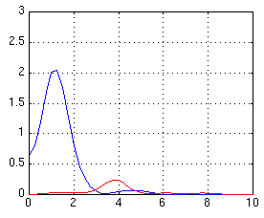
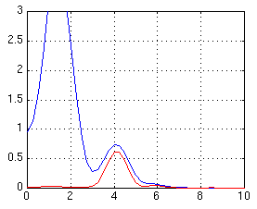
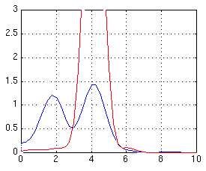
Example of Biodynamic Coupling Incident
Time History: Offset Landing Maneuver Task, stif 1 Configuration
Lateral Stick Deflections (+ 1)
Lateral Cockpit Acceleration Cmd (g)
35 40 45 50 time, sec
Power Spectra
Mode 2 ~1.7 Hz
(1st AN)
Sustained
Feedback of Cockpit
Vibrations
0 2 4
Frequency, Hz
Voluntary Inputs
0 2 4
Frequency, Hz
Input Contamination
0 2 4
Frequency, Hz
Notes:
Example of Biodynamic Coupling Incident
This figure presents a power-spectrum analysis of a lateral offset landing run in which the pilot experienced biodynamic coupling while flying the stif1 configuration with no additional damping or cancellation. The time history at the top of the figure shows lateral cockpit accelerations in g’s (dashed red line) and lateral stick deflections (solid blue). Although the units on the two quantities differ, the scaling of +1 is convenient since it represents the maximum throw for lateral stick deflection and since lateral g’s commanded by the simulation remained in the range of + 1 g. The plot in the lower left of the figure shows the power spectral density of lateral accelerations (red) and lateral stick deflections (blue) applied to a 6-second segment of the time history (from 39 to 45 seconds). The frequency spectrum of the pilot’s voluntary control inputs during this period lies primarily below 1 Hz. The frequency spectrum of the lateral accelerations at the pilot station shows some content at the first antisymmetric mode frequency of 1.6 Hz and the second antisymmetric mode frequency of 2.5 Hz due to minor turbulence excitation of these structural modes.
The power spectrum of a later 6-second segment of the time history (from 44 to 50 seconds) indicates the bulk of the pilot’s input spectrum remains below 1 Hz, but it also shows some frequency content of the pilot’s inputs in the range of the lateral elastic modes. Once the pilot begins to move the stick at the resonant frequency of the first antisymmetric structural mode there is tremendous potential for the lateral mode to be excited by the control inputs, producing larger lateral accelerations at the pilot station. These lateral accelerations can move the pilot’s frame in a fashion which produces involuntary control inputs that further excite the structural mode. The third power spectrum plot is applied to a 6-second segment of the time history from 47 to 53 seconds. Here, the spectrum of the pilot’s stick input exhibits a pronounced resonant peak at the frequency of the first antisymmetric structural mode. It is highly unlikely that the pilot’s inputs in this frequency range are voluntary. A clear change in the character of the pilot’s stick inputs is apparent in the time history, indicating well-developed biodynamic coupling as lateral accelerations feed through the pilot’s frame and back into the control inceptor. The pilot would break the involuntary coupling loop if he released the stick, but he is in the midst of the flare and therefore unable to do so.

Slide 19
Video of Biodynamic Coupling Incidents
Notes:
Example of Biodynamic Coupling Incident
This figure presents a power-spectrum analysis of a lateral offset landing run in which the pilot experienced biodynamic coupling while flying the stif1 configuration with no additional damping or cancellation. The time history at the top of the figure shows lateral cockpit accelerations in g’s (dashed red line) and lateral stick deflections (solid blue). Although the units on the two quantities differ, the scaling of +1 is convenient since it represents the maximum throw for lateral stick deflection and since lateral g’s commanded by the simulation remained in the range of + 1 g. The plot in the lower left of the figure shows the power spectral density of lateral accelerations (red) and lateral stick deflections (blue) applied to a 6-second segment of the time history (from 39 to 45 seconds). The frequency spectrum of the pilot’s voluntary control inputs during this period lies primarily below 1 Hz. The frequency spectrum of the lateral accelerations at the pilot station shows some content at the first antisymmetric mode frequency of 1.6 Hz and the second antisymmetric mode frequency of 2.5 Hz due to minor turbulence excitation of these structural modes.
The power spectrum of a later 6-second segment of the time history (from 44 to 50 seconds) indicates the bulk of the pilot’s input spectrum remains below 1 Hz, but it also shows some frequency content of the pilot’s inputs in the range of the lateral elastic modes. Once the pilot begins to move the stick at the resonant frequency of the first antisymmetric structural mode there is tremendous potential for the lateral mode to be excited by the control inputs, producing larger lateral accelerations at the pilot station. These lateral accelerations can move the pilot’s frame in a fashion which produces involuntary control inputs that further excite the structural mode. The third power spectrum plot is applied to a 6-second segment of the time history from 47 to 53 seconds. Here, the spectrum of the pilot’s stick input exhibits a pronounced resonant peak at the frequency of the first antisymmetric structural mode. It is highly unlikely that the pilot’s inputs in this frequency range are voluntary. A clear change in the character of the pilot’s stick inputs is apparent in the time history, indicating well-developed biodynamic coupling as lateral accelerations feed through the pilot’s frame and back into the control inceptor. The pilot would break the involuntary coupling loop if he released the stick, but he is in the midst of the flare and therefore unable to do so.

Slide 20
Concluding Remarks (1 of 3)
At least 3 of the 6 pilots encountered BDC at some point in the experiment
Triggered by high-gain maneuvering (firm grip on stick is a crucial ingredient)
Always dangerous, sometimes catastrophic (not just an annoyance)
Influenced by inceptor design, control law design, piloting style & physical characteristics
Aileron-Rudder Interconnect (ARI) is implicated in coupling
No BDC events were observed when modal damping was > 0.15
Some provision must be made to ensure that BDC never occurs
Flight-critical mode suppression?
Consider BDC susceptibility in control inceptor design
Notes:
Remarks Regarding Biodynamic Coupling Incidents
To summarize, biodynamic coupling is indicated when cockpit vibrations due to elastic modes feed directly through the pilot's arm and back into the control stick. The phenomenon is evidenced by a resonant peak in the power spectrum of the pilot's stick inputs at the frequency of one of the dynamic elastic modes. The tendency to couple with structural modes appears to increase when pilots tighten their grip on the stick, often in preparation for the flare as the aircraft nears the runway. The phenomenon is influenced by design of the control inceptor and control laws, piloting style and possibly even certain aspects of the pilot’s physical stature. The severity of the coupling which was sometimes observed indicates that some provision must be made to ensure that BDC is never encountered during either normal or reversionary operation of the HSCT flight control system.
One element of the control system that is implicated in the occurence of BDC is the aileron-rudder interconnect (ARI). This is the control path whereby lateral stick displacements produce rudder deflections in proportion to aileron deflections to achieve turn coordination. But it is also the path whereby lateral cockpit vibrations may feed directly through the pilot/ inceptor dynamics and back into rudder deflections, further exciting lateral elastic modes. It is possible that some provision may be included in the design of the ARI to interrupt or prevent Biodynamic Coupling. Susceptibility to BDC should also be taken into consideration during design of the control inceptor, itself.
The potential hazard posed by Biodynamic Coupling would seem to suggest that certain elements of the HSCT active mode suppression control system, or at least some provision in the basic SCAS to prevent BDC, should be designated as flight critical. However, a final judgment regarding this issue should be made on the basis of evaluations performed with a higher fidelity dynamic aeroelastic model of the final aircraft configuration.

Slide 21
Concluding Remarks (2 of 3)
Antisymmetric modes were highly problematic
Symmetric (longitudinal) mode suppression not sufficient
Structural Stiffening and Display Compensation did not appear to solve problem
Damping and Modal Cancellation were both highly beneficial
Design Insights
Use Filtered Air Data - “noisy” surface deflections can degrade ride quality by exciting high frequency modes
Watch Aileron/Rudder Interconnect (implicated in BDC)
Minimal damping suggestions:
0.3 nominal on 1st & 2nd AN and 1st & 2nd SY modes
0.15 reversion (failure) - or other measures sufficient to prevent BDC; Prioritize AN over SY if necessary
Notes:
References
[1] Jackson, E. Bruce; Raney, David L; Hahne, David; Derry, Stephen D., NASA Langley Research Center, and Glaab, Louis J., Lockheed-Martin Engineering Services Company: "(LaRC.1) Pilot Briefing Guide", pending NASA TM, November 1996.
[2] Raney, David L.: "Flying Qualities Issues Associated with Aeroelasticity of a High Speed Civil Transport Simulation Model." NASA HSR CDTM 10016, August 1997.
[3] Ashkenas, I.L.; Magdaleno, R.E.; McRuer, D.T.: "Flight Control and Analysis Methods for Studying Flying and Ride Qualities of Flexible Transport Aircraft". Systems Technology, Inc.; Contract NAS1-1847, NASA Contractor Report 172201, August 1983.
[4] B. Newman, “Proposed Flying Quality Metrics and Simulations Studies for Elastic Vehicles” (AIAA GFC, ‘96).
[5] Waszak, Martin R.; Schmidt, David K.: "Analysis of Flexible Aircraft Longitudinal Dynamics and Handling Qualities, Volumes I and II." NASA Contractor Report 177943, Grant NAG1-254, June 1985.
[6] Adams, Bill; Buttrill, C.; Chowdhry, R.; Christhilf, D.; Greiner, G.; Pototzky, A.; Stockwell, A.: "LaRC.1 Dynamic Aeroservoelastic Math Model", Procedings of 1997 Aerodynamic Performance Workshop, Flight Controls Sessions, February, 1997.
[7] Derry, S. and Scott, M., NASA Langley Research Center; Taylor, G.; Hunt, G.; Martin, D., Unisys Engineering Support Services Co.: "Motion Cueing for Ref-H Dynamic ASE in LaRC.1", Procedings of 1997 Aerodynamic Performance Workshop, Flight Controls Ses-sions, February, 1997.
[8] Parrish, Russell V.; Dieudonne, James E.; Martin, Dennis J.; Copeland, James L.: "Compensation Based on Linearized Analysis for a Six-Degree-of-Freedom Motion Simulator", NASA TN D-7349, 1973.
[9] Smith, John W.; Montgomery, Terry: “Biomechanically Induced and Controller- Coupled Oscillations Experienced on the F-16XL Aircraft During Rolling Maneuvers”, NASA TM 4752, Dryden Flight Research Center, Edwards, CA, 1996.
David L. Raney
NASA Langley Research Center
(757) 864-4033 • d.l.raney@larc.nasa.gov

Slide 22
Concluding Remarks (3 of 3)
Some limitations
Mode shapes are configuration-specific
Pilot evaluations were influenced by HSCT context
Inceptor design
Controller architecture
Display concept
Motion base frequency range < 3Hz
Suggestions for future work
More generic evaluation environment, or broader context
Various inceptor types,
Alternate feedback architectures
More general display format
More capable motion base
Can include higher frequency modes
Notes:
References
[1] Jackson, E. Bruce; Raney, David L; Hahne, David; Derry, Stephen D., NASA Langley Research Center, and Glaab, Louis J., Lockheed-Martin Engineering Services Company: "(LaRC.1) Pilot Briefing Guide", pending NASA TM, November 1996.
[2] Raney, David L.: "Flying Qualities Issues Associated with Aeroelasticity of a High Speed Civil Transport Simulation Model." NASA HSR CDTM 10016, August 1997.
[3] Ashkenas, I.L.; Magdaleno, R.E.; McRuer, D.T.: "Flight Control and Analysis Methods for Studying Flying and Ride Qualities of Flexible Transport Aircraft". Systems Technology, Inc.; Contract NAS1-1847, NASA Contractor Report 172201, August 1983.
[4] B. Newman, “Proposed Flying Quality Metrics and Simulations Studies for Elastic Vehicles” (AIAA GFC, ‘96).
[5] Waszak, Martin R.; Schmidt, David K.: "Analysis of Flexible Aircraft Longitudinal Dynamics and Handling Qualities, Volumes I and II." NASA Contractor Report 177943, Grant NAG1-254, June 1985.
[6] Adams, Bill; Buttrill, C.; Chowdhry, R.; Christhilf, D.; Greiner, G.; Pototzky, A.; Stockwell, A.: "LaRC.1 Dynamic Aeroservoelastic Math Model", Procedings of 1997 Aerodynamic Performance Workshop, Flight Controls Sessions, February, 1997.
[7] Derry, S. and Scott, M., NASA Langley Research Center; Taylor, G.; Hunt, G.; Martin, D., Unisys Engineering Support Services Co.: "Motion Cueing for Ref-H Dynamic ASE in LaRC.1", Procedings of 1997 Aerodynamic Performance Workshop, Flight Controls Ses-sions, February, 1997.
[8] Parrish, Russell V.; Dieudonne, James E.; Martin, Dennis J.; Copeland, James L.: "Compensation Based on Linearized Analysis for a Six-Degree-of-Freedom Motion Simulator", NASA TN D-7349, 1973.
[9] Smith, John W.; Montgomery, Terry: “Biomechanically Induced and Controller- Coupled Oscillations Experienced on the F-16XL Aircraft During Rolling Maneuvers”, NASA TM 4752, Dryden Flight Research Center, Edwards, CA, 1996.
David L. Raney
NASA Langley Research Center
(757) 864-4033 • d.l.raney@larc.nasa.gov

Slide 23
www.nasa.gov

Slide 24
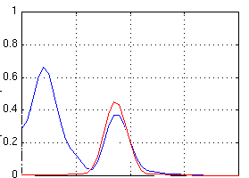
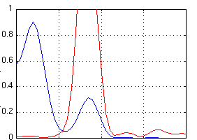
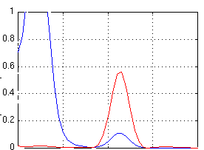
Biodynamic Coupling Incidents for 3 Pilots
Stick
Accels
Power Spectra
Time History Segments
Pilot B,
damp 9
CIR: 4
RQR: 6
CHR: 8
Pilot E,
damp 9
CIR: 4
RQR: 5
CHR: 7
Pilot C,
stif 3
CIR: 5
RQR: 5
CHR: 8
0 1 2 3 4
40 46 52
frequency, Hz
time, sec
Notes:
Biodynamic Coupling Incidents for 3 Pilots
A number of incidents of biodynamic coupling were encountered when test pilots flew the HSCT with no active suppression of the lateral structural modes. At least three of the six test pilots encountered biodynamic coupling during some portion of the experiment. Examples of BDC incidents for pilots B, E, and C are shown in the figure. Power spectra of the pilots’ stick inputs for each of these cases indicate a resonant peak at the frequency of the first antisymmetric elastic mode.
Encounters with BDC were always dangerous and sometimes catastrophic. Note that Pilot C experienced coupling with the stif3 configuration, which has its first antisymmetric mode at a higher frequency than the stif1 baseline (2.2 Hz instead of 1.6 Hz.) The time histories shown for pilots B and E are for the damp 9 configuration, which actually applies 0.3 damping to the symmetric modes but leaves the antisymmetric modes undamped. The presence of significant damping for symmetric modes did little to prevent the coupling since the lateral axis is far more prone to BDC for a number of reasons. First, the pilot’s seat tends to support the body longitudinally and vertically, but not laterally, so side-to-side accelerations are more difficult to resist. Furthermore, symmetric modes produce vertical accelerations while the stick input is fore and aft, so there is less tendency for the pilot’s body motions to feed directly into the stick. However, antisymmetric modes produce lateral accelerations which feed directly into lateral stick deflections. A sidestick control inceptor was used in this experiment. The susceptibility of various inceptor types to biodynamic feedthru is a potential topic for future investigations.

Slide 25
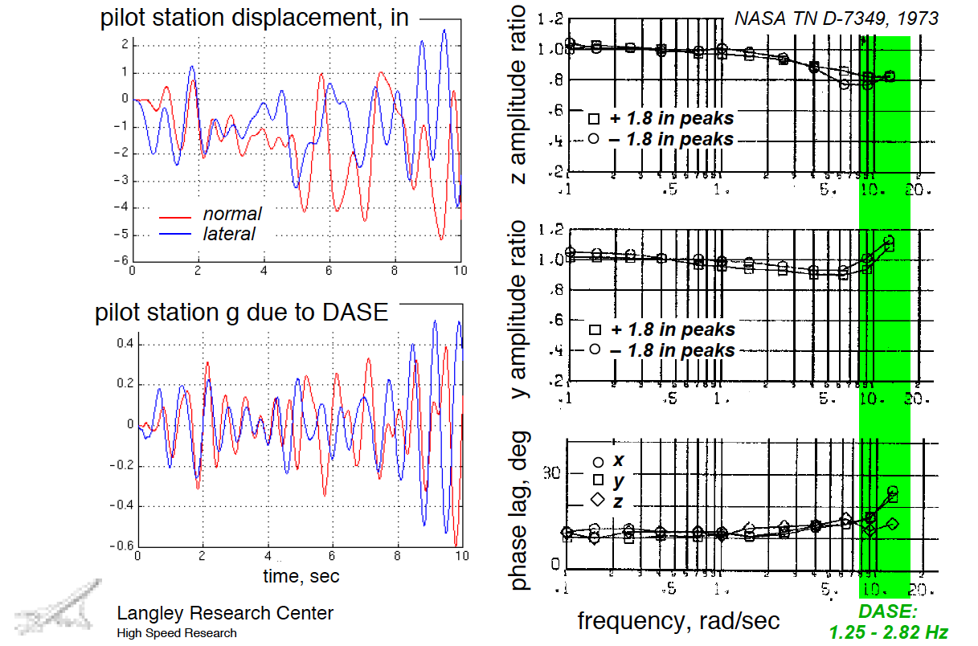
DASE Responses vs LaRC VMS Specs
Notes:
DASE Responses vs LaRC VMS Specs
This figure shows displacements of the pilot station from the mean axis that occurred during the 10-second excerpt from a lateral offset landing task that was performed during the earlier LaRC.1 simulation test. These plots show both vertical and lateral displacements at the pilot station due to dynamic elastic modes and the resulting accelerations. Displacements on the order of + 2 inches at the frequencies included in the aeroelastic model are sufficient to produce the 0.2-g ringing that was observed at the pilot station.
The figures to the right were taken from a 1973 report which documented the frequency response capabilities of the Langley VMS Motion facility [8]. The input/output amplitude ratios for vertical and lateral sinusoidal inputs of 1.8 inches are shown, along with the resulting phase lag, for input frequencies from 0.1 to 12 rad/sec. Also shown on these plots is the frequency range of the dynamic elastic modes that were included in the LaRC.1 assessment. It is clear that the dynamic elastic portions of the model are causing the Langley motion platform to operate at the threshold of its capabilities. But at the lowest frequency bending modes (1.25 and 1.39 Hz), the motion base appears to possess reasonable performance (0.8 amplitude ratio vertically and 1.0 amplitude ratio laterally, with about 15 deg of phase loss.) The next two dynamic elastic modes (at 2.0 and 2.1 Hz) appear to be marginally within the motion platform’s capabilities with about 25 deg of phase loss. The facility appears to provide a reasonable representation of the lowest frequency modes included in the dynamic aeroelastic model.

Slide 26
Data Collected
Videotape of cockpit and pilot’s hand on control stick
Time history data of all relevant flight dynamic simulation parameters
Transcribed micro-cassette recordings of pilot comments immediately following flights
Quantitative Evaluation Measures
Touchdown dispersions and sink rates
Flight director tracking tolerances
Spectral analysis of pilot stick inputs
Subjective Evaluation Measures
Cooper-Harper Flying Qualities Ratings (CHR)
“Ride Quality Rating” (RQR) - identifies DASE influence on comfort & ride quality
“Control Influence Rating” (CIR) - identifies voluntary/ involuntary (biodynamic) modification of pilot’s control inputs
Pilot option for task abandonment (pilot discomfort, imminent loss of control)

