Slide 1
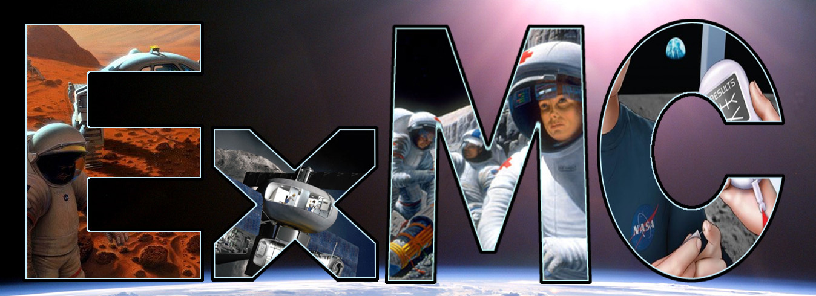
Exploration Medical Capability Introduction and Project Goals
Technology Exchange Meeting
January 14, 2016
Tony Lindsey MS, PhD
Element Data Scientist
Biomedical informatics
Stanford School of Medicine

Slide 2
Objectives
Overview of Exploration Medical Capabilities Element
ExMC Mission and Responsibilities
ExMC Medical System for Space Exploration
Risk Reduction and Medical Capability
Summary

Slide 3
Introduction
Space Medicine Operations
SD
Human Research Program
(HRP)
Exploration Medical Capability (ExMC) Element

Slide 4
ExMC Element Organization
Data Architecture
Medical Decision Support
Exploration Medical Capability (ExMC) Element
Manager – Mike Canga
Deputy Manager – Bara Reyna, D Eng
Scientist – Erik Antonsen, MD, PhD
Deputy Scientist – Ronak Shah, DO, MBA
Element Integrators – Jennifer Goss
Element Integrator – Michelle Urbina
Ames Research Center (ARC)
Center Lead
Tianna Shaw
Biosensors
Lab Analysis
Technology Watch
Integrated Medical Model
Physician CMO
Glenn Research Center (GRC)
Center Lead
Sam Hussey
Consumables Tracking
Flexible Ultrasound
Oxygen Concentrator
Sterile Fluid Generation
Suction & Fluid Containment
Johnson Space Center (JSC)
Center Lead
Kerry McGuire
Technology Watch
National Space Biomedical Research Institute (NSBRI)
Dorit Donoviel, PhD
Ginger Wotring, PhD
Concept of Operations
Pharmacy Provision
Personalized Medicine
Integrated Medical Model
MONSTR
Langley Research Center (LaRC)
Center Lead
Matt Simon
Technology Watch
WBS Legend
Vehicle Integration
Medical Habitable Volume
Portfolio Management
Knowledge Development
Technology Development
Technology Watch
Technology Watch

Slide 5
Our Mission
The medical system supports healthy crew to enable completion of mission objectives. We are concerned with adverse health prevention not just catastrophic events.
To minimize mission medical risk through medical system development and integration into the overall mission and vehicle design.

Slide 6
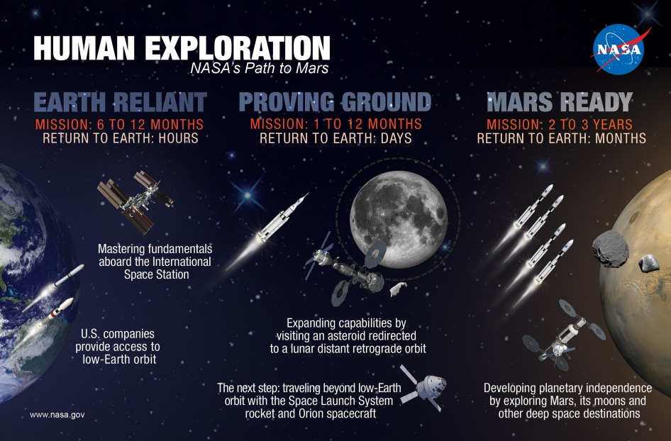

Slide 7
ExMC Responsibilities
Risk Title: Risk of Adverse Health Outcomes & Decrements in Performance due to Inflight Medical Conditions
Description: Given that medical conditions will occur during human spaceflight missions, there is a possibility of adverse health outcomes and decrements in performance during these missions and for long term health.
Other ExMC Risks:
Risk of bone fracture due to spaceflight induced changes in bone.
Risk of ineffective or toxic medications due to long term storage.
Risk of renal stone formation.

Slide 8
Spaceflight Medical Events Risk
Top 100 In Mission Medical Events and 30 Specific Human Risks
~30 Specific
Human Risks
~100 Medical Events
in IMM
Abdominal Injury
Abdominal Wall Hernia
Abnormal Uterine Bleeding
Appendicitis
Acute Diverticulitis
Anaphylaxis
Eye Abrasions
Dental
Diverticulitis
Gall Bladder
Hernia
Indigestion
Med Overdose/Reaction
Pancreatitis
Sepsis
……
…..
Aerobic Capacity
Dynamic Loads (overlap)
Electric Shock
HSDI
Immune (some overlap)
Micro (some overlap)
Muscle
Nutrition/Food
Neuro-vestibular
Long Term Osteoporosis
Medication Storage
Orthostatic Intolerance
Radiation (long term)
Sunlight Exposure
Team Cooperation
Acute Radiation
Altitude Sickness
Cardio
Angina/ Myocardial Infarction
Atrial Fibrillation/ Flutter
Stroke
Sudden Cardiac Arrest
Back Pain
Behavioral/Depression
Bone Fracture
Carbon Dioxide (headache)
Celestial Dust Exposure
Decompression Sickness
EVA Injuries
Hearing Loss
Renal Stones
Sleep
Specific Toxic Exposure
Urinary Retention
VIIP

Slide 9
Goal – Develop a System
A comprehensive medical system to support the crew in Exploration Missions targeting autonomy.
In order to do this, ExMC will need integration with vehicle systems – single point solutions are not desirable for Exploration Missions.
Networked Exploration Medical Information Support and Integration System
Provide for centralized medical care
Enhance available knowledge base
Provide for electronic training needs
Monitor supplies for crew
Monitor crew as needed
Streamline communication with ground flight surgeons
Decrease likelihood of medical errors

Slide 10
Medical System Capture Diagram
Sensors
Medical Equipment
Performance
Biomonitors
Environmental
EVA
Exercise
Behavioral
Imaging
3-D Printing
Devices
Behavioral Monitor
Exercise Monitor
Medications
Rehab
Tracking
Data Streaming
Caregiver Interface
Training
Consumables
Food
Medications
Fluids
Medical Eq.
EMS
Medical Procedures
Imaging Techniques
Behavioral Intervention
Displays / Conferencing
EMR
AMP
Intelligence Augmentation
Vehicle Data Interface
References
Pharmacologic
Toxicologic
Medical Imaging
Training Modules
Up-To-Date TM
Models
IMM
MONSTeR
Digital Astronaut
Radiation
Medical Decision Support
Telemedicine
Semi-autonomy
Autonomy

Slide 11
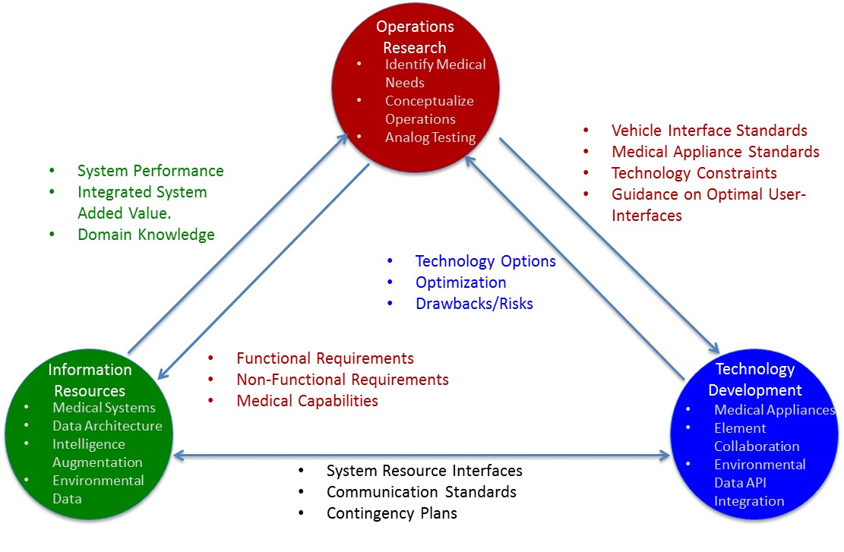
How to decompose the work
Incremental and Iterative Approach
Pedigree:
DoDAF
Relationships between research divisions in the Exploration Medical Capability Element.

Slide 12
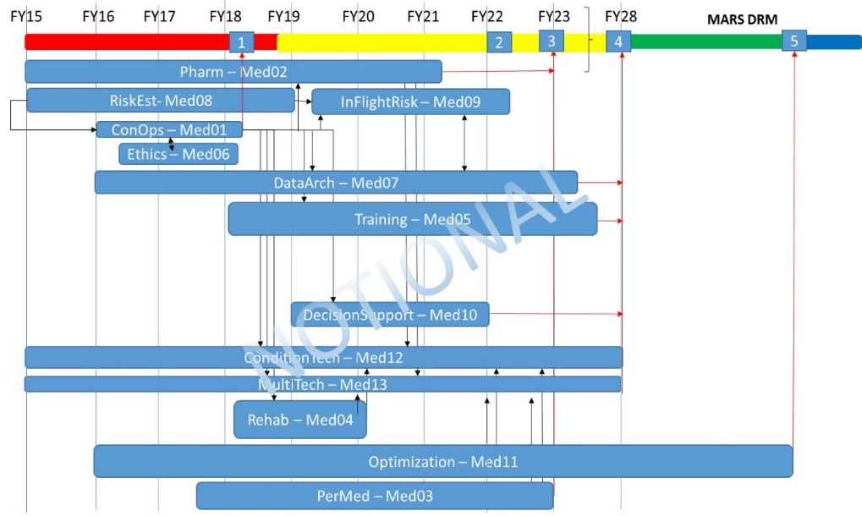
Gap Restructuring Enables System Creation
Safe and Effective Pharmacy
Oxygen Delivery
Medical Suction
Ultrasound Imaging
Laboratory Analysis
Biosensors/EKG
concept of operations
pharmacy recommendation
select technologies
Risk
integrated medical system
optimized medical system
1
2
3
4
5
Capability

Slide 13
Summary
These gaps lead to a conceptual progression for medical system development to replace single point solutions for exploration mission medical needs.
Analog version testing of this system with operational flight surgeons ensures medical operations relevance.
Specific deliverables from this structure buy down the primary medical risk in a step-wise fashion through creating medical capability.
This necessitates integration with vehicle design concepts early in the design cycle.

