Slide 1
GeneLab and The LSDA

Slide 2
Premises
Researchers should be able to go to one web site to find information and links for all NASA Space Life Sciences science results and supporting data.
Entry of the same information into more than one metadata repository/system could result in
Duplicative effort for data entry and updates
Inconsistent data
Increased program costs

Slide 3
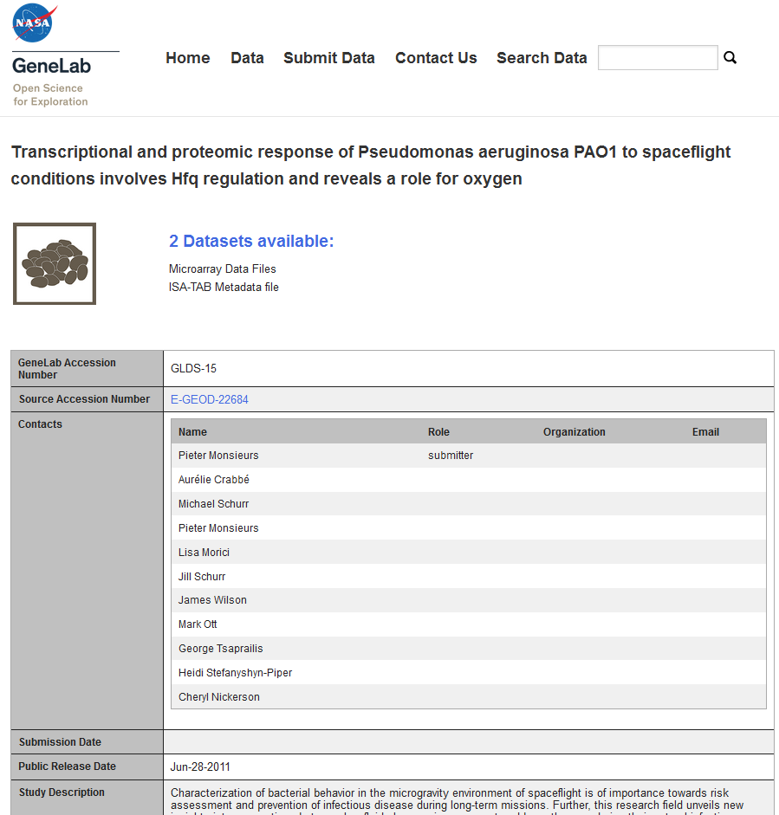
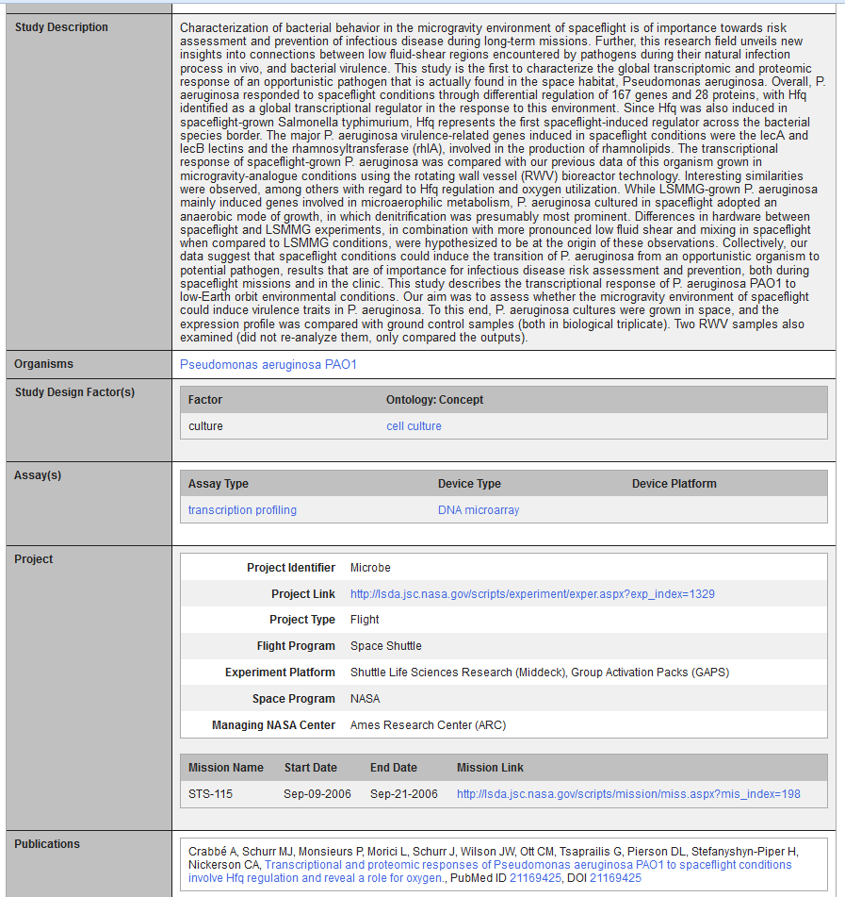
GeneLab Data Systems (GLDS) v1.0 http://genelab.nasa.gov/data
Is an Omics Experiment Data Repository
Supports study metadata display
Supports basic experiment/study metadata search
http://genelab.nasa.gov
Notes:
Leave audience with the message that we plan to have data analysis in the future (not stop at retrieval)

Slide 4
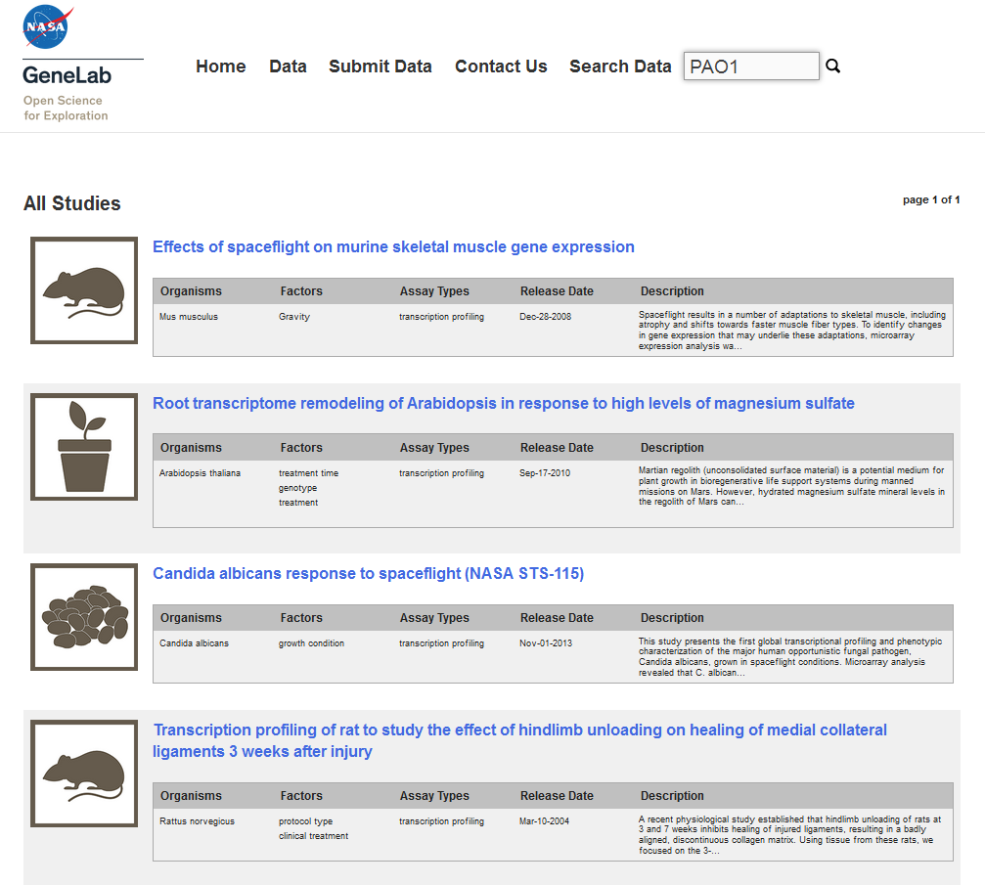
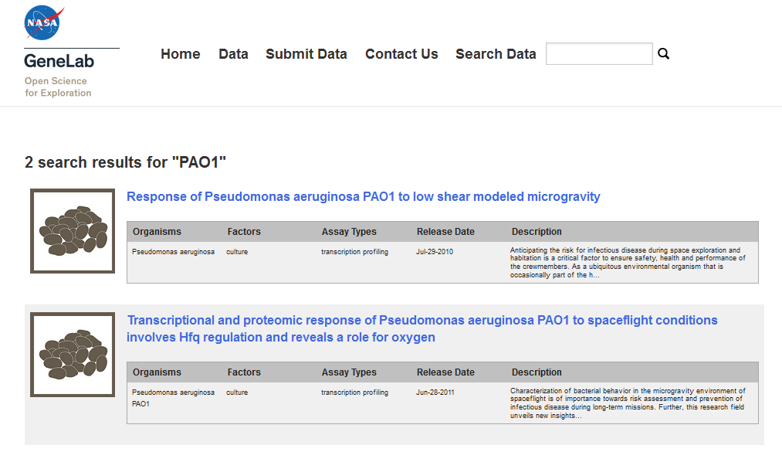
GeneLab Data Systems (GLDS) v1.0 http://genelab.nasa.gov/data
Is an Omics Experiment Data Repository
Supports study metadata display
Supports basic experiment/study metadata search
http://genelab.nasa.gov
Notes:
Leave audience with the message that we plan to have data analysis in the future (not stop at retrieval)

Slide 5
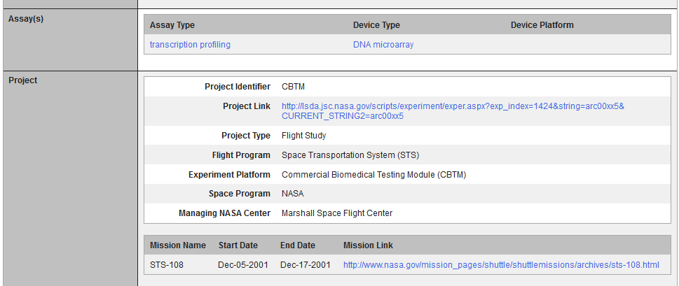
Space Biology Experiment Metadata in GLDS 1.0
Flight Project Title (From LSDA)
Flight vs. Ground
Space Biology Experiment Platform Name
Currently these metadata are manually generated/ synchronized with LSDA and Taskbook information

Slide 6
Approach 1 - GeneLab + ALSDA Data Flow
JSC Astronaut Medical Data
JSC Human Research Experiments
LSDA Public Web Site
(lsda.jsc.nasa.gov)
GeneLab Public Website
(http://genelab.nasa.gov/)
Genome Data Sets
Exp links
International ISS Experiments
Non-NASA Gene Exp Desc
All Verified & Released Experiment Descriptions & Data
Via the DevTool
Genelab Experiment Descriptions
KSC Plant Data
ALSDA
Relational Database Management System
GeneLab
Non-NASA Space Bio
Exp Desc & Data
(CASIS, DOD)
BioBanking
(Cryotrack)
Selecting for Ames Life Sciences
Selecting for Space Life Genomics
Task Book
PI & Project Science Data
Grants
ISS Website

Slide 7
Approach 2 - GeneLab + LSDA DevTool
LSDA Public Web Site
(lsda.jsc.nasa.gov)
KSC Plant Data
GeneLab Public Website
(http://genelab.nasa.gov/)
Data for Public
DevTool
ExprmtDescr
JSC
JSC Astronaut Medical Data
JSC Human Research Experiments
All Verified & Released Experiment Descriptions & data
GeneLab
International ISS Experiments
ALSDA
Genome Data Sets
Relational Database Management System
Non-NASA Exp Desc
http://alsda.arc.nasa.gov/home.php
BioBanking
(Cryotrack)
Selecting for Ames Life Sciences
Selecting for Space Life Genomics
Task Book
PI & Project Science Data
Grants
ISS Website

Slide 8
Approach - GeneLab + ALSDA + LSDA DevTool
LSDA Public Web Site
(lsda.jsc.nasa.gov)
KSC Plant Gene Data
KSC Plant Data
Data for Public
DevTool
Human ExprmtDescr
JSC
JSC Astronaut Medical Data
GeneLab Public Website
(http://genelab.nasa.gov/)
JSC Human Research Experiments
All Verified & Released Experiment Descriptions & data
GeneLab
International ISS Experiments
ALSDA
Genome Data Sets
Relational Database Management System
Non-NASA Exp Desc
Space Bio
ExprmtDescr
http://alsda.arc.nasa.gov/home.php
BioBanking
(Cryotrack)
Non-NASA Space Bio
Exp Desc & Data
(CASIS, DOD)
Selecting for Space Life Genomics
Selecting for Ames Life Sciences
Task Book
Ames PI & Project Science Data
Grants
ISS Website

