Slide 1
GeneLab: “Omics” Data System for Space Biology Research
Sylvain Costes, Ph.D.
Project Manager
Marla Smithwick
Deputy Project Manager
The GeneLab Team

Slide 2
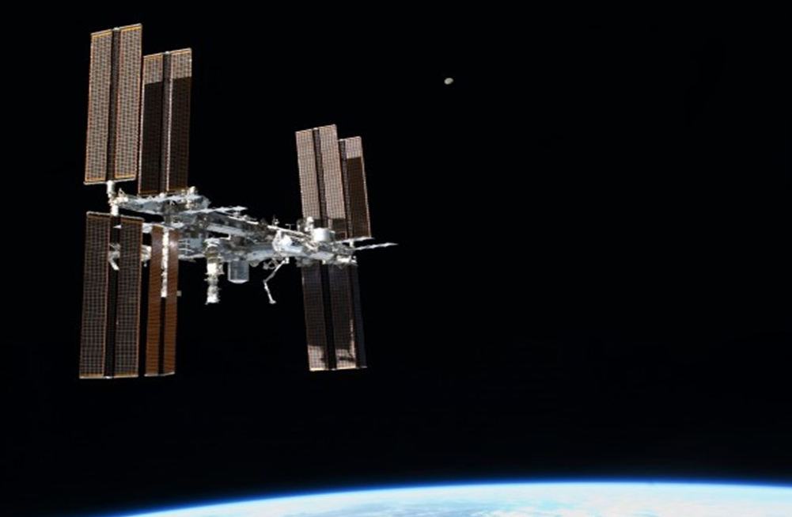
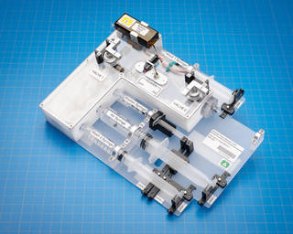
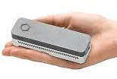
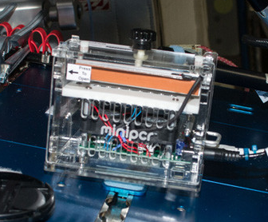
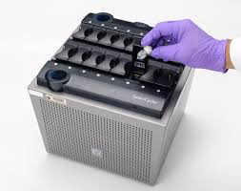
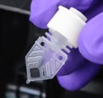
Omics Acquisition in Space is Now a Reality
This is truly an exciting time for cellular and molecular biology, omics and biomedicine research on ISS with these amazing additions to the suite of ISS Laboratory capabilities.
Sample Preparation Module
Oxford Nanopore MinION Gene Sequencer
Reaction tube containing lyophilized chemical assay bead
(proprietary)
Cepheid Smart Cycler qRT-PCR
Mini-PCR

Slide 3
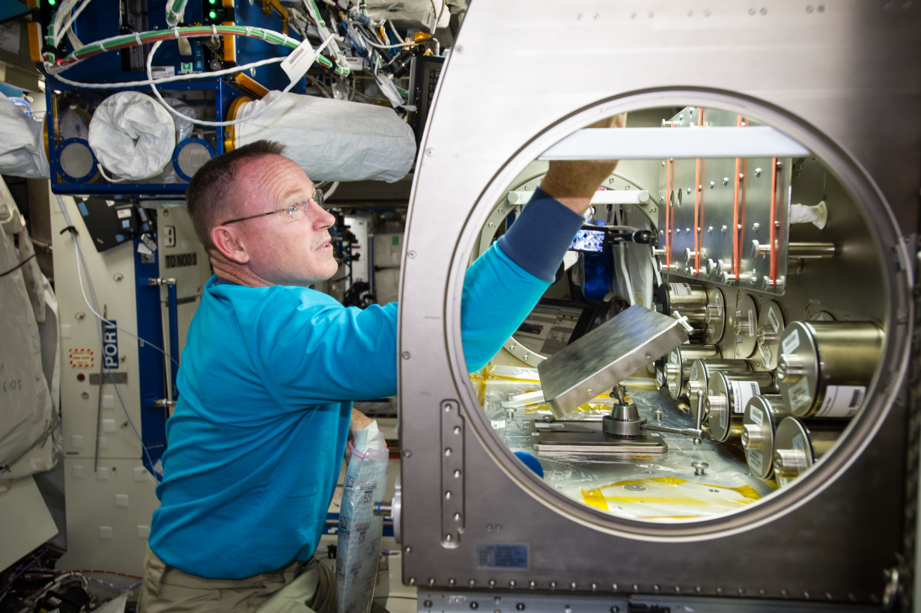
ISS Based Research
New technologies to produce high-quality Omics data from research missions aboard the ISS
Limited access and high demand for the ISS platform
Facilitate systems biology to predict and/or mitigate changes due to microgravity
NASA astronaut Barry "Butch" Wilmore setting up the Rodent Reseach-1 hardware in the Microgravity Science Glovebox aboard the International Space Station.

Slide 4

Three-tier Client Strategy to Democratize Data
Physiological Changes
Pathway Enrichment
Differential Expression
Normalization
GeneLab
Data Democratization
Higher Order Data
Visualization
Filters
view
Ground vs Flight
Species
Strains
Genes/Pathways
Processing
pipelines
Tier 3
Citizen Scientists
GL4HS
Processing
view
Metadata
Reproducibility
Input multi-Omics
Input Reference Dataset
Tier 2
Scientific Community
GL Team
Disease Signatures
(e.g. Cancer)
Disease Related Pathways
Tier 1
Bioinformaticians
Ref Genome
Ref Experiment
New Experiments
New Hypothesis

Slide 5







From GLDS 2.0 to GLDS 4.0
GLDS 2.0 – Oct 1st 2017
ANIMAL MICROBES PLANT CROSS-SPECIES HUMAN?
GLDS 3.0 – Oct 1st 2018
GLDS 4.0 – Oct 1st 2019
VISUALIZATION PORTALS CONSORTIUM
Galaxy
+
GL Pipelines
Private
GL
Higher Order (DGE)
Lower Order (Alignment)
High throughput
Platform
(AWG pipelines)
Private
GL
USER
Private
GL
Raw
WORKSPACE
GENELAB
GL

Slide 6
GeneLab Phased Implementation
Oct , 2018
GLDS 3.0 + ASGSR
Oct 1, 2019
GLDS 4.0 Release
Nov 2018 March
2019 Visualization Portal
April 2019 Onward
GeneLab Academy and Intern Network
April 23rd, 2018 AWG workshop
Oct 1, 2017
GLDS 2.0 Release
June 2018 Summer interns
Phase 1
Searchable Data
FY2014 –2015
Phase 2
Data Exchange
FY2016-2017
Phase 3
Tool Integration
FY2018– 2019
Phase 4
Maintenance
FY2020 – 2021
Data System
Public Website
Searchable Data Repository
Top Level Requirements
New Data and Legacy Data
Data System
Link to Public Databases via Data Federation
Integrated Search (e.g., data mashup)
Data System
Integrated Platform across model organisms
Build Community via AWG
Provide access to biocomputational tools for omics analysis
Provide collaboration framework and tools
Open Source Maintenance
User community becomes primary provider of new tools/knowledge
Maintain integrity of data, and data system

Slide 7
Engaging the Scientific Community
  GeneLab Analysis Working Groups (AWG) will be tasked with analyzing all data across the GLDS with relevance to a specific domain to generate higher-order data.
  Goals:
  Peer-reviewed publications describing AWG’s comprehensive analysis.
  Consensus data analysis pipelines relevant to AWG domains to be used on the GLDS will help domains harmonize their analyses.
    Summer interns will process all data based on AWG recommendation
    Processed “higher-order” data relevant to domains will be posted on the GLDS.
    Strategies needed to link metadata to processed data will be put in place for the visualization portal deployment
  Feedback for the GLDS to be used for improving its utility; test driving passed along to scientific community via the AWG
    Access to galaxy toolshed and Jupyterlab GenePattern notebook within GeneLab provided with CPU and RAM AWS resources
    Integration of GenomeSpace workspace with processing tools
    GLDS 2.0 search query needs to be improved – What should we do different?
  AWGs emphasis:
  Animal Group
    Mammals
    Non-mammals
  Plants
  Microbes
  Multi-omics/Systems Biology

Slide 8
Guiding principles to look at GeneLab data
Increasing Genetic Diversity (more samples/payload)
Identify Shared Processes/ Molecular Signatures
Hypoxic Response ?
Oxidative Stress
Common Tissue (e.g. muscle, liver, heart, eyes, brain,…)
Human (future GL database?)
PLANT AWG
Increasing Human Relevance
ANIMAL AWG
MULTI-OMICS AWG
MICROBE AWG

Slide 9
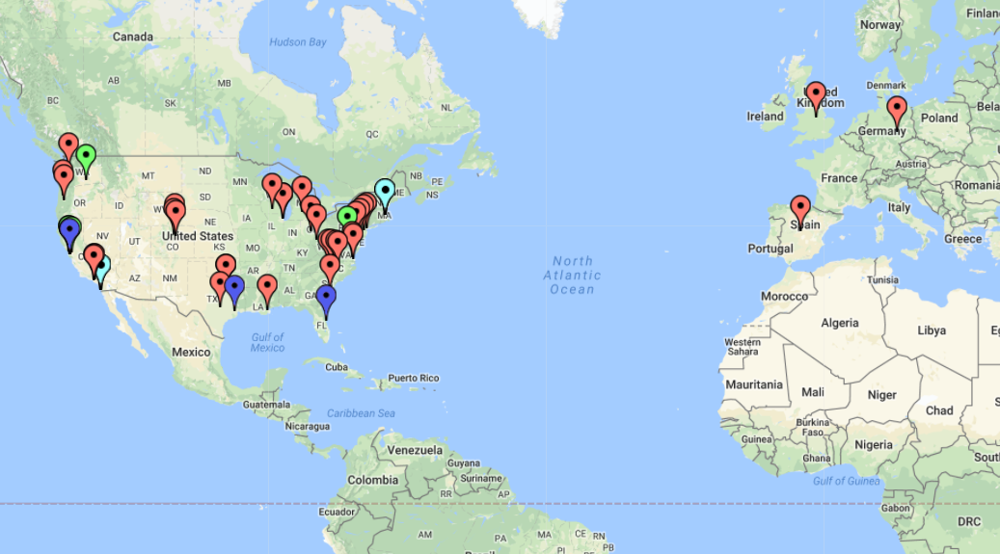
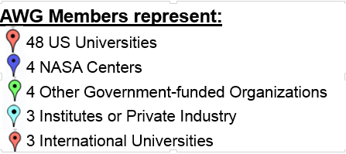
AWG Members
Total AWG Members:
114
AWG Members Per Group:
Animal 47
Multi-Omics/ 33
System Biology
Plants 24
Microbes 21
*Some members are in multiple groups
Map created with https://www.zeemaps.com/

Slide 10
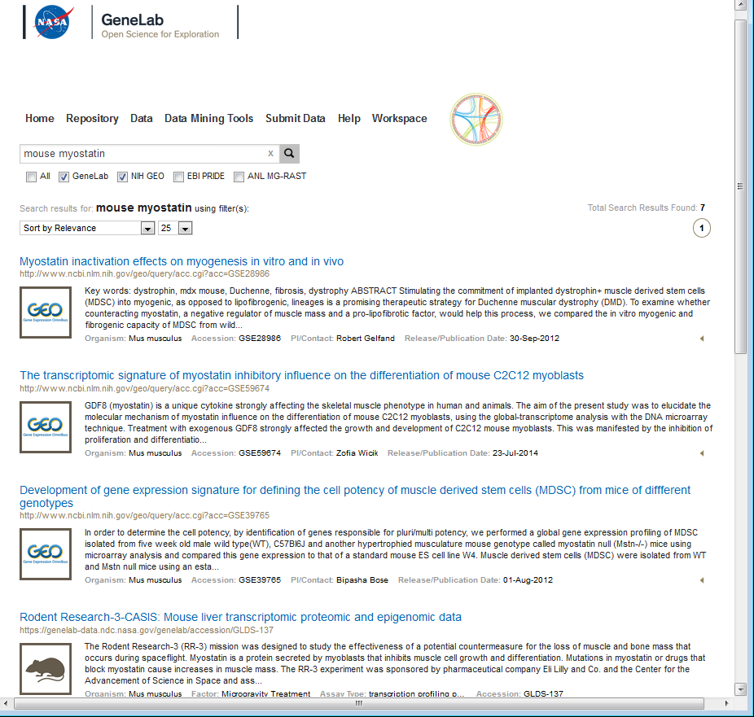
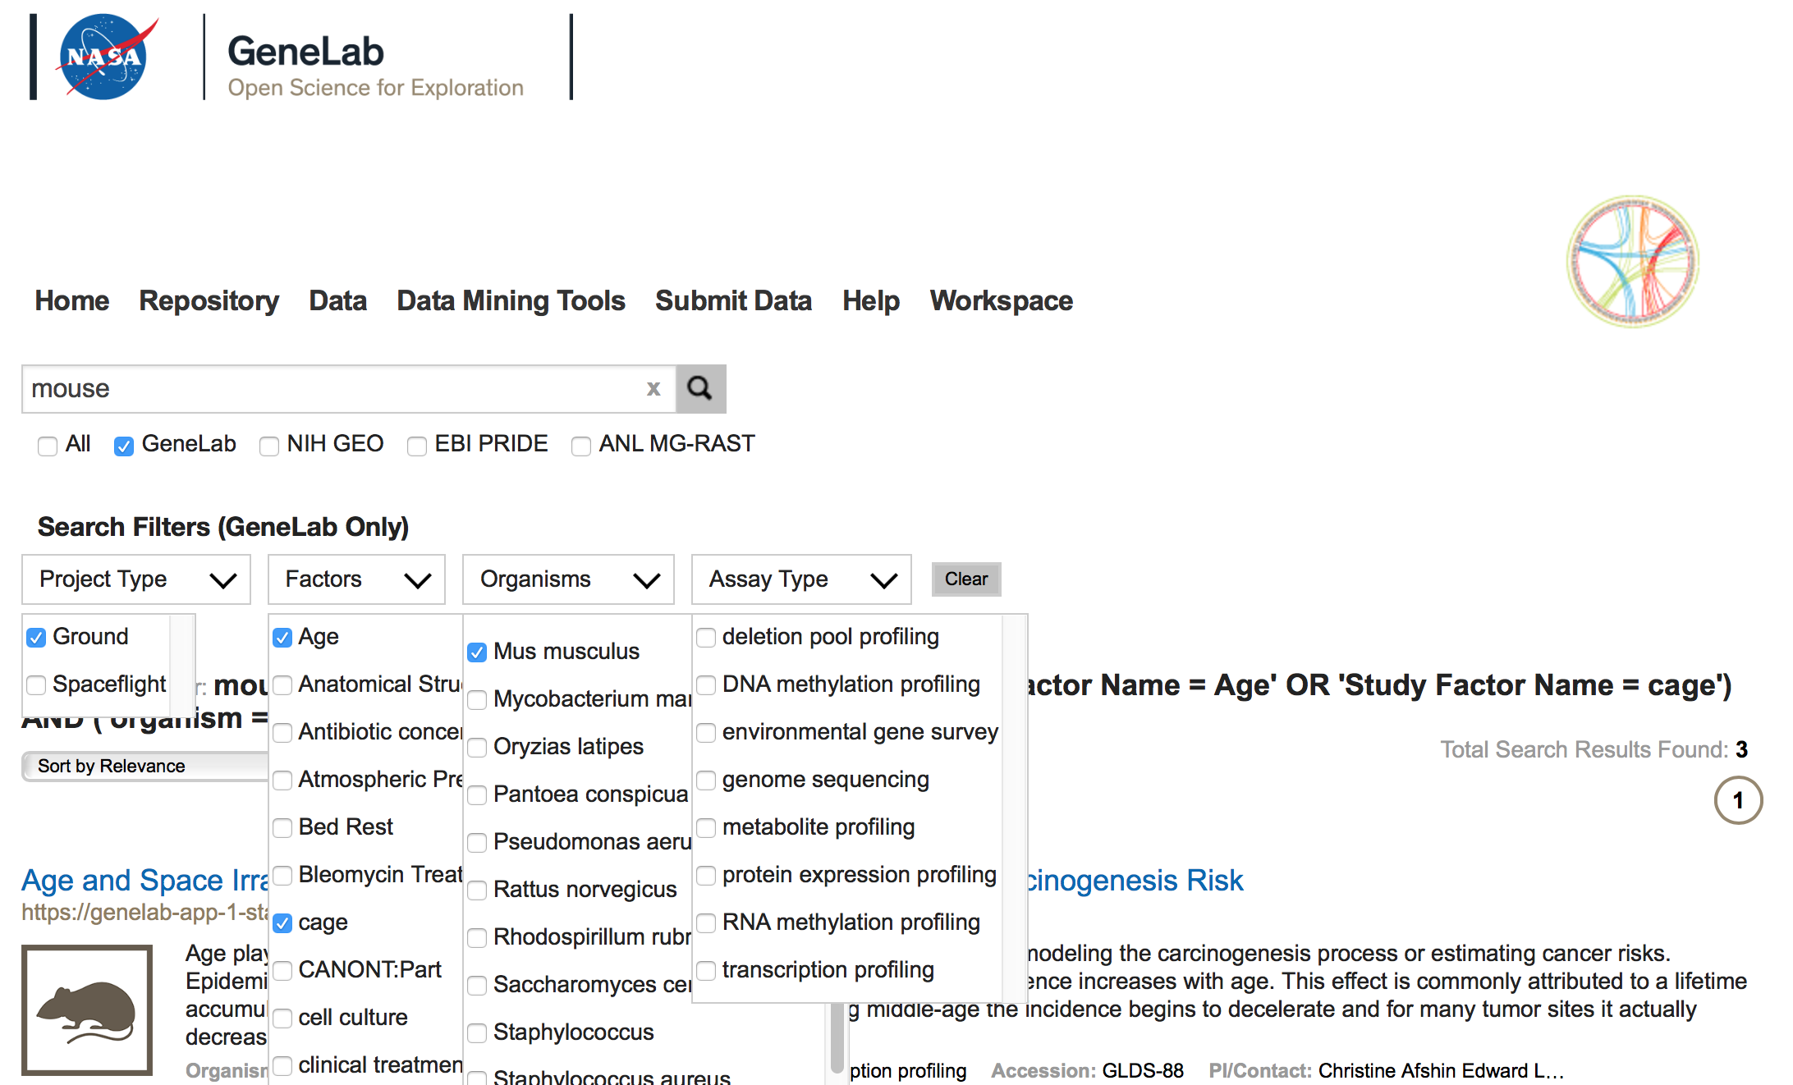
GLDS Phase 2 (Release 2.0)
Google-like Search, Federated Search
Data federation/integration with heterogeneous bioinformatics external databases (GEO, PRIDE, MG-RAST)
Federated Search
Search Filters for GeneLab

Slide 11
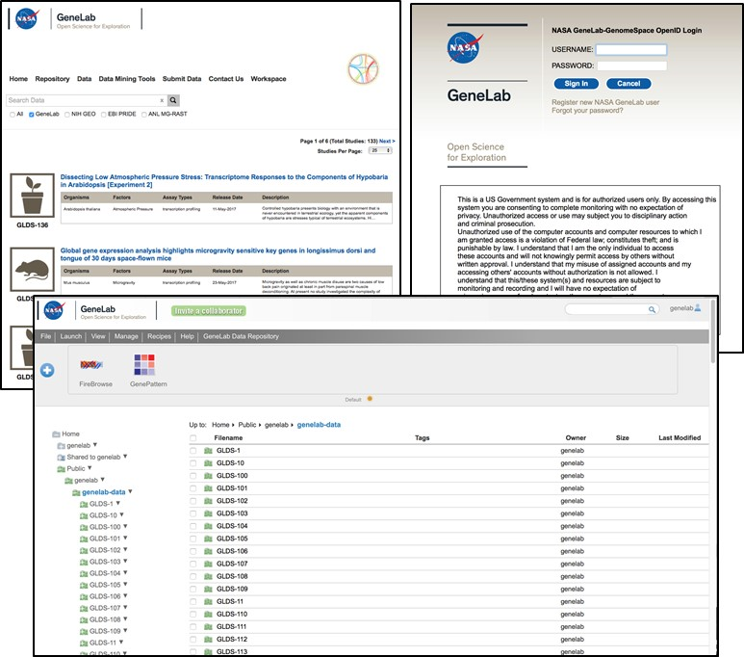
GLDS Phase 2 (Release 2.0)
Customized NASA Collaborative Workspace
User Account Mgmt., Access Controls (e.g., Private, Shared, Public Folders)

Slide 12
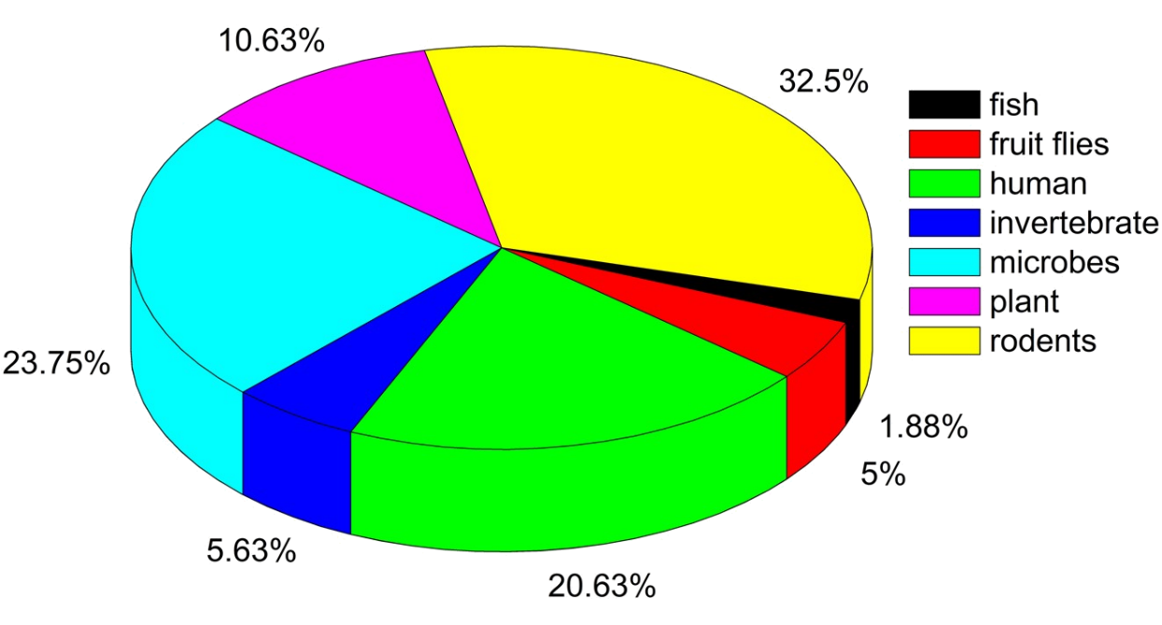
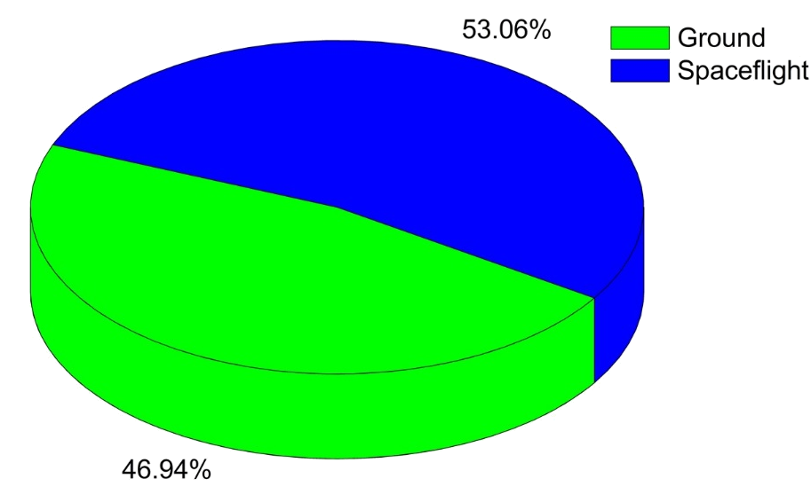
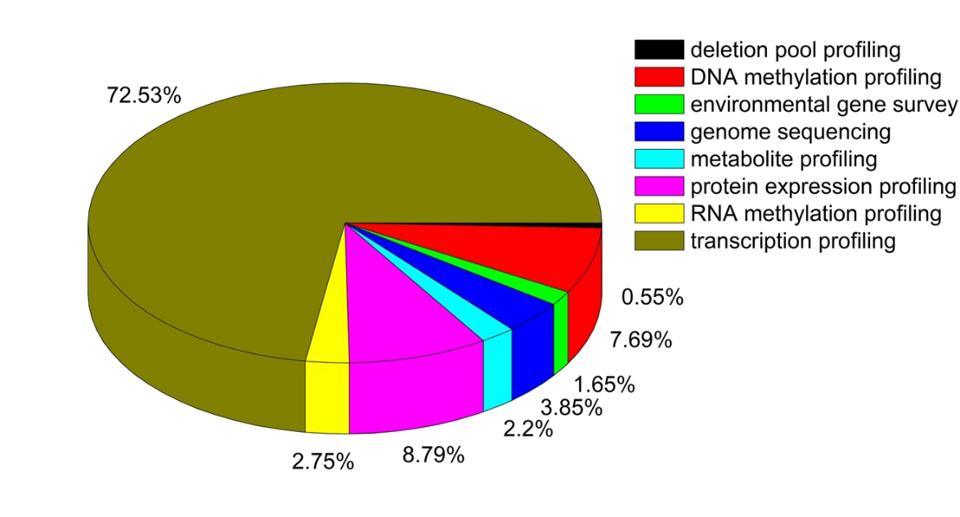
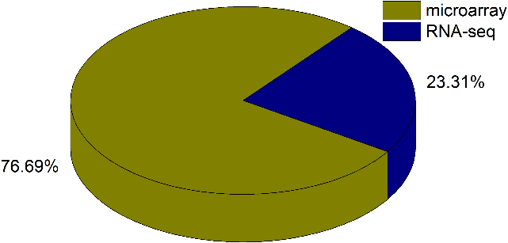
GeneLab Database: 154 data sets
Data Growth Since 2014
Distribution by organism type
Majority is spaceflight samples
Distribution by assay type
Notes:
This slides shows the general status of GL since its creation in 2014. One can see the number of dataset is growing faster every year. Also, the size of each dataset has gone up and reached a plateau mainly reflecting the switch from microarray gene expression data to much deeper set of RNAseq dataset. Pie chart shows the variety of of sample by organism, going from microbes and plants all the way to rodent and human cells. Half of the data are ground data and the majority of the data is transcriptomics (primarily microarray from legagy data and more recently from RNA-seq from ISS experiments).

Slide 13
Recent GeneLab publications

Slide 14
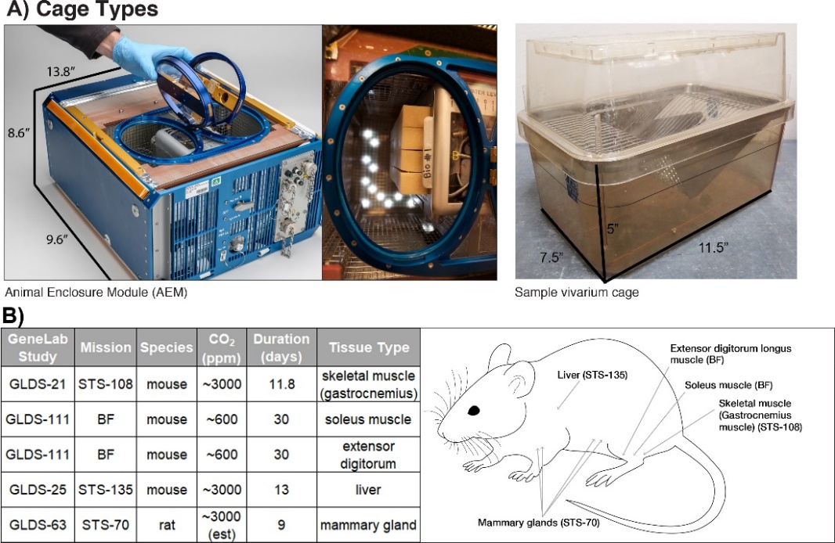
Global transcriptomic analysis suggests carbon dioxide as an environmental stressor in spaceflight: A systems biology GeneLab case study
First GeneLab paper published in March 2018 issue of Scientific Reports (https://www.nature.com/articles/s41598-018-22613-1)
The paper demonstrated that with publicly available data on GeneLab, we are able to generate new hypothesis to direct future experimental rodent research
GeneLab scientists involved: Drs. Afshin Beheshti (Wyle Labs/SCR), Egle Cekanaviciute (USRA/SCR), David J. Smith (SCR) and Sylvain V. Costes (SCR)
Examined how rodent cage architecture and environmental conditions replicating ISS telemetry (e.g. atmospheric carbon dioxide levels) affect physiological responses
Through a systems biology approach, the authors concluded that rodent cage types (producing carbon dioxide differences) could be influencing metabolism, immune response, and potentially the activation of cancer related pathways even without microgravity and space radiation
Research insights could shed light on new experimental designs for rodent research and ultimately the biological risks for astronauts associated with long-term space missions.
“Global transcriptomic analysis suggests carbon dioxide as an environmental stressor in spaceflight: A systems biology GeneLab case study”, Scientific Reports, March 2018, DOI: 10.1038/s41598-018-22613-1

Slide 15
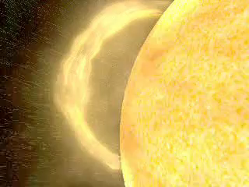
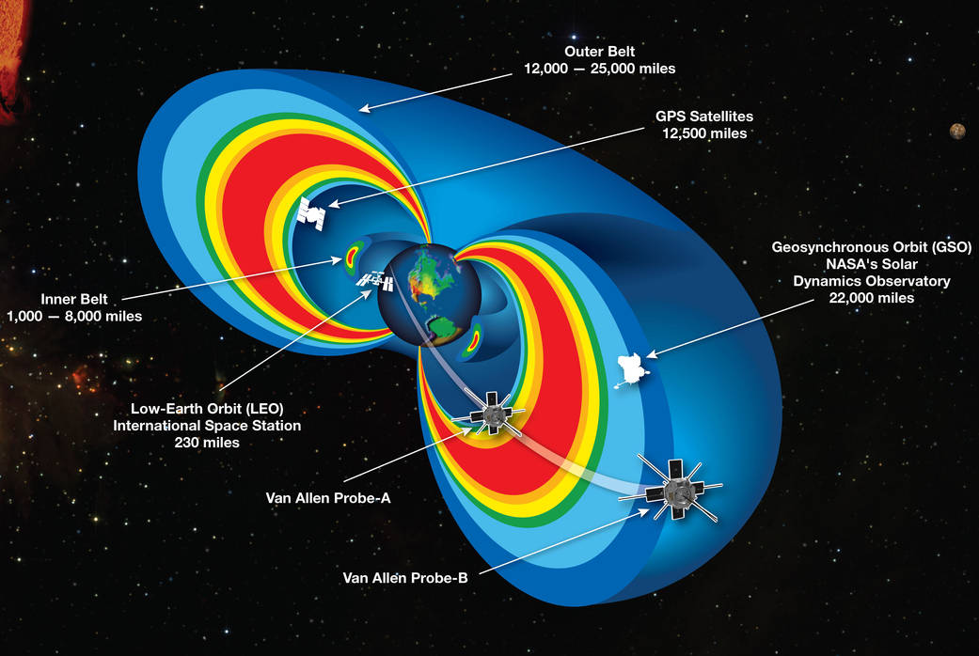
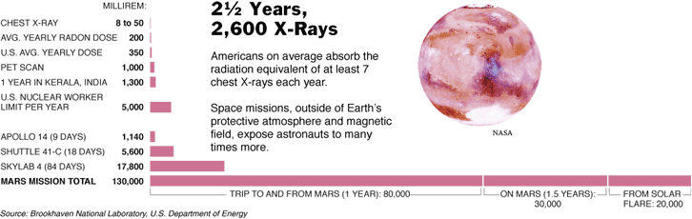
Earth’s magnetic field protects us from cosmic radiation
Notes:
This computer animation illustrates the Earth's space storm shield in action. The solar wind, a thin, high-velocity electrified gas, or plasma, blows constantly from the Sun at an average speed of 250 miles per second (400 kilometers/sec). It is represented as a stream of yellow particles flowing from the Sun. The solar wind impacts the Earth's magnetic field, represented by the blue lines. As the solar wind flows past the Earth's magnetic field, it generates enormous electric currents that heat Earth's space storm shield -- a layer in the Earth's electrically charged outer atmosphere (ionosphere) -- causing the shield to eject electrically charged oxygen atoms (oxygen ions) into space. The expelled oxygen ions are represented by the green particle streams. The ejected oxygen ions gain tremendous speed as they leave the atmosphere, become trapped by the Earth's magnetic field and ultimately encircle the Earth, where they form a billion-degree plasma cloud around the planet, represented by the red cloud. The blue doughnut shape represents the high-speed flow of these particles around the Earth. The red 'ring of fire' around the Earth's polar regions represents the contribution of the particles to the aurora (the northern and southern lights).

Slide 16
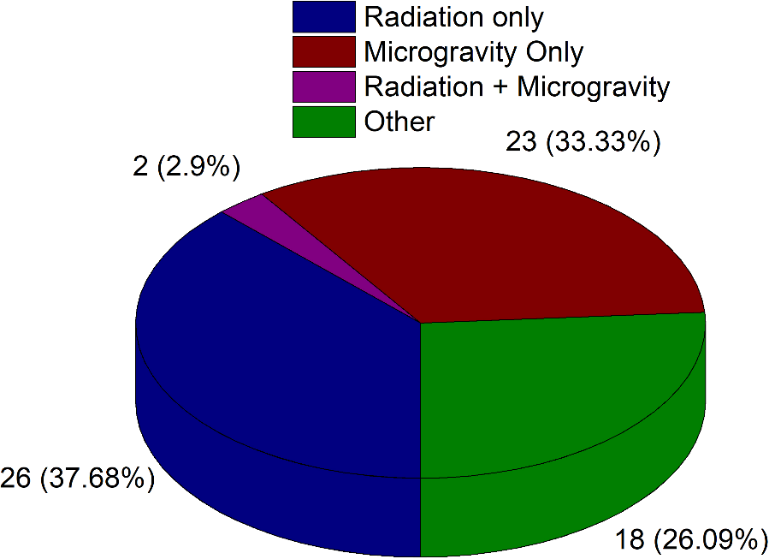
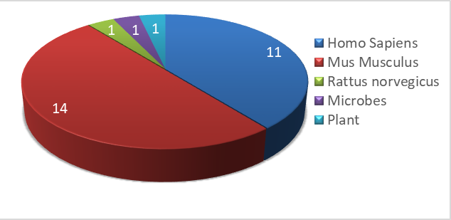
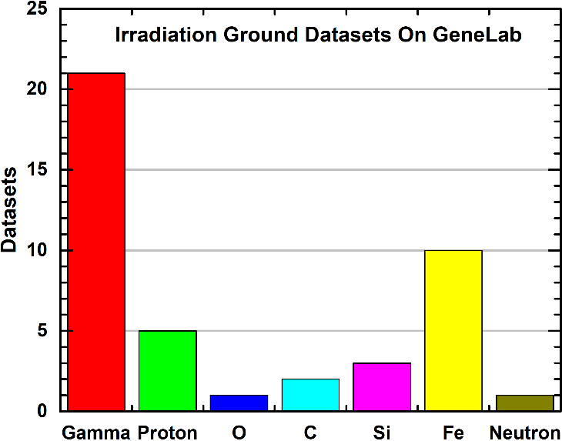
69 Ground Data Sets
Types of Ground Data
28 Ground Radiation Data Sets by Organism
LET range:
0.1 to 170 keV/µm
Dose and Dose rate distribution
Radiation Quality Distribution
Notes:
IF one focuses on the ground dataset (69), Radiation experiment dominates these datasets. Note that 2 Datasets overlap for Microgravity and Radiation
Others include the following:
Atmospheric Pressure
Clinical Treatment
Exercise/Nutrition
Freezing
Genotype
Hypergravity
Sample Collection Protocol
Temperature
Time/Timepoint
Focusing on radiation dataset alone, the majority is focused on human cells or mouse experiments. The main radiation being studies is gamma and X-ray (red bar). It is interesting to note that for high-LET experiment, Fe is the dominant particle, primarily reflecting HRP original focus on 1 GeV/n Fe particles. In terms of dose range, the majority of the high dose experimens are focused on microbes or human cells. Dose rates are considered fast across all dataset, clearly high lighting the biggest gap in this field: i.e. understanding the impact of chronic exposure to cosmic radiation with an estimated dose rate of 0.2 uGy/day against experiment dose rates in the range of 0.5 Gy/min!

Slide 17
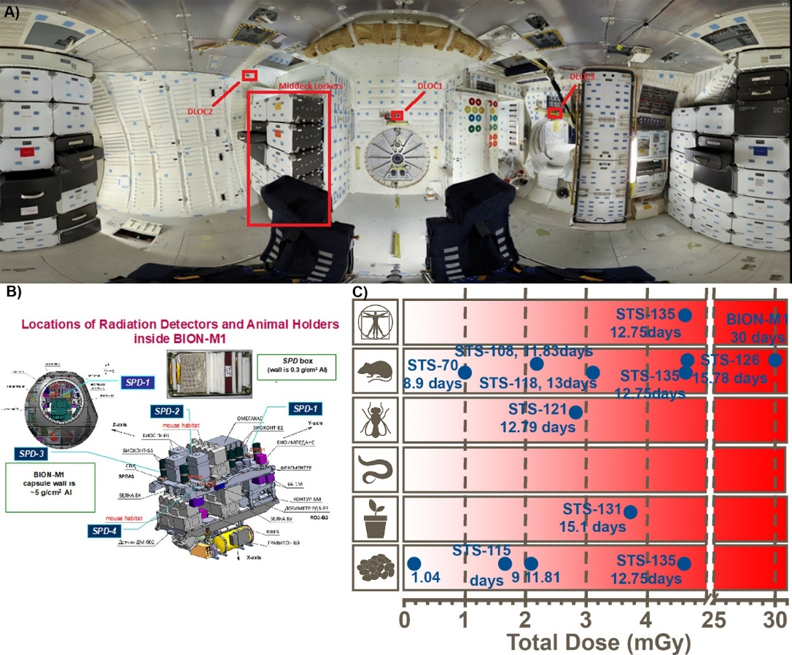
NASA GeneLab Project: Bridging Space Radiation Omics with Ground Studies
Commentary on GeneLab’s datasets associated with radiation research and is in press to be published in June in Radiation Research.
The paper gives a global view of all the radiation data available on GeneLab that is associated with space research:
  New omics data from radiation ground studies (i.e. HRP radiation investigations, Low dose Program from DOE, NIH radiobiology data)
  New metadata characterizing space radiation dosimetry for spaceflight dataset (currently STS or Bion, but soon ISS as well)
GeneLab scientists involved: Drs. Afshin Beheshti (Wyle Labs/SCR), Daniel Berrios (USRA/SCR), Samrawit Gebre (Wyle Labs/SCR), and Sylvain V. Costes (SCR)
This is also the first comprehensive review of what datasets are available on GeneLab (i.e. pie charts describing data type, species, and type of omics)
Radiation Research is an international Journal read by the Radiation Biology community. This commentary will disseminate these new resources beyond the NASA HRP/Space Biology investigator community and we expect more investigators to analyze these data
“NASA GeneLab Project: Bridging Space Radiation Omics with Ground Studies”, Radiation Research, June 2018 (in Press)

Slide 18
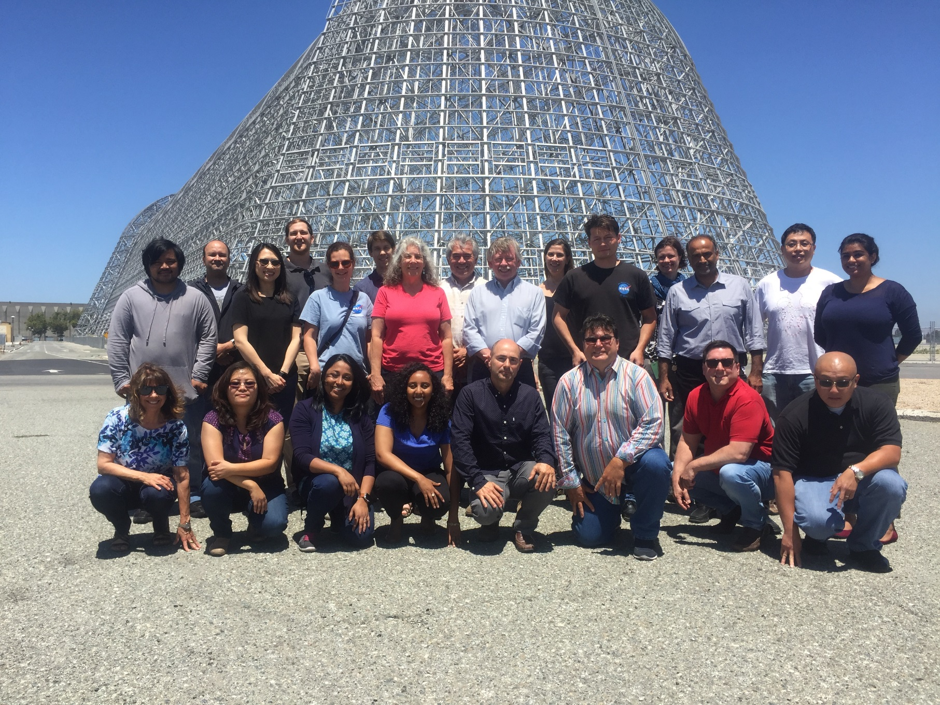
GeneLab Acknowledgements
  Chris Barreras
  Afshin Beheshti
  Dan Berrios
  Valery Boyko
  Sonja Caldwell
  Jairon Camarillo
  Kaushik Chakravarty
  Egle Cekanaviciute
  John Costa
  Sylvain Costes (PM)
  Marie Dinh
  Sandy Dueck
  Homer Fogel
  Jon Galazaka (PS)
  Samrawit Gebre
  Dennis Heher
  Lynn Hutchison
  Yared Kidane
  San-Huei Lai Polo
  Tristan Le
  Qiang Li
  Shu-Chun Lin
  Sneha Raghunandan
  Shayoni Ray
  Sigrid Reinsch
  David Smith
  Marla Smithwick
  Hao Thai
  Khai Peter Tran
  Andrew Williamson
TO JOIN GENELAB AWG, CONTACT: sylvain.v.costes@nasa.gov
Genelab.nasa.gov
Notes:
Finally GL is reaching out to the larger PI community by establishing AWG (Analysis Working Group), which will establish processing protocol to generate the processed higher order data required for our visualization portal. We are still taking members, if you are interested, please reach out to Dr. Costes. Finally, this is the acknowledgement slide. In bold are the main contributors for the scientific content of these slides.

