Slide 1
KSC LSDA Introduction and Goals
Stephanie Richards

Slide 2
  KSC Emphasis.
At KSC our payloads are predominantly focused on plant and unicellular organism research.
Primarily the projects managed by KSC provide a greater foundation in elucidating adaptive responses of these organisms when subjected to microgravity and spaceflight conditions.
Hardware portfolio:
  Biotube
  Biological Research In Canisters (BRIC) Series
    -60
    -100
    -100VC
    -Opti
    -Petri Dish Fixation Unit (PDFU)
  FASTRACK
  Kennedy Space Center Fixation Tube (KFT)
  Vegetable Production Unit (VEGGIE)
  Under development
    Advanced Plant Habitat (APH), expected completion 2016
    BRIC-Light Emitting Diode (LED), expected completion 2016
    Multispectral Fluorescent Imager, expected completion 2017

Slide 3
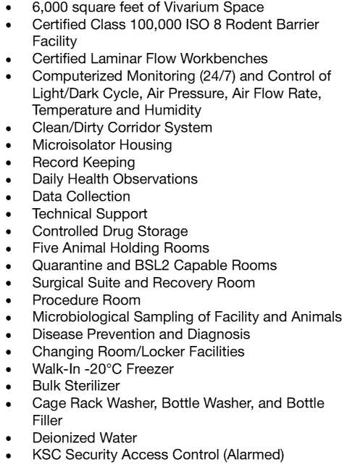
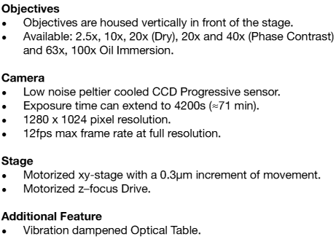
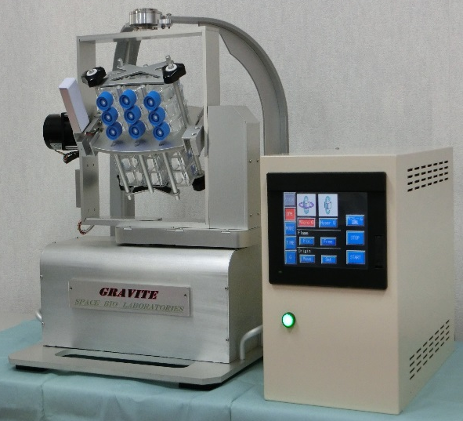
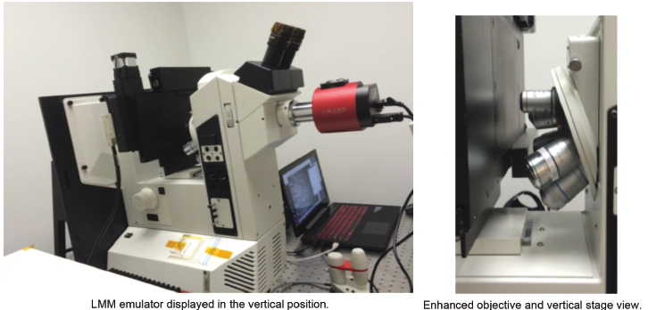
  Additionally at KSC.
Animal Care Program
  Light Microscopy Module (LMM) Emulator
Microgravity Simulator Facility
Space Bio-Laboratories, Inc. GRAVITE
Specifications:
Microgravity setting
Adjustable inner and outer frame speed.
Real-time data: gX, gY, and gZ.
Adjusted by the sample and materials.
Regular use settings: < 10rpm.
Hypergravity setting
Capable of producing 2-3g.
Provides a very stable rotation.
Regular use settings: 10-20rpm.

Slide 4
  Recently Completed Payloads.
Flight | Payload | Project Title | PI | Data
SpaceX-2 | BRIC 17-1 | Cell Signaling in Undifferentiated Cells - Perceiving the Environment without Specialized Tissues | Anna-Lisa Paul | Microarray, Transcriptome (mRNA)
SpaceX-2 | BRIC 17-2 | BRIC: Mapping Spaceflight-Induced Hypoxic Signaling and Response | Simon Gilroy | Microarray, Transcriptome (mRNA)
SpaceX-3 | BRIC 18-1 | Development of Multiple Antibiotic Resistance by Opportunistic Bacterial Pathogens during Space Flight | Wayne Nicholson | Sequencing, Transcriptome (mRNA)
SpaceX-3 | BRIC 18-2 | Mechanisms for Plant Adaptation to Space Environment | Federica Brandizzi | Sequencing, Transcriptome (mRNA)
SpaceX-3 | APEX 02-02 | Evolution of Genotypic and Phenotypic Changes in Yeast Related to Selective Growth Pressures Unique to Microgravity | Timothy Hammond | Microarray, Transcriptome (mRNA)
SpaceX-3 | VEG 01 | Veggie Series Proof of Concept Flight | Gioia Massa | Sequencing, Microbiome; Nutritional composition
SpaceX-3 | Biotube-MICRo | Microgravity and Magnetic Fields – Directional Root Growth and Gene Expression | Karl Hasenstein | Microarray, Transcriptome (mRNA)
SpaceX-4 | BRIC 19 | BRIC: Plant Mechanical Signaling During Spaceflight | Simon Gilroy | Sequencing, Transcriptome (mRNA)
SpaceX-5 | BRIC 20 | Proteomics Analysis of Arabidopsis Seedlings in Microgravity | Sarah Wyatt | Sequencing, Transcriptome (mRNA); Proteome
SpaceX-5 | APEX 03-01 | Utilizing ISS to Uncover Microgravity’s Impact on Root Development & Cell Walls | Elison Blancaflor | Sequencing, Transcriptome (mRNA)
SpaceX-5 | APEX 03-02 | Molecular Biology of Growth & Cell Remodeling within the Spaceflight Environment | Robert Ferl | Sequencing, Transcriptome (mRNA); Microscopy
SpaceX-6 | BRIC 21 | Global Transcriptome Profiling to Identify Cellular Stress Mechanisms Responsible for Spaceflight-Induced Antibiotic Resistance | Wayne Nicholson | Sequencing, Whole Transcriptome (total RNA)
SpaceX-7 | VEG 03 | Pick-and-Eat Salad-Crop Productivity, Nutritional Value, and Acceptability to Supplement the ISS Food System | Gioia Massa | Sequencing, Microbiome; Nutritional composition

Slide 5
  Ongoing/Future Payloads.
Targeted Flight | Payload | Project Title | PI | Data
SpaceX-8 | VEG 03 | Pick-and-Eat Salad-Crop Productivity, Nutritional Value, and Acceptability to Supplement the ISS Food System | Gioia Massa | Sequencing, Microbiome; Nutritional composition
SpaceX-9 | APEX 02-02 | Evolution of Genotypic and Phenotypic Changes in Yeast Related to Selective Growth Pressures Unique to Microgravity | Timothy Hammond | Sequencing, Transcriptome (mRNA)
SpaceX-10 | APEX 04 | Epigenetic Change in Arabidopsis thaliana in Response to Spaceflight Differential Cytosine DNA Methylation of Plants on the ISS | Anna-Lisa Paul | Sequencing, Whole transcriptome (total RNA) and Epigenome
SpaceX-11 | None | None | None | None
SpaceX-12 | BRIC 22 | Mechanisms for Plant Adaptation to Space Environment | Federica Brandizzi | Sequencing, Transcriptome (mRNA)
SpaceX-13 | APEX 05 | Spaceflight-Induced Hypoxic/ROS Signaling | Simon Gilroy | Sequencing, Transcriptome (mRNA)
SpaceX-13 | PH 01 | An integrated Omics Guided Approach to Lignification and Gravitational Responses: The Final Frontier | Norman Lewis | Sequencing, Transcriptome (mRNA); Proteome; Metabolome; Phenome
SpaceX-13 | EMCS 02 | Characterizing Plant Gravity Perception Systems | C. Scot Wolverton | Imaging; (Sequencing, Transcriptome (mRNA) under consideration requiring augmentation)
SpaceX-14 | VEG 04 | Pick-and-Eat Salad-Crop Productivity, Nutritional Value, and Acceptability to Supplement the ISS Food System | Gioia Massa | Sequencing, Microbiome; Nutritional composition; (Sequencing, Transcriptome (mRNA) under consideration requiring augmentation)
SpaceX-15 | None | None | None
SpaceX-16 | APEX 06 | Using Brachypodium distachyon to Investigate Monocot Plant Adaptation to Spaceflight | Patrick Masson | Sequencing, Transcriptome (mRNA)
SpaceX-16 | VEG 05 | Pick-and-Eat Salad-Crop Productivity, Nutritional Value, and Acceptability to Supplement the ISS Food System | Gioia Massa | Sequencing, Microbiome; Nutritional composition; (Sequencing, Transcriptome (mRNA) under consideration requiring augmentation)

Slide 6
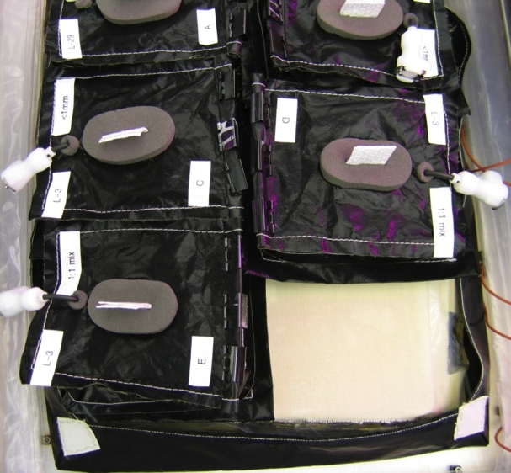
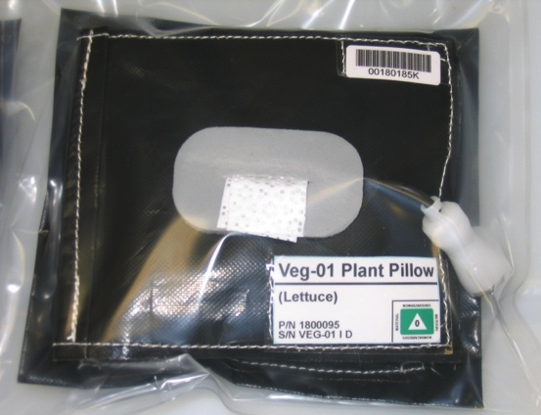
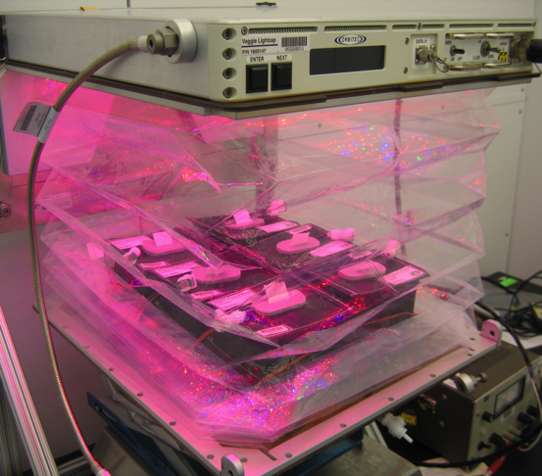
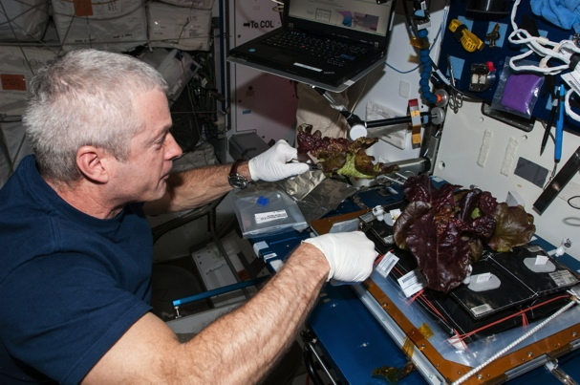
Highlighted Hardware and Payloads: VEGGIE
The Vegetable Production Unit (VEGGIE) has been designed to produce fresh vegetables on ISS.
It will have near term psychological benefits for the crew as a source of recreation/aesthetics and long term benefits as a minor food supply for future missions.
To be used for both Science and Outreach Activities.
Specifications:
LED Light Cap: Red (630 nm): low, med, high
Blue (455 nm): low, med, high
Green (530 nm): on/off
Cabin Air Fan: Low / High / Off
Footprint: Baseplate: 29.2 cm x 36.8 cm
Root mat: 21.6 cm x 35.6 cm
Max. Height: 47 cm empty; 41.9 cm w/ root mat
Individual plant pillow.
One pillow removed revealing capillary surface of reservoir below.
Rooting Pillow Concept:
Different sizes for variety of plant types
  1, 2, 3 or 6 pillows per Veggie
Media and fertilizer containment
Plant/glue seeds dry
Hydrate on orbit
Passive wicking from reservoir
Minimal crew time
Single use, disposable
Six pillows within VEGGIE.
VEG-01a on-orbit harvest.

Slide 7
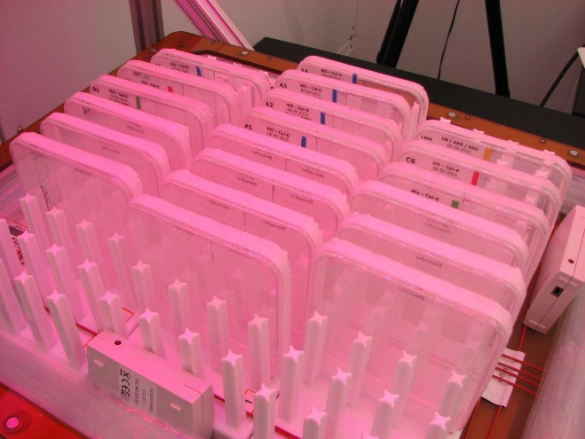
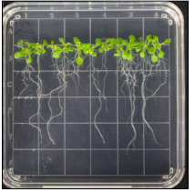
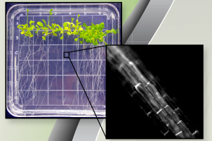
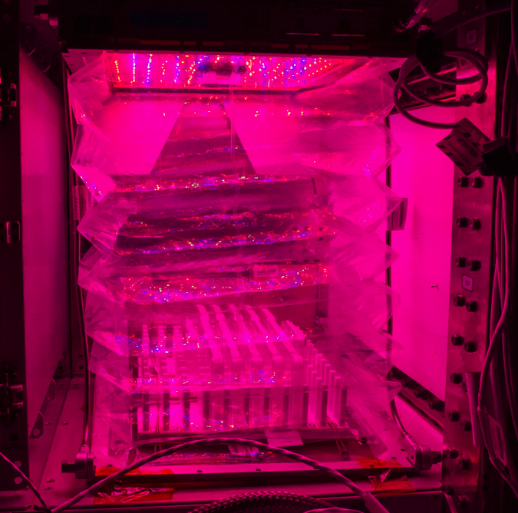
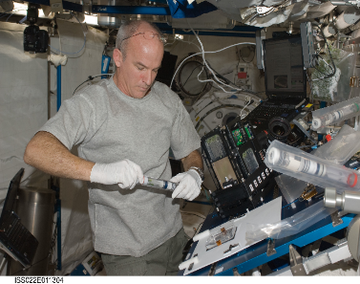
Highlighted Hardware and Payloads: VEGGIE
Configured Petri plates within rack.
Arabidopsis seedlings on Petri plate.
LMM Photography
Fluorescent image of Arabidopsis root taken in LMM.
Crew Photography
After photography, Arabidopsis plants fixed within Kennedy Space Center Fixation Tubes.
Petri plate holders in VEGGIE with bellows closed.

Slide 8
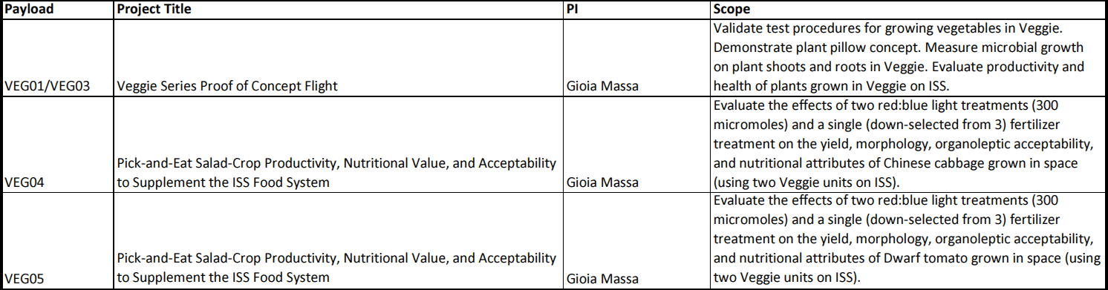
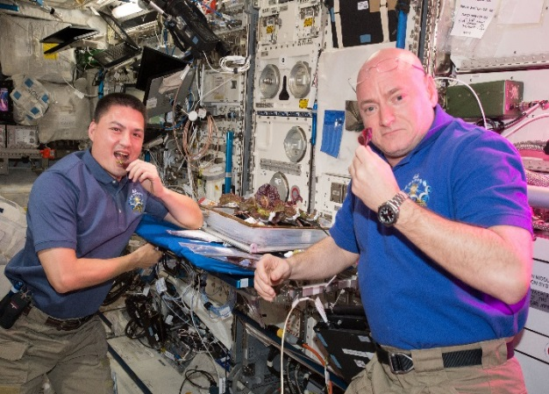
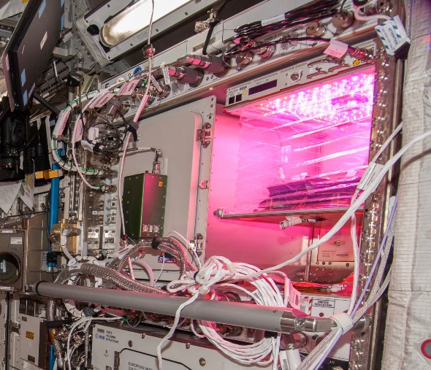
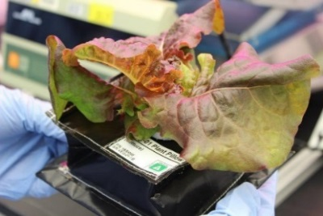
  Highlighted Payloads: VEG
VEGGIE in Columbus Module.
Mature ‘Outredgeous’ red leaf lettuce within a plant pillow.
Astronauts Kjell Lindgren and Scott Kelly enjoying
freshly harvested lettuce from Veg-01b.

Slide 9
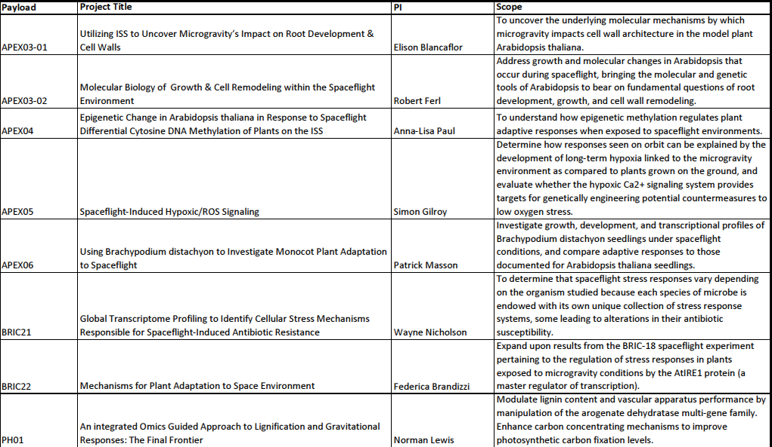
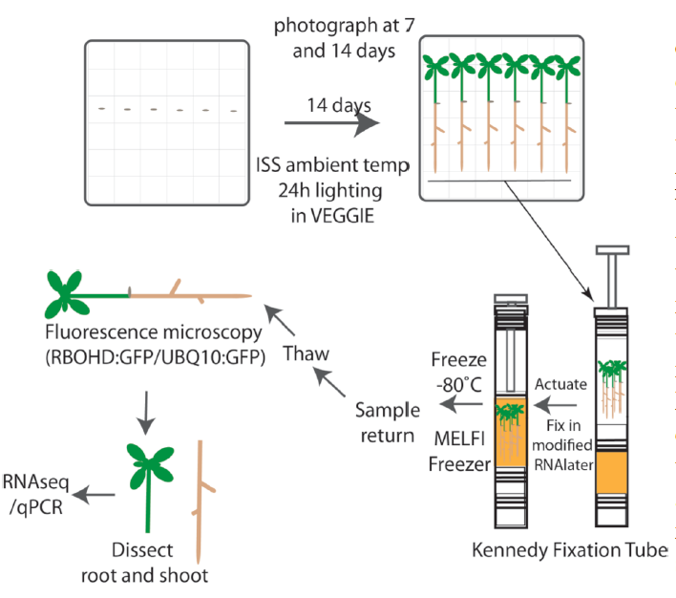
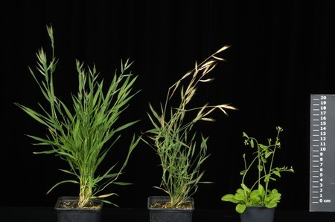
  Highlighted Payloads: Advanced Plant Experiments (APEX)
Growth in constant light.
ISS ambient temp
Ungerminated seeds
Brachypodium distachyon (left) compared to Arabidopsis thaliana (right).
Photo & Harvest
Experimental overview for APEX research.

Slide 10
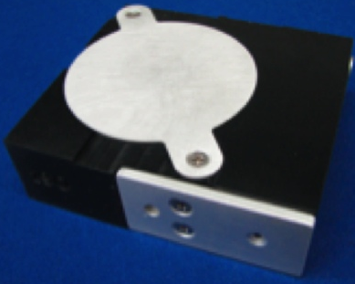

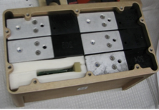
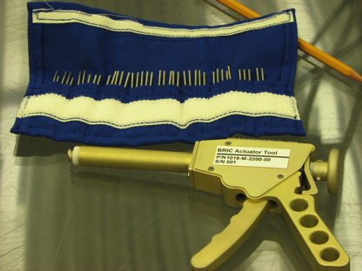
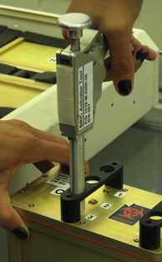
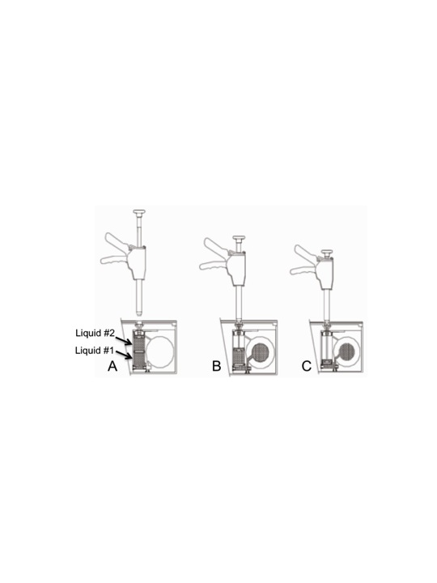
Highlighted Hardware and Payloads: BRIC
The BRIC-PDFU hardware facilitates Rapid Turn-Around payloads involving in-flight fixation & multiple NRA-selected PIs.
Provides shorter period of time for PI to obtain flight opportunity and ultimately flight data for analysis and publication.
A
B
C
D
E
F
A. Petri Dish Fixation Unit (PDFU). B. Callus culture on petri dish within a PDFU. C. 5 PDFUs plus 1 temperature logger within a BRIC-PDFU Canister. D. BRIC-PDFU Canister with two pin guards attached. E. Actuator Rod Kit & Actuator Tool. F. Actuator Tool attached to BRIC- PDFU canister.
Injection of fluids into PDFU Petri dishes:
A. Actuator Tool prior to attachment to BRIC-PDFU.
B. Actuator partially depressed to Liquid 1.
C. Completion of actuation allows Liquid 2 to be delivered.
Astronaut Rick Mastracchio actuating a BRIC-PDFU.

Slide 11
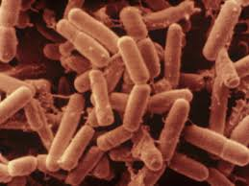
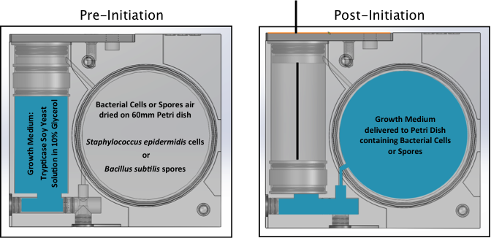
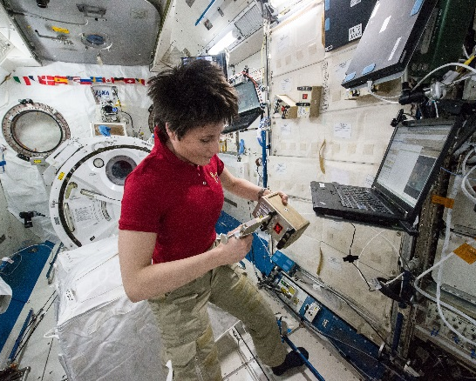
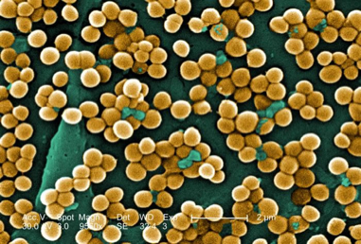
  Highlighted Payloads: BRIC.
Bacillus subtilis
Staphylococcus epidermidis
Initiation of BRIC 21 experiment onboard ISS by astronaut Samantha Cristoforetti.
Post-flight etiolated
seedlings from BRIC 18.
BRIC 21 Test Organisms and Schematic.

Slide 12
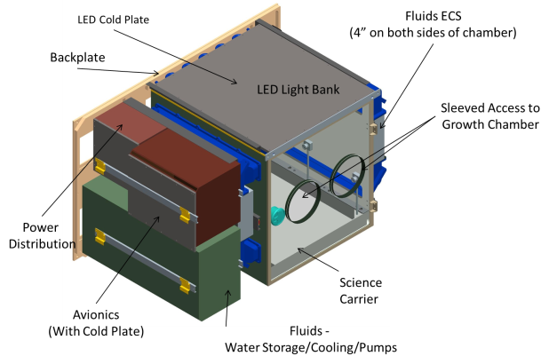
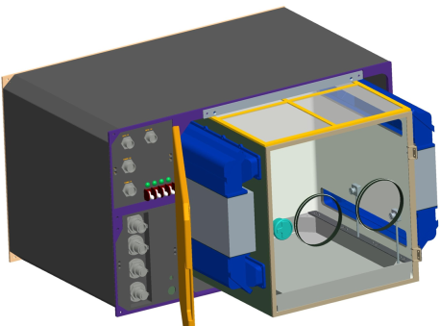
Highlighted Hardware and Payloads: APH
Objective: Develop a large volume plant habitat for multi-generational studies in which environmental variables (e.g., Temperature, Relative Humidity, Carbon Dioxide Level, Light Intensity and Spectral Quality) can be tracked and controlled in support of whole plant physiological testing and Bioregenerative Life Support System investigations.
Open architecture concept to allow critical subsystems to be removed and replaced.
Specs: Max. Shoot Height: 45 cm; Root Zone Height: 5 cm, Growth Area: 2,500 cm2; Growth Volume: 112,500 cm3;
Light Intensity: >600 mmol/m2/s; Temp: 18-30 C; Relative Humidity: 50-86%

Slide 13
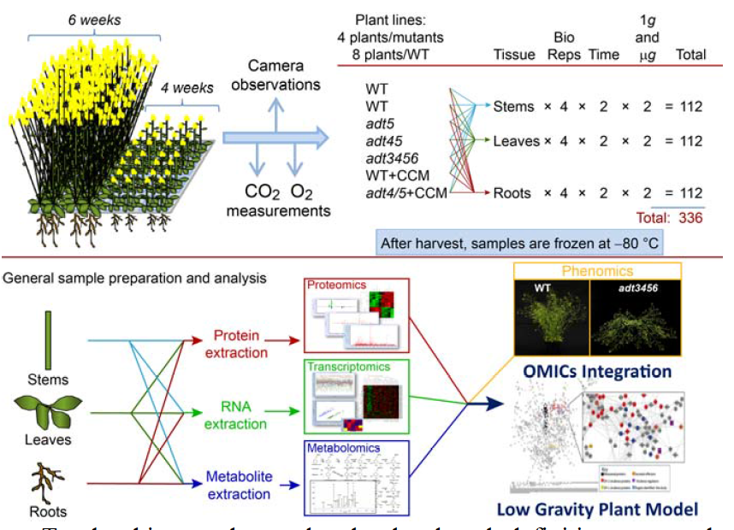
  Highlighted Payloads: PH.
Protein
extraction
Proteomics
RNA
extraction
Transcriptomics
OMICS Integration
Metabolite extraction
Metabolomics
Advanced Plant Habitat (APH) prototype.
PH 01 schematic of the integrated omics tissue analyses.

Slide 14
  Next Steps.
KSC payloads have predominantly shifted from microarray analysis to sequencing analysis (storage equivalent = Gb to Tb of data).
Type of data for submission into GeneLab:
  RNA Sequencing
    Whole transcriptome (total RNA)
    Transcriptome (mRNA)
  DNA Sequencing
    Epigenome
    Microbiome
  Proteome
  Metabolome
Additional data for incorporation into the LSDA:
  Images
  Nutritional composition

Slide 15
Questions?

