Slide 1
Curation of Institutional Scientific Collections Biospecimen Sharing Program (BSP) Biospecimen Support Facility(BSF) Ames Space Biosciences Division Helen Stewart & Alison French January 15, 2015

Slide 2
Contents
LSDA, ALSDA, GeneLab, Human Research Program, Space Radiation Lab & ISSP Space Flight Payload Projects
NASA Policy Directive (NPD) and NASA Procedural Requirement (NPR)
Difference between institutional scientific collection and project collection
Biospecimen Sharing Program (BSP)
Requesting Biospecimens
Biospecimen Support Facility (BSF)

Slide 3
NASA Policy Directive (NPD 7100.xxx) & Standards
This NPR describes the procedures necessary to effectively carry out NASA’s policy on maintaining the curation of biological (to include human) scientific institutional collections as specified in NASA’s Policy Directive (NPD) 7100.XXX, “Curation of Institutional Scientific Collections".
“All of NASA’s institutional scientific collections shall be accessible to qualified proposers within and outside the Agency. Procedures for requesting access to samples and information about how such requests will be evaluated shall be posted online publically.”
“This NPD does not establish policy for NASA’s project scientific samples, which are samples unique to projects and not publically accessible. “
Ames has provided input into this NPD and the subsequent NPR (still in progress).
The BSF uses software and practices in alignment with International Society for Biological and Environmental Repositories (ISBER) “2012 Best Practices for Repositories” Collection, Storage, Retrieval, and Distribution of Biological Materials for Research.

Slide 4
Institutional vs. Project Collection
Institutional Scientific Collection
Objects in the custody of of or owned by NASA that have been identified for long-term preservation and management, and are made available through formal procedures to qualified parties within and outside the agency for research, education or exhibition. Such collections are subject to all of the requirements of this NPD.
Project Collection
Objects in the custody of of or owned by NASA that are (or were) primarily used and managed by the staff associated with the project or program that collected the specimens. NASA has not identified a scientific or educational rationale for either long-term preservation of providing wider access to the material to the research and education communities in general. Typically, the specimens are not accessible through sample sharing or loan procedures, or such access is only at the discretion of those associated with the project or program.

Slide 5
Biospecimen Support Facility Activities Managed by Helen Stewart - Ames SpaceBiosciences Division
Biospecimen Sharing Program
Team Members
Alison French, April Gage, Dorothy Leung
Biospecimen Culling
Team Members
Jon Rask, Kaushik Chakravarty, San-Huei Lai, Oana Marcu, Sungshin Choi, Alison French, Frances Donovan
Ames Biobanking (Cryotrack)
Team Members
Alan Wood, Dan Berrios, Kaushik Chakravarty, San-Huei Lai, Sungshin Choi, Alison French, April Ronca, Paul Espinosa

Slide 6
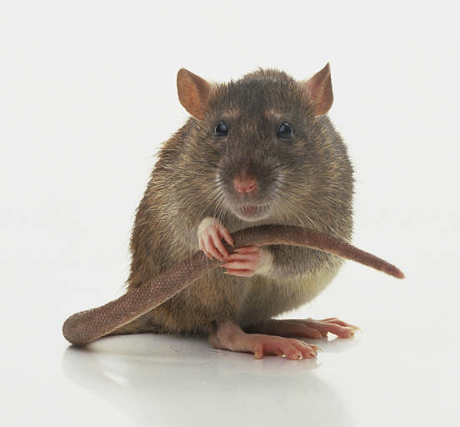
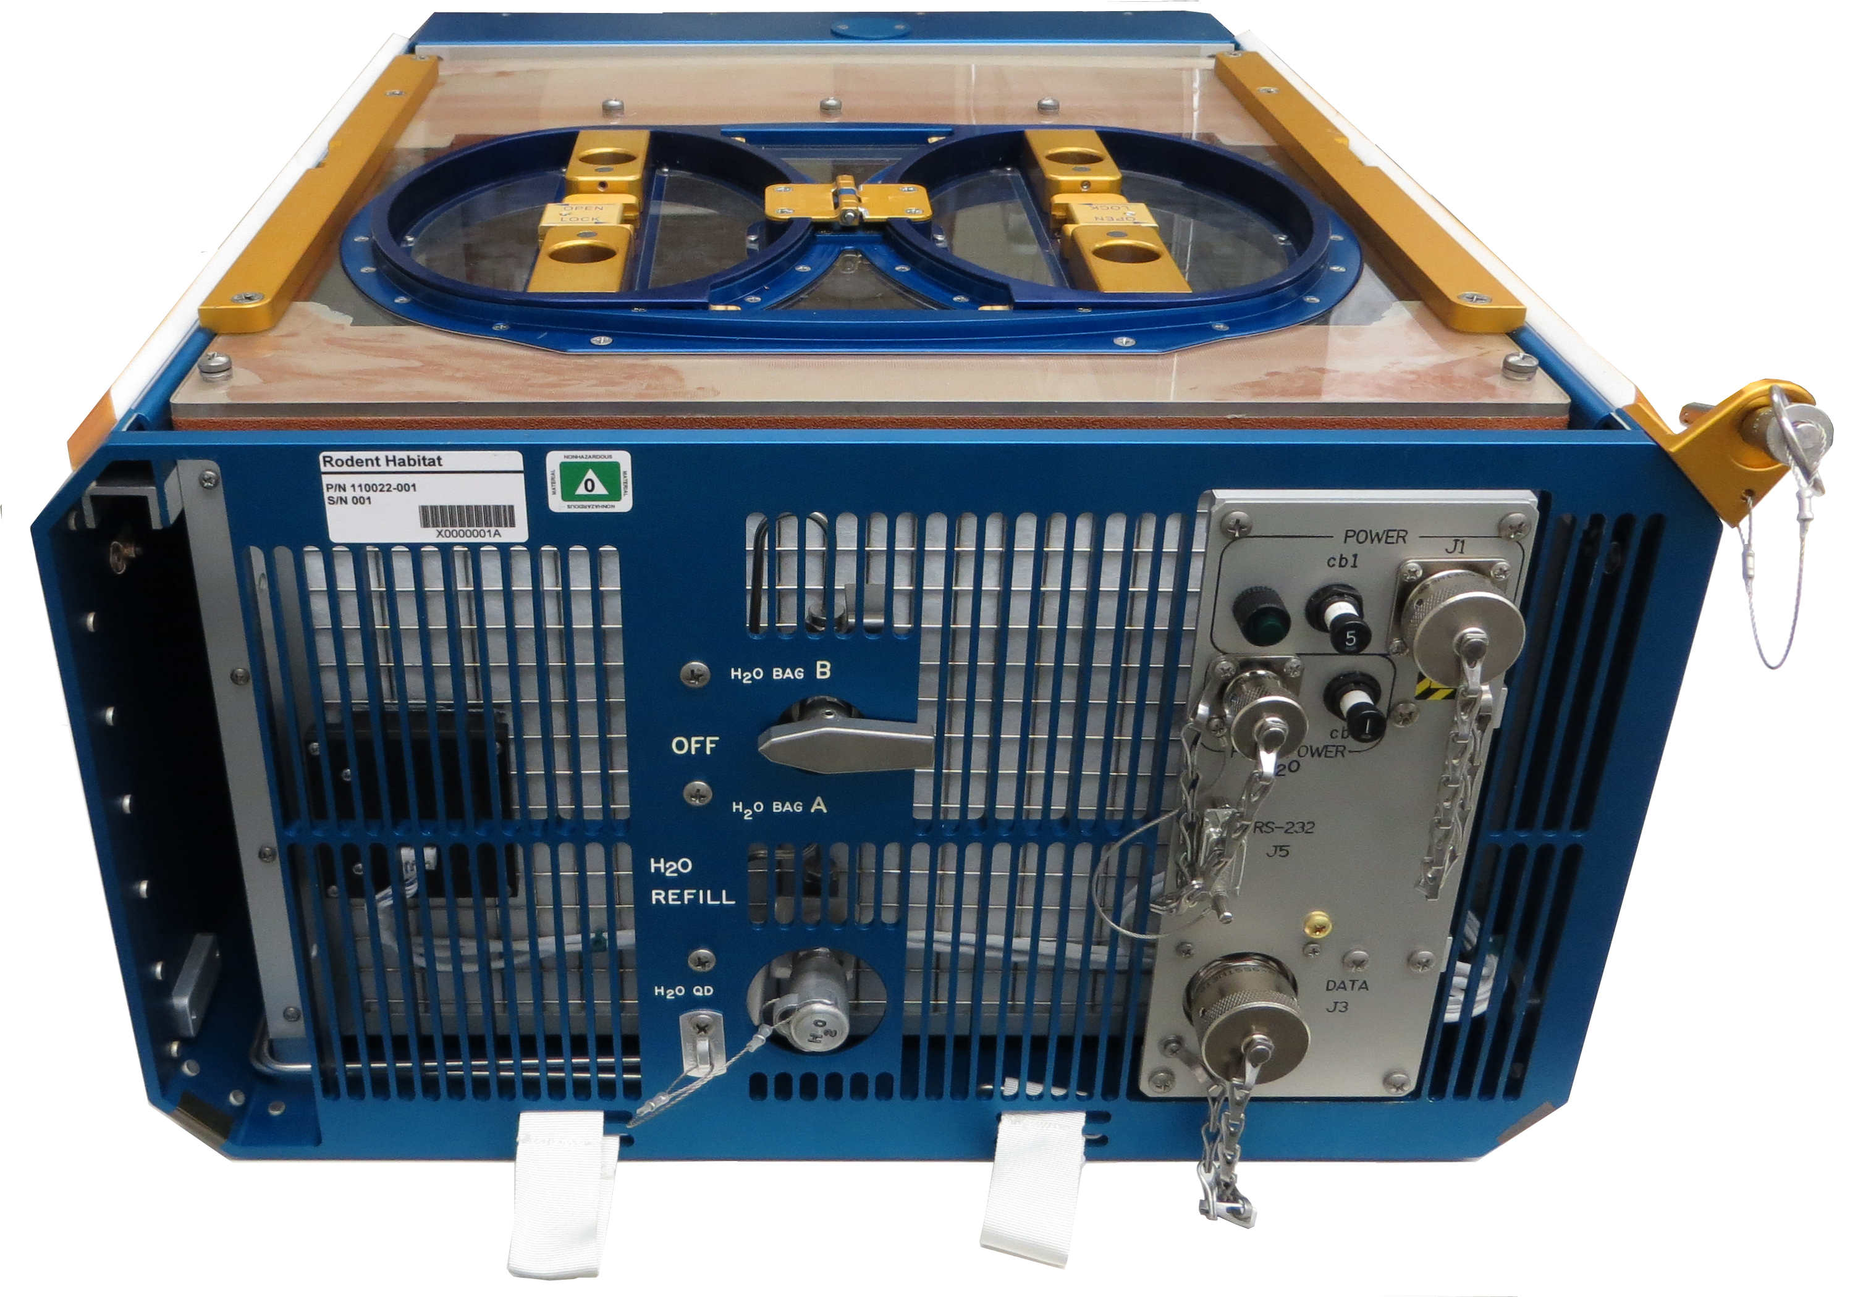
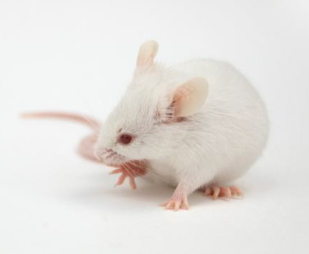
Biospecimen Sharing Program (BSP) History
The NASA Ames Research Center BSP was developed to ensure that valuable tissue samples from rare and complex spaceflight experiments, and not part of primary investigations, would be made available to the scientific community for analysis.
Maximize overall scientific return from the specimens flown
Encourage broader participation of the research community
The present effort builds upon more than 50 years of highly successful Ames collaborative investigations, starting in the 1960’s, that have a proven track record for maximizing utilization and scientific return from unique animal specimens.
The concept was originally pioneered during the early US/USSR collaborations conducted aboard unmanned Russian Cosmos flights.

Slide 7
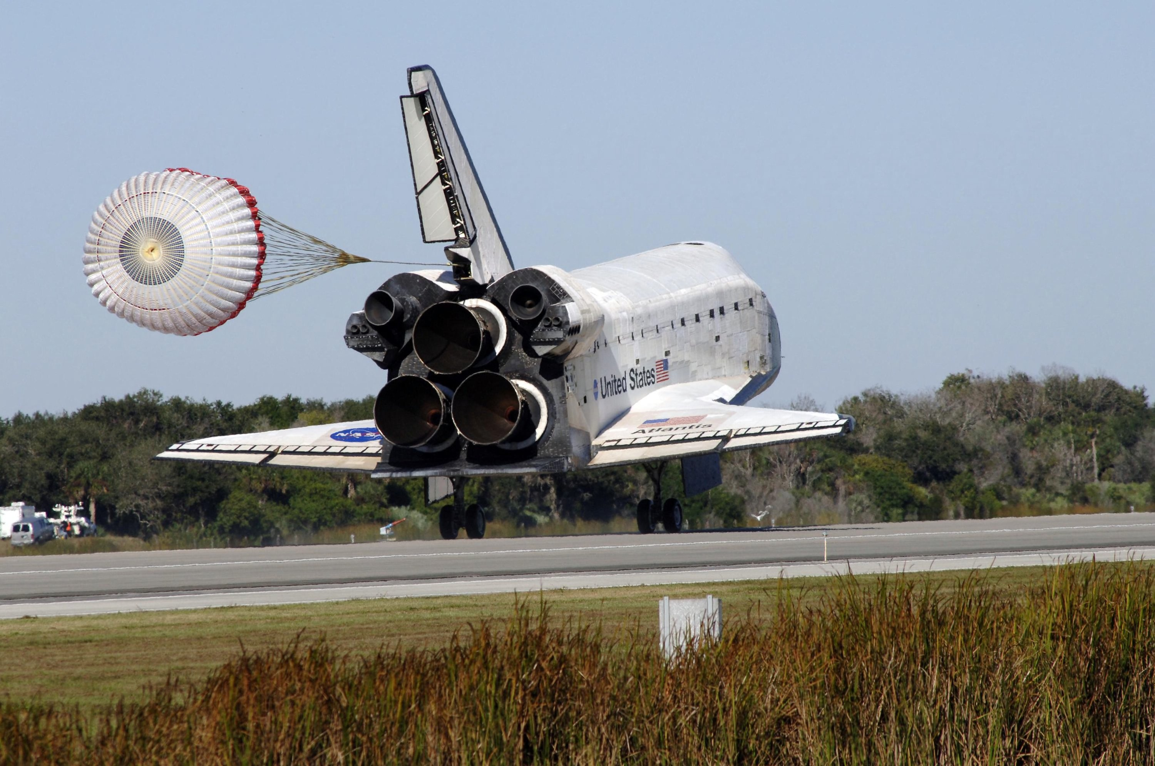
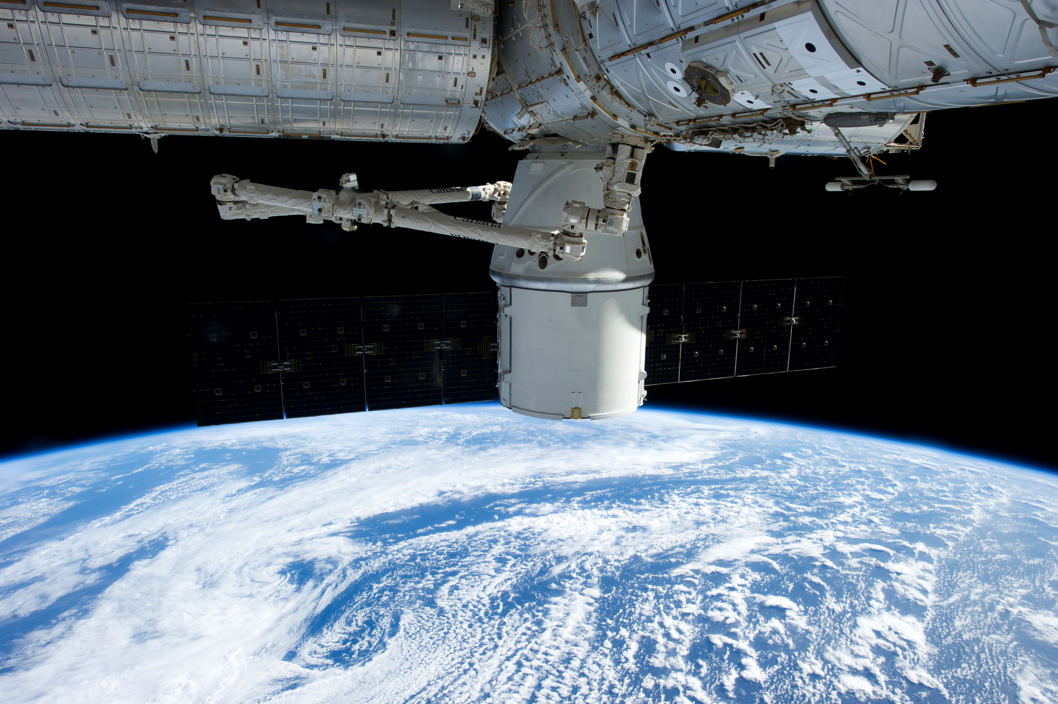
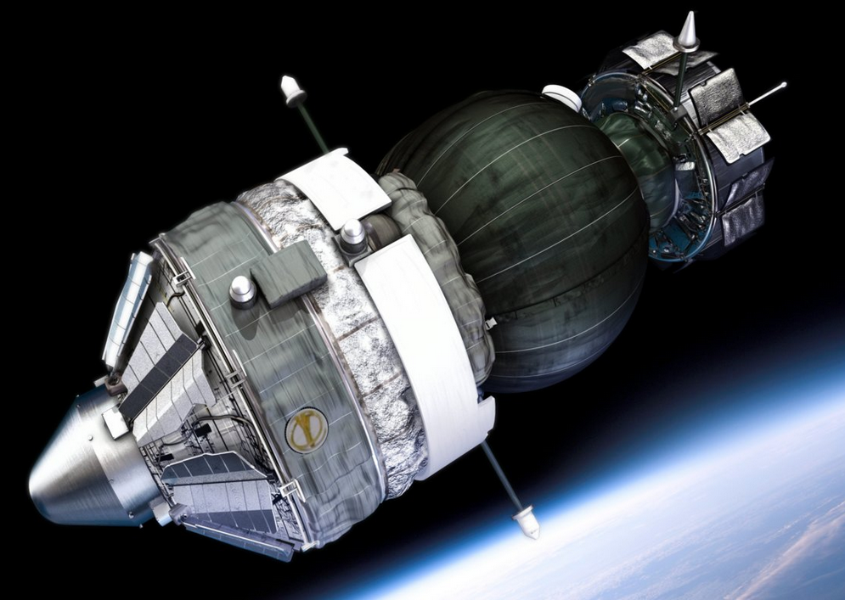
Missions Participating in BSP or Collaborations
Early Collaborations
1960’s US Biosatellite I/II and III: 21 BSP
1975-1996 Cosmos/Bion flights (9): approx. 200 collaborative exps.
Space Shuttle 1985-2011:
STS-51B, SL-3, 1985: Rat (30 BSP)
STS-40, SLS-1, 1991: Rat (22 BSP)
STS-58, SLS-2, 1993: Rat (30 BSP)
STS-56, PARE.03, 1993: Rat
STS-70, NIH.R2, 1995: Rat
STS-72, NIH.R3, 1996: Rat
STS-90, Neurolab, 1998: Rat (9 BSP)
STS-108, CBTM, 2001: Quail
STS-118, CBTM-2, 2007: Mouse
STS-131, Immune, 2010: Mouse (10 BSP)
STS-133, Mouse Immune 2, 2011: Mouse (10 BSP)
STS-135, CBTM-3, 2011: Mouse (32 BSP)
International Space Station 2014-present
SpaceX-4, Rodent Research 1, 2014: Mouse (11 BSP)
SpaceX-8, Rodent Research 4, 2016: Mouse (TBD)
Post Mission Analysis (PMA):
26 BSP requests shipped
US/Russia Collaborations:
Foton M2, 2005: Newt, Gecko, Bacteria, Snail
Foton M3, 2007: Newt, Gecko, Bacteria, Snail
Bion M-1, 2013: Mouse

Slide 8
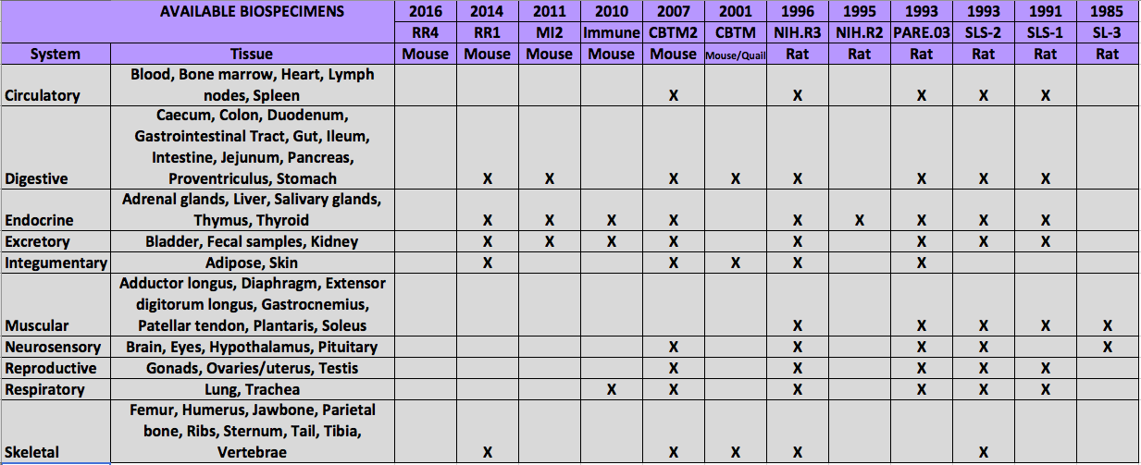
Available BSP Tissues

Slide 9
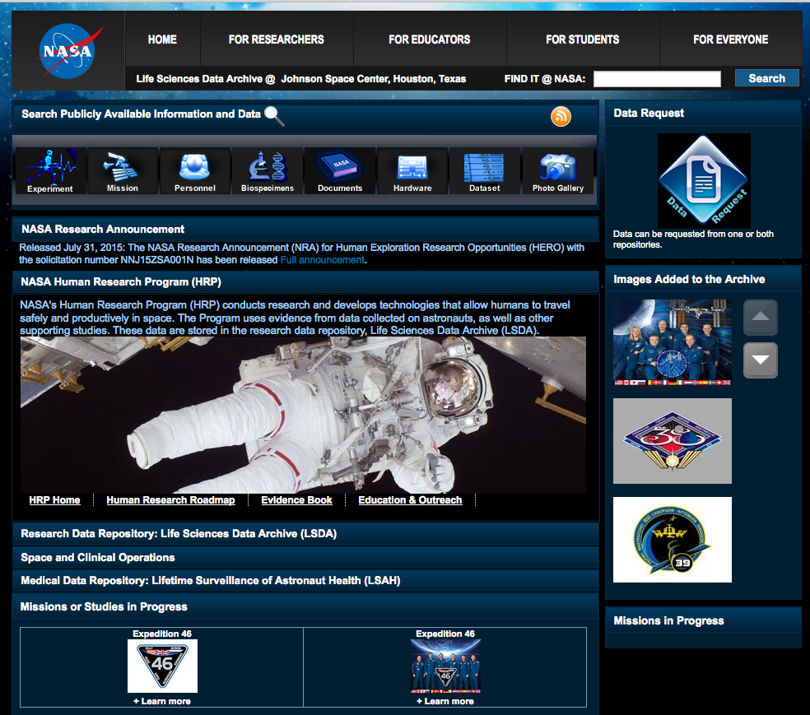
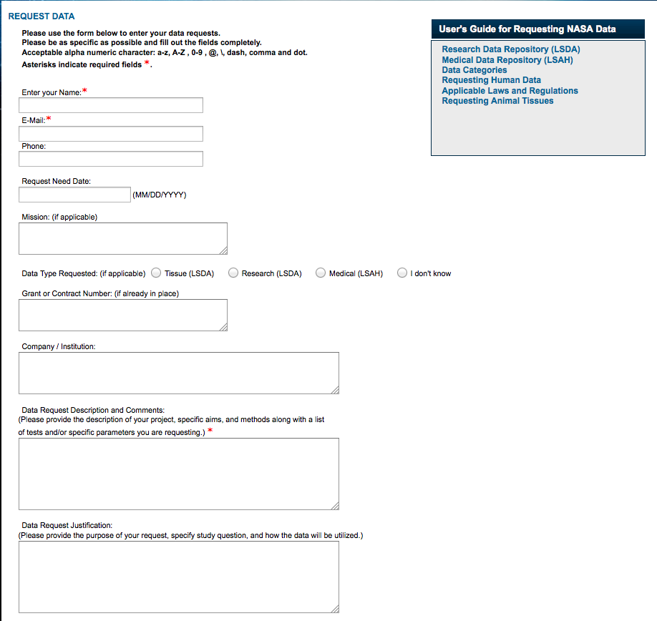
Requesting Biospecimens
To request biospecimens visit the LSDA website at: https://lsda.jsc.nasa.gov
and submit a Data Request

Slide 10
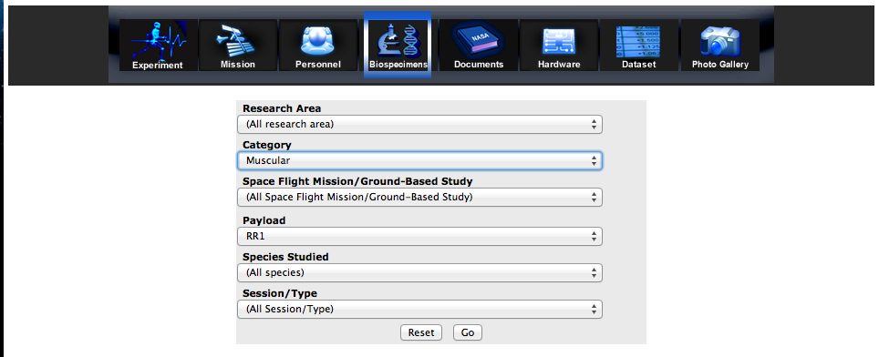
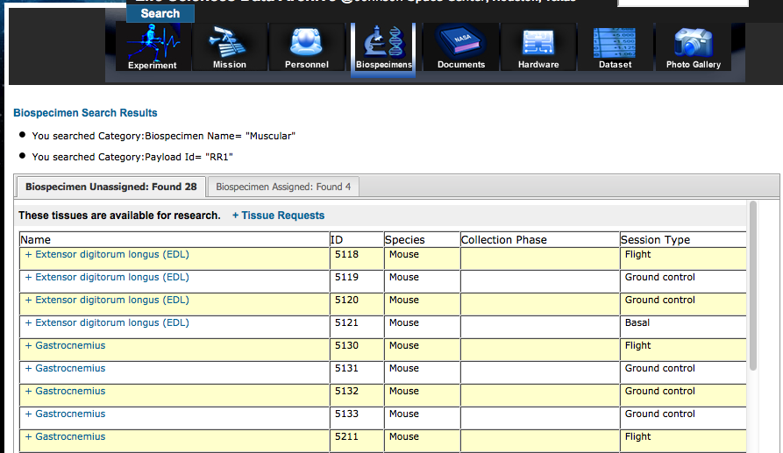
Locating Biospecimens
To search for available tissues visit the “Biospecimens” section of the LSDA website:

Slide 11
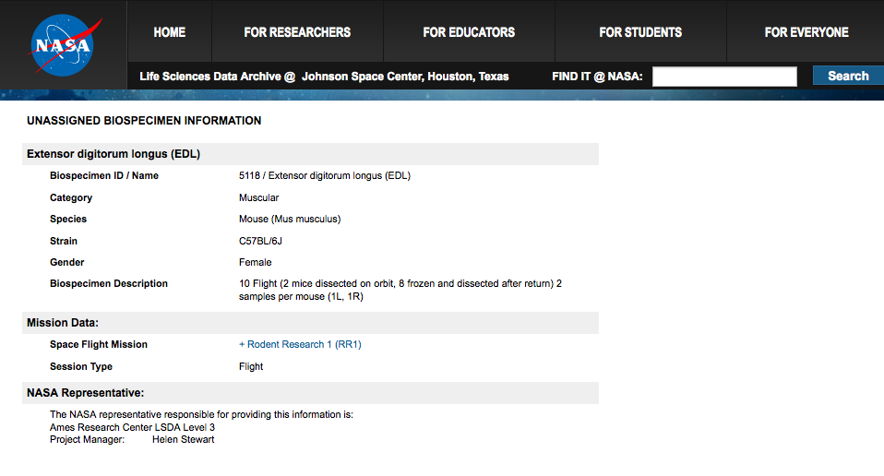
Biospecimen Detail Information

Slide 12
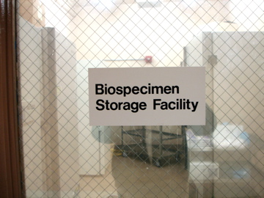
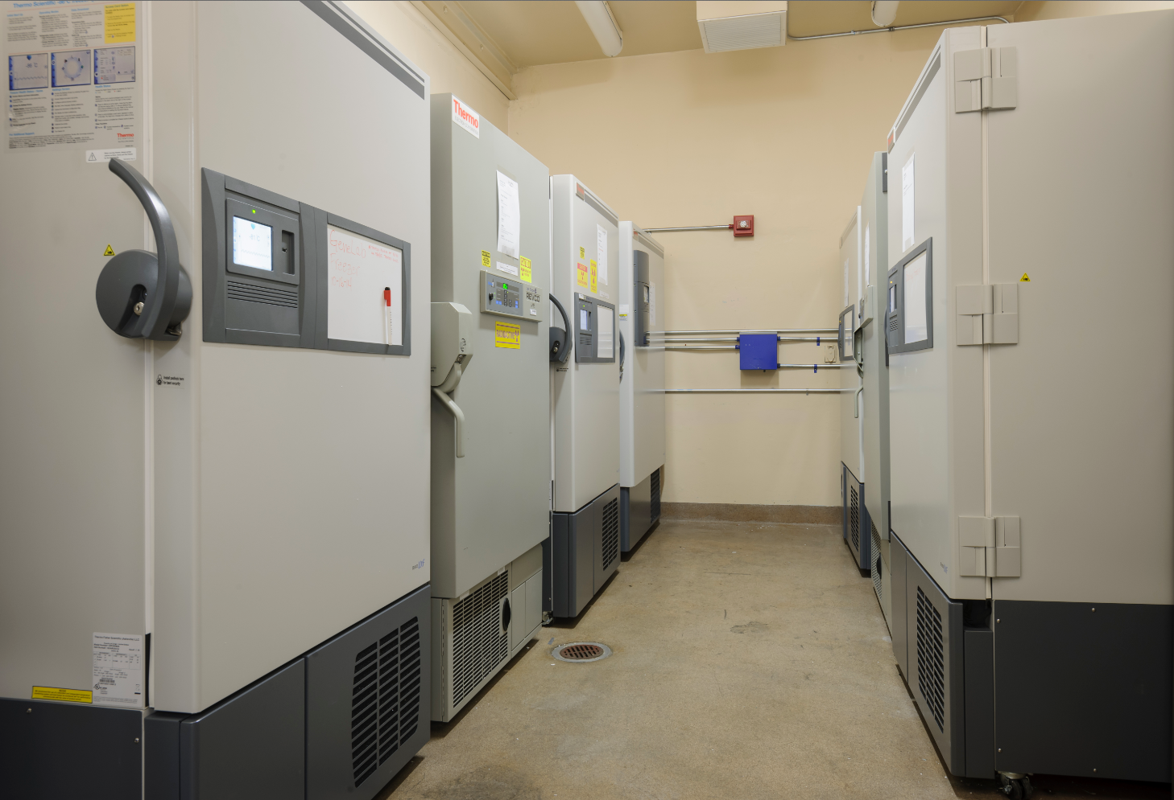
Biospecimen Support Facility (BSF)
The BSF is located in a secure building at Ames Research Center. The BSF maintains fixed and frozen biospecimens collected from space flight and related ground controls. The facility is approved for storage of tissues treated with radioactive isotopes.
Storage: Seven -86ºC Freezers (~21 cu ft. ea). One freezer is maintained as a back-up.
Safety Features: Fail-safe power backup; connected to emergency generator, all units alarmed and monitored 24/7. Emergency procedure on file with the Ames duty office with NASA/contractor call tree for on/off duty hours.
Inventory Management: Secure Filemaker Pro database to collect and preserve tissue information (species, tissue type, fixation, treatment, location, etc.), track location of individual tissues and assure optimum storage conditions. The ALSDA is working with Genelab and TSP to transition to the Cryotrack Inventory Management software.

Slide 13
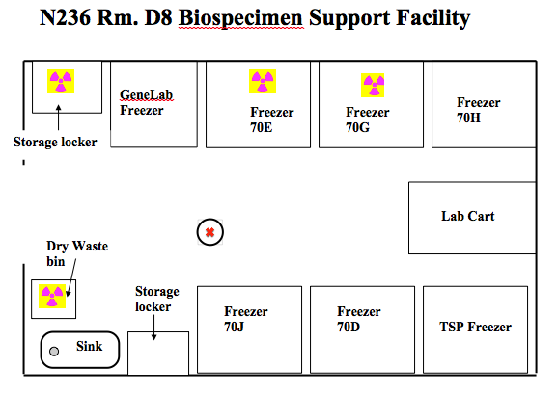

Slide 14
BSF Challenges, Gaps and Next Steps
Facility
ALSDA is currently working on finding suitable housing for the BSF as the current facility is near maximum capacity and many more specimens are on the way.
Outreach
Since the purpose of retaining specimens is for furthering scientific research then it is imperative to continue outreach to the science community so they are aware of this valuable resource.

Slide 15
Questions?

