Slide 1
ARC Life Sciences Data Archive (ALSDA)
International Space Station Operations Center (ISOC)
Collaborative Life Science Repository (CLSR)
Helen Stewart
January 14, 2015

Slide 2
  Contents
LSDA, ALSDA, GeneLab, Human Research Program, Space Radiation Lab, BioSciences & ISSP Space Flight Payload Projects
ARC Life Sciences Data Archive (ALSDA)
International Space Station Operations Center (ISOC)
Collaborative Life Science Repository (CLSR)

Slide 3
Ames Life Sciences Data Archive (ALSDA)
The ALSDA is a node of the NASA Space Life Sciences Data Archive and is responsible for capturing, curating and distributing Ames-managed life science research.
Current holdings include:
  Experiments dating back to the Gemini program
  More than 700 experiments
  Full experiment descriptions, plus some supporting data for those experiments
  Searchable publications list
  Images and Video (historic project) ~3000 each
  Many documents including final reports, safety reports, science requirements, project reports
  Substantial engineering documents and hardware drawings (supported by the Ames Engineering Release Center (ERC))
  ~ 15,000 biospecimens
  Some raw downlink and ground control data streams and much more coming in with research coming from ISS (vs Shuttle where most missions were unique)
  Rodent Research 1 – Nearly curated and soon to be available via LSDA.JSC.NASA.GOV
  Rodent Research 2 – Being curated but mostly private sector so not so much of it online

Slide 4
ALSDA Challenges, Gaps and Next Steps
ALSDA is currently working on finding suitable housing for non-digital holdings and space is scarce at Ames.
Will need to develop link(s) to support Genelab.
Working on resolving long-term storage for commercial experiment data.

Slide 5
Ames Life Sciences Data Archive Structure (Top Level View)
Central Node at JSC
LSDA Website
JSC Firewall
ARC Firewall
Devtool
Various JSC databases and servers
Ames
managed flight/ground experiments*
ARC Node
BSF
Biospecimen inventory*
RDMS
JSC Nodes
Science
Library
ALSDA
Web site
KSC Node
*only these data get transferred to JSC
In planning phase

Slide 6
International Space Station Science Operations Center (ISOC)
The ISOC is a subset of the MMOC and is located in Building 245
Managed by Helen Stewart and staffed by:
Anthony Chan, Sue Blumenberg, Brian Yu, Cameron Milne, and Cedric Priscal. Science Ops: Nancy Rustemeyer
The ISOC has responsibility for:
Commanding the habitat & Capturing ARC data from ISS
Transforming the data for science and engineering use
Hosting live data access
Delivering raw and processed data sets to the archive

Slide 7
ISOC Stakeholders
ARC (ISOC-MMOC)
MSFC (POIC/HOSC/DMC)
KSC (REMA)
CASIS (Various) BioServe (Univ of Colorado) Techshot(Greenville, IN)
PIs (NASA SLPS ) (Various)
Pis (HRP) (Various)
Veterinarians (Various)
Multimedia Mission and Operations, Bldg 8 & Water Refill Rep(JSC)
DoD

Slide 8
s
ISOC reserved
For Cell Science (CS)
And Seedling Growth (SG
Microbial Labs)
ISOC reserved for
Rodent Research (RR)
And Fruit Fly (FF)

Slide 9

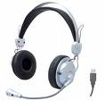
Layout for Rodent Research
MOVE
Table?
MOVE
Engineering Analysis
Science Team
Operations Team
MOVE
MOVE

Slide 10
ISOC Challenges, Gaps and Next Steps
Reduce payload operator fatigue in ISOC e.g., for ARC ISOC SF Payload Operations
  Move majority of Engineering and Science operations into the CLSR (enabling operators to work from anywhere during after-hour events)
Reduce ISOC IT Support after hours
  System monitoring automation processes
  Enhanced exception monitoring and automation of payload archiving for trending data for higher precision science return
    Improve science return turnaround time and science PI fatigue

Slide 11
Collaborative Life Sciences Repository (CLSR)
The CLSR is significant new (FY15) infrastructure to NASA space life sciences
Provided by Westprime, and broker Infozen.
The ISOC team, working with the archive and science ops, implemented a file sharing cloud instance as a means for collecting large live data streams (terabytes per mission) and hosting those video and data files until operational needs are met.
Deployed a 1 Terabyte EC2 Linux instance type c3.xlarge with elastic S3 buckets for storage.
Cloud is Amazon .gov service that provides ITAR/Pii level security.
The ISOC implemented file management software FileCloud which provides:
IT Security Interconnection Agreements meeting FISMA
Registration of domain name, STRAW, …
  Single Sign-On (SSO) - SAML 2.0 solution which utilizes LaunchPad authentication.
Near Real time video collection (onboard and GC) and distribution to Science for daily review via a web interface.

Slide 12
Cloud Benefits Specific to Rodent Research
    The cloud enabled the Science team to perform daily health checks with-out requiring the ops team to support the RODENT console 2X a day, as for RR1.
    Collection and publication of daily Health Check videos from the Habitats to the Cloud allowed the following:
      Ops and Science personnel able to support real-time RR2 ops and meet the RR3 product development schedules during same time frame.
      Allowed use of a surge team of scientists from many different NASA sites availability to aid in the daily review of the animal heath check videos and contribute to RR3 development.
      Able to convey sensitive animal imagery and large video files between RR team members and CASIS PIs conveniently and securely.
      Enabled near real-time access to RR habitat health checks video, habitat environmental data, dissection video, and ISS and SpaceX environmental telemetry. (one stop shop for all forms of data collected during the investigation)
      Enhanced science research project turnaround time significantly by enabling real-time access from anywhere (earlier it used to take PIs 30 days to access TLM & Video for investigation).
      Crew Training personnel at multiple centers using cloud to access videos and develop crew training materials
      Savings:
        Operations resource savings: went from 8-16 hours to 2-4 hours a day (mitigating travel)
        Science turnaround gave science a month head start on investigation
        Veterinary animal health checks from a day to real-time (mitigating travel)

Slide 13
CLSR Challenges, Gaps and Next Steps
Will continue build-out of this relatively new service
Explore bio-informatics and decision tools to incorporate contingent on science and payload project needs

Slide 14
Rodent Research TLM Video Distribution Implemented RR3 CASIS Configuration
Ku-Band
Video filtered by UDP Port address
All Video Data to JSC
White Sands
All Video Data to MSFC
Video filtered by UDP Port address
All Video (Payloads and Ops video)
MCC-H Internal Distribution
“HOSC Distributed Video”
POIF Viewing
POIC Video Decoders & Matrix
Payload Data Service System (PDSS)
MPEG-2 Video
MCC-H
Command & Data Processor (CDP)
MCC-H
Video Switch
ESA Gateway
Dump 2
ASI Gateway
Unprocessed real-time and dump payload video (real-time & playback requests)
JAXA Gateway
Other?
DMF
(2 Year Retention)
MCC-H
HOSC Distributed Video to Payload Developers:
1. Privacy (user access controlled)
2. No quality loss (user access to ‘raw’ video)
3. Future distribution
JSC Building 8
Public Affairs
Live Stream SD (Habitat)
Live Stream HD (Science)
JSC Building 8
Video Control Center
Building 8 Video Switch
JSC Institutional Distribution
Outside JSC
HOSC
Payload Developer (RR Team)
Ames
Recorded Video (Health Check)
NISN Gateway
(JSC Building 17)
Russian Gateway
KSC
REMA/ RR Sci and PI personnel
MMOC/RR Ops personnel direct Crew actions. Use VLC to record live downlink video and push to web.
PROCESS is
AUTOMATED
SDI/MPEG Multicast
Greenville, IN
Ames
Video Review, Video Reduction, Cataloging
Techshot (Densitometer Only)
MMOC Submits DSRS (DSM) Request for LOS and Health Check Video Files
“Peering Point”
Permanent Archive
Ames
Boulder, CO
MMOC/Web Stream Video on Secure internet site**
Univ. of Colorado Control Center (BioServe)
Ames
MMOC/RR Ops personnel collect files and upload to cloud once a day
CSA
Peering Point:
1. No privacy (multicast to all users)
2. Low quality (multiple encode cycles)
3. To be phased out
DIMS
Future FTP Capability
MSFC
Legacy Payload Developers
Other NASA Centers
Ames
Veterinarians,
Remote Sci & Ops
MMOC Submits Imagery Dub Request** (if ever needed)
KSC
Recorded Ground Control Health Check Video
Life Science
Cloud (Ames)**
Live video restriction
application point
**Requires Pre- approved Access

Slide 15
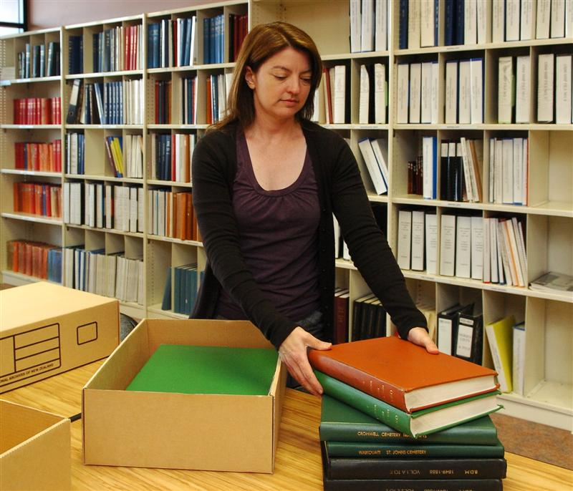


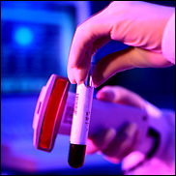
Current ISOC/ALSDA Data Flow
ISS Program/HRP/SLPs
Secure Internal Links
External Links
HRP
JSC ISS Image & Video Lab & Archives
Bldg. 8
JSC LSDA DB & Archives
ARC ISOC/HOSC PDSS
Rodent Research
Payload On Orbit &
Ground Data
ISS Program
Public Published
ARC Gene Lab
Repository
ISS Program
Cell Science
Fruit Fly
TLM &
Video
Seeds
Science Operations
Public Cloud
Public Published
ALSDA/ ERC
Internal Cloud- Not Public
Collaborative Life Sciences Repository (CLSR)
ALSDA RDMS
ERC
DB
Project Investigators
Scientists
Veterinary Services
ARC
SLPs/HRP
LSDA
Biospecimen
Storage
Facility
Cryotrack
Human Health Counter Measures
Tissue Sharing
Proprietary
National
Labs
CASIS commercial partners –DOD
Genelab Sample Processing
Publications
Returned SF payload
Specimens

Slide 16
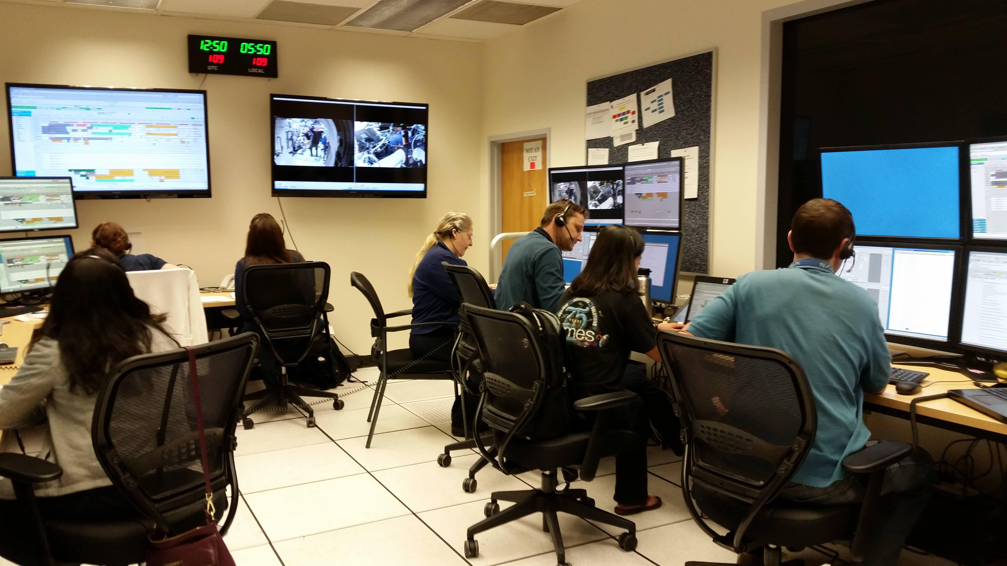
ISOC Distributed Real-time and Near Real-time Operations
Rodent Research-2 teams at ARC and MSFC are all smiles as the first on-orbit science operations for Rodent Research-2 (CASIS) were successfully completed ahead of schedule, Cloud for post processing completed.

Slide 17
Questions?

Slide 18
BACKUP SLIDES

Slide 19
Life Science Cloud Development Phases
 | RR1 (SpX4?) Validation Investigation (2 Flight /2 GC Habitats) | RR2 (SpX6) CASIS (2 Flight /2 GC Habitats) | RR3 (SpX8) Eli Lilly (2 Flight /2 GC Habitats)
CLOUD PHASE | No Cloud | 1 (Windows Server) | 2 (Linux Server)
IMPLEMENTATION DATE | N/A | April 2015 | December 2015
Remote access capability (NASA network access required) | None | Access to cloud and HC videos from any computer | Access to cloud and HC videos from any computer
Secure user retrieval of large video files | Video files transferred user to user via LFT email on a as needed basis. | Users able to access and play video files on cloud. Cloud File folder level access control only. | Users able to access and play video files on cloud. Cloud graphical user interface. Stronger user access and privileges control.
Health Check (HC) Video Availability | Live restricted ISS video (within the MMOC only) | 5 to 7 hours after live recording ends. (Cloud) | Available minutes after live recording ends. (Cloud)
Upload of Files to Cloud | N/A | Admins only | User and Admins
Encryption and Security | N/A | No SFTP capability | Secure services and scans, SFTP capability
Science Personnel Support | Real-time (live) support required 2 X daily in MMOC at Ames | Remote access to HC video, allowed additional scientists to support from KSC, JSC and Ames | Remote access to HC video, allowed additional scientists to support from KSC, JSC and Ames
Ops Eng & ISOC Personnel Support | Real-time (live) support required 2 X daily in MMOC at Ames | No Ops team support required. ISOC team required to transfer & compress HC video files daily. | No Ops or ISOC team support required. Automated HC video file transfer from ISS and GC Habitats to the Cloud
Team fatigue and ability to support other tasks | Fatigue: high Task support: not possible | Fatigue: significantly reduced Task support: ability to develop some products for next mission. | Fatigue: minimized Task support: ability to develop products for next mission.
Estimated Man-hours (m-hrs) required to support daily Health Checks | 1- 4 hour support X 2 HC a day X 2 people for ~ 8 mhrs of real-time support on average every day. TOTAL: ~ 8 to 16 m-hrs/day | Science: 1 hr/day per Habitat to review HC video. (less time required if fast forwarding through video) ISOC: 1 hr/day per Habitat to transfer & compress HC video files. TOTAL: ~ 6 to 8 m-hrs/day | Science: 1 hr/day per Habitat to review HC video. (less time required if fast forwarding through video) TOTAL: ~2 to 4 m-hrs/day

