Slide 1
Lifetime Surveillance of
Astronaut Health (LSAH)
Mary Van Baalen, PhD

Slide 2
The primary aim of the LSAH is “to investigate and describe the incidence of acute and chronic morbidity and mortality of astronauts and to determine whether the unique occupational exposures encountered by astronauts are associated with increased risks of morbidity or mortality.”
LSAH/Epidemiology Team:
  Mary Van Baalen, NASA, Manager
  Binaifer Kadwa, NASA,
  Mary Wear, Wyle, Discipline Lead
  Lesley Lee, Wyle, Project Lead
  Epidemiologists: 4 PhDs and 6 MPHs
  Biostatisticians: 2 PhDs and 1 MPH Biostats/Epi
  Science Coordinators: 3 BS
  Other Staff: 2 Medical Coders, 2 Data Entry, 1 Admin.

Slide 3

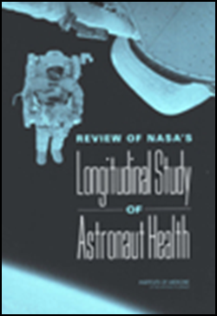
Reviews by Institutes of Medicine concluded:
NASA must serve two sometimes conflicting goals of research and occupational surveillance...
No comparison group can meet every goal or need, it should be individualized...
Increase the quality and quantity of preventive care to increase the data...
NASA should assume responsibility for the lifelong health care of its active and former astronauts.
Longitudinal Study of Astronaut Health (Research Study)
  Two phases, analyses of medical exam data on astronauts with JSC civil servant workforce as controls
  Problems with comparing the two populations increased over time
2001
2004

Slide 4
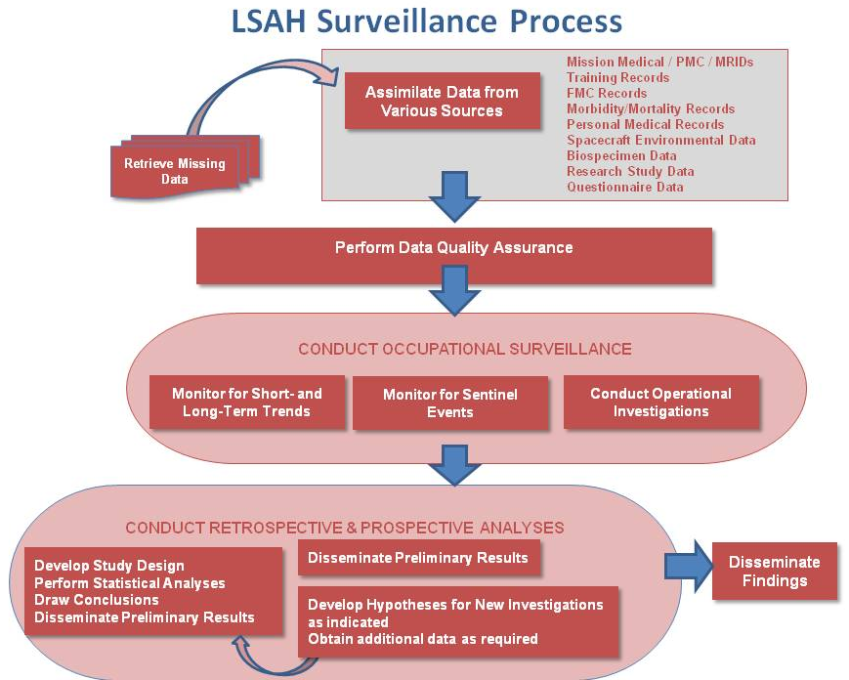

Slide 5
  List of stakeholders including supported projects:
HEOMD
OCHMO
Human Research Program & Investigators
Crew Health & Safety
Astronaut Occupational Health Project
NASA & IP Clinicians
ISS Program and Commercial Crew
HHPD Internal Orgs (e.g., Biomedical, Environmental Labs, Clinic, etc.)
Other Functional Orgs (e.g., EVA, ECLSS, Engineering, etc.)
Human System Risk Board and Risk Custodians, Evidence Base
Academia / Data Requesters
Astronauts and Retirees

Slide 6
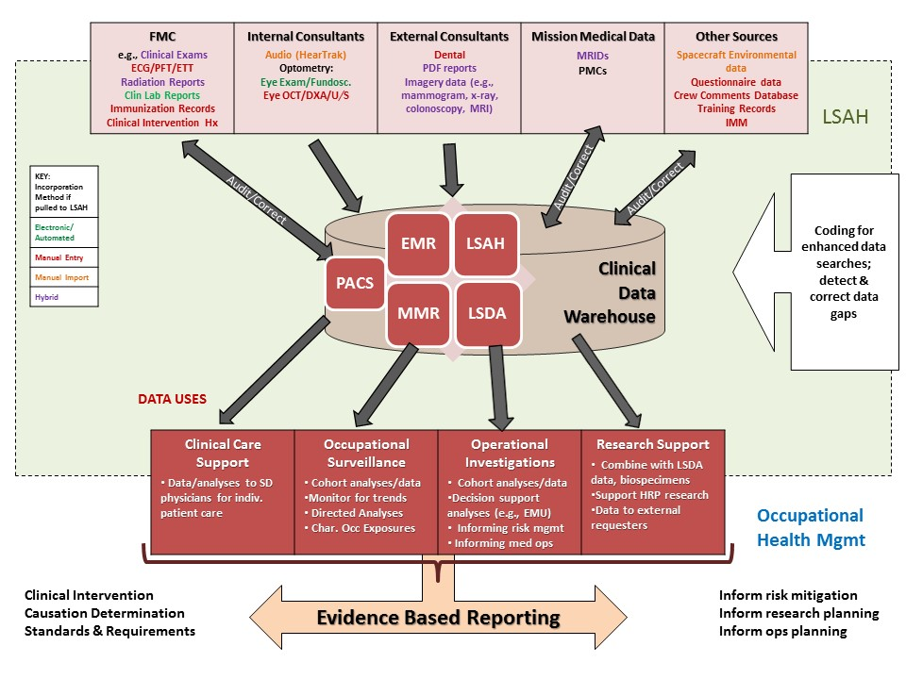

Slide 7
Development of Data Request Process
With fewer astronauts flying, there is increased need to optimize use of retrospective data contained in the archive systems
  Previously, there was limited cross-pollination of medical and research findings
  Where applicable, analyze medical data alongside research data to better understand spaceflight physiology, health, and performance issues
NASA direction in 2010 to develop processes for release of retrospective medical and research data while protecting astronaut privacy
Socialization of this new capability within SA and at HRP IWS began in late 2010, before many processes were in place
  Created unrealistic expectations
  As processes worked out, new data requests challenged our thinking and systems

Slide 8
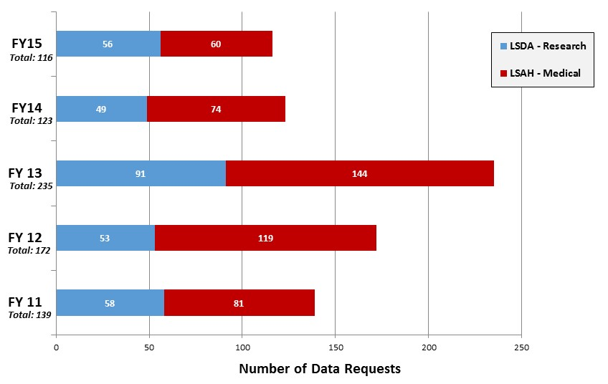
Processed Requests for Astronaut Data by Fiscal Year
Notes:
This slide is illustrating the need for data. In FY 11, 12, and 13 we saw a increasing need for small, de-id data sets. These data sets allowed many initial analyses to be conducted. In FY 14 and 15 we saw the increase in complexity of data sets. Large multi-aim studies were proposed using retrospective data. In more than 20% of the LSAH data sets released there were 1M+ data fields for each aim. In one cardiovascular study data was provided for all astronauts longitudinally for all annual exams as well as in-flight data. With these types of studies NASA is able to evaluate the human system risks with larger subject numbers than previously obtained with flight studies. Subject numbers greater than 50 have been obtained for most of the VIIP studies.

Slide 9
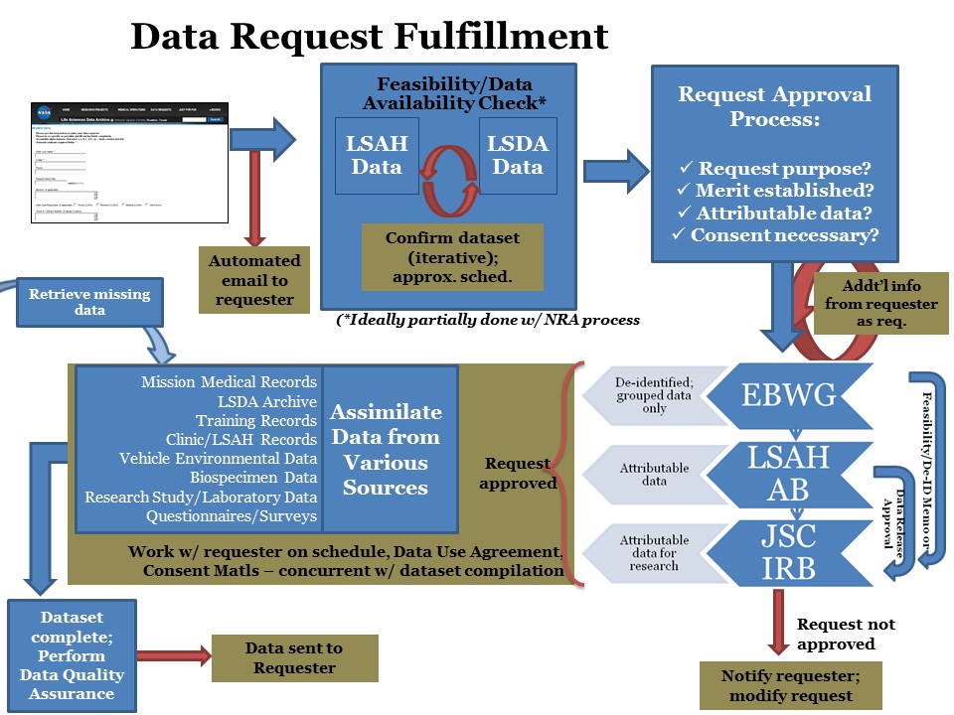
Data Request Fulfillment Process

Slide 10
Retrospective Data Request Process
Data Request Received via lsda.jsc.nasa.gov portal
Understand & Verify Data Set
NASA Approval Processes
Data Compilation & Audit
Can data be grouped, de-ID’ed?
Iterative communication w/ requester on data available/needed
Products: final, verified data set; feasibility/de-ID letter to the IRB to facilitate ‘exempt’ protocol review
Vetting of requester, science merit, funding, resource priorities
Reconciliation of records
Approvals may be required by:
Evidence Base Working Group
AOHMG
LSAH Advisory Board
JSC IRB
Resolve hardware/ software incompatibilities
Retrieve missing data
Mask identifiers
Notes:
I would walk through the process describng the three big steps ending with the focus on the data compilation and audit process.

Slide 11
Data Request Received via lsda.jsc.nasa.gov portal
Following request submission, an iterative process between the assigned Epidemiologist/ Archivist(s) and the Requester(s) begins
  Usually 4 – 5 conversations required to determine all data needed, timeline for data release and final data products
      Do we have the data?
      Review of variables being requested vs scientific aims, hypotheses
      Discussion of variables that are more difficult to compile and need clarification
  For instance, requester asks for heart rate and blood pressure (systolic and diastolic) for the exercise stress test
        HR, SBP, and DBP readings every minute for 10 minutes prior to the exercise stress test,
        HR, SBP, and DBP readings during every minute of the exercise stress test (average length 10 minutes)
        HR, SBP, and DBP readings every minute for 8 minutes following the stress tests
        Requester potentially asking for 84 variables that are needed to fulfill two data concepts requested
Understand & Verify Data Set
Can data be grouped, de-ID’ed?
Iterative communication w/ requester on data available/needed
Products: final, verified data set; feasibility/de-ID letter to the IRB to facilitate ‘exempt’ protocol review

Slide 12
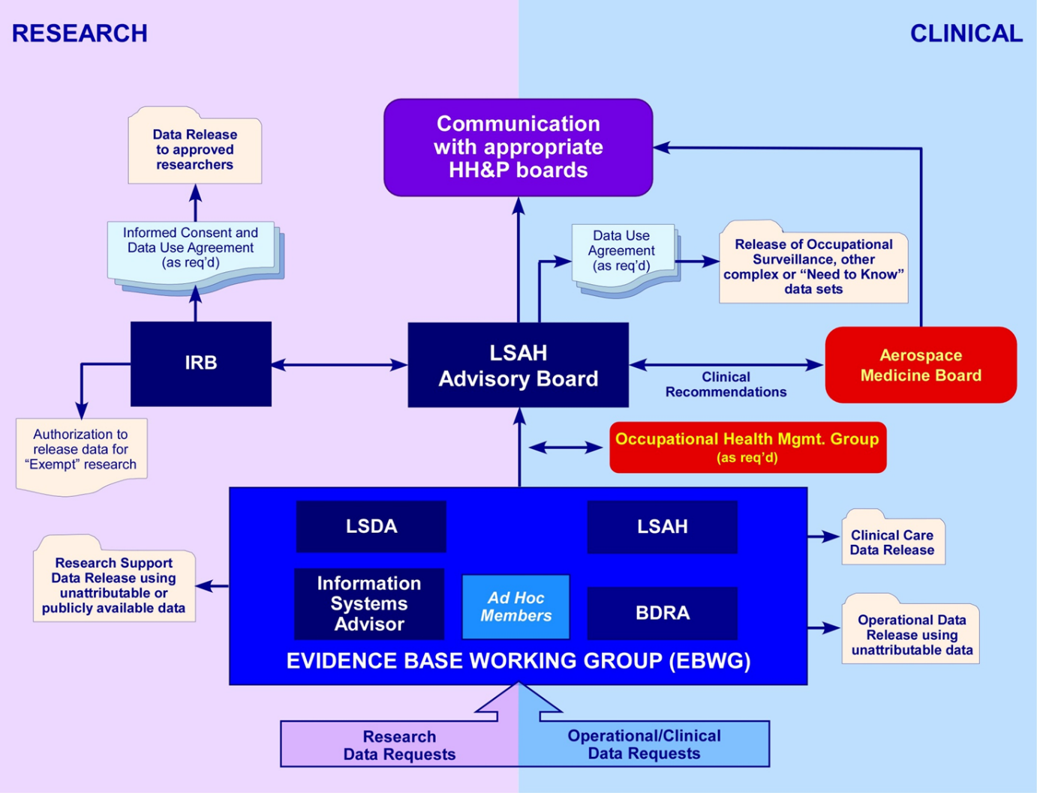
NASA Approval Processes
Vetting of requester, science merit, funding, resource priorities
Approvals may be required by:
Evidence Base Working Group
AOHMG
LSAH Advisory Board
JSC IRB

Slide 13
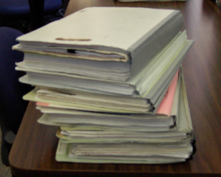
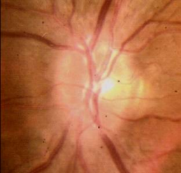
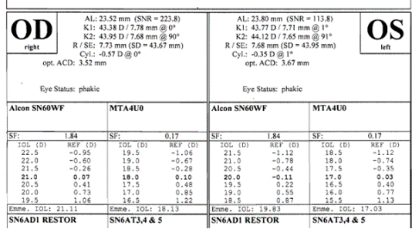
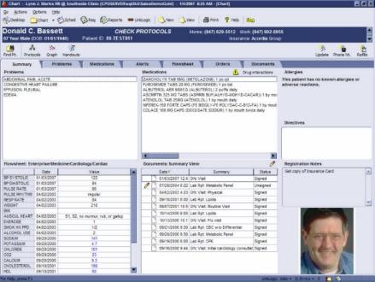
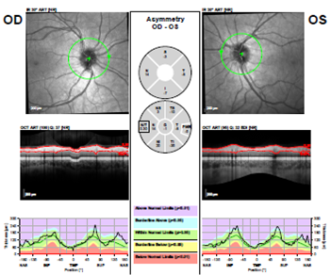
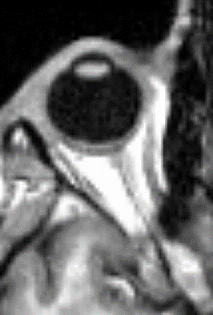
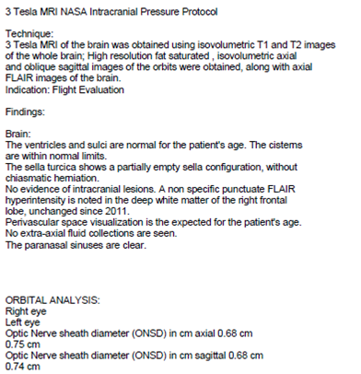
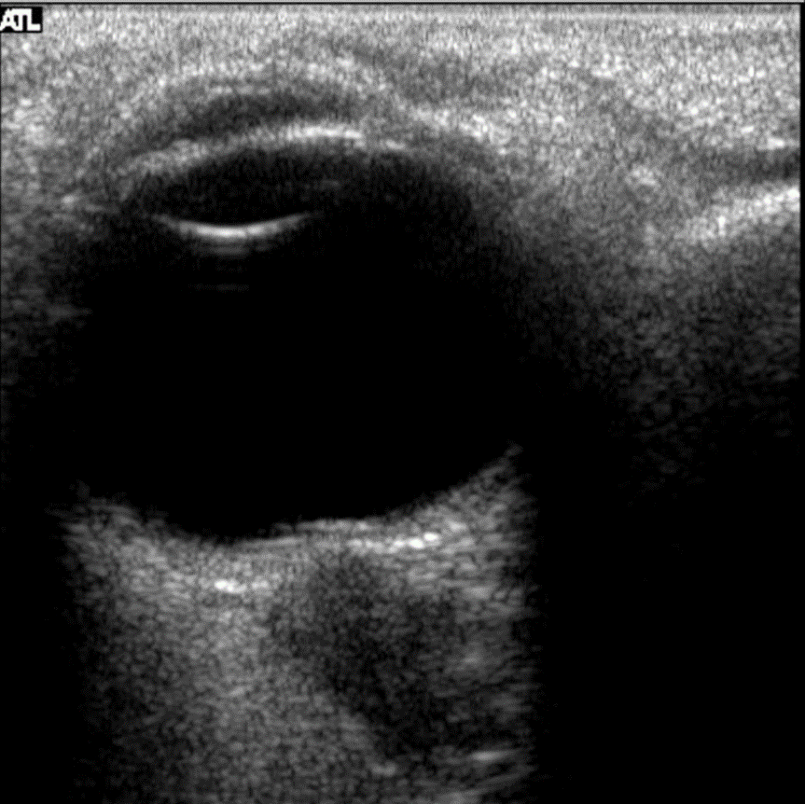
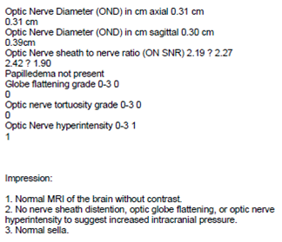
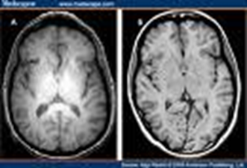
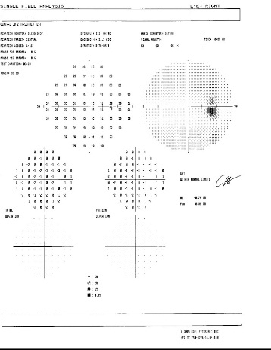

Data Compilation & Audit
Reconciliation of records
Resolve hardware/ software incompatibilities
Retrieve missing data
Mask identifiers
Notes:
Transformation of data from a variety of paper, PDF, and electronic queriable/non-queriable sources

Slide 14
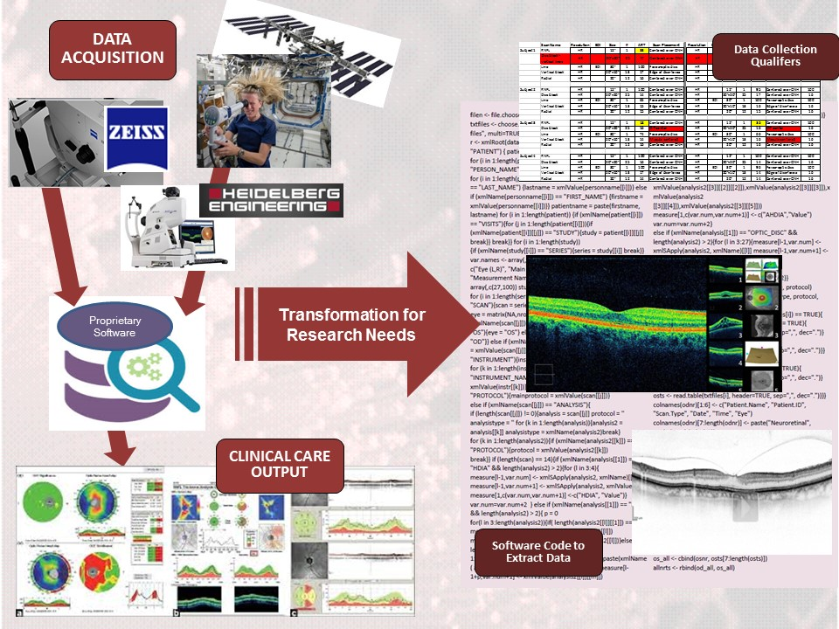
Challenges of Data Transformation

Slide 15
  Next Steps – Same as LSDA PLUS
Key Issues –
  Data privacy in the age of Omics and subject consent
  Curation and use of human biospecimens
  Location of human Omics data archive and the increased storage capacity requirements
  Search capabilities and data analytics capabilities
  Manual nature of combining Omics data with medical testing data
Questions –
  What is NASA’s plan for housing the volume Omics data?
  What analytics tools are Genelab researchers using? Who has access to these data and tools?
  Is dbGaP being considered a possible storage site for human spaceflight Omics data?
  Potential interfaces with other archives?
Desired Take Away from this TEM
  Learn who the Data Systems players are and their goals
  Understanding of the scope of Genelab
  Development of a strategic plan for integration of repositories
  Sharing of Lessons Learned
  Format of Omics data for archive and searching purposes
Future Plans
  Continued improvements to data accessibility
  Supporting studies funded under the new HRP Translational Research Institute
  International Data Sharing

Slide 16
Questions?

Slide 17
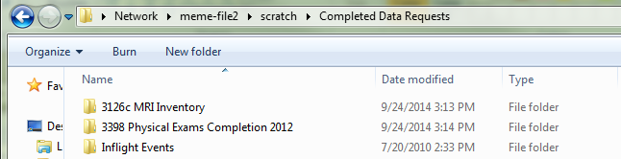
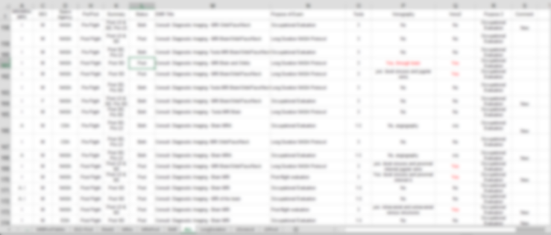
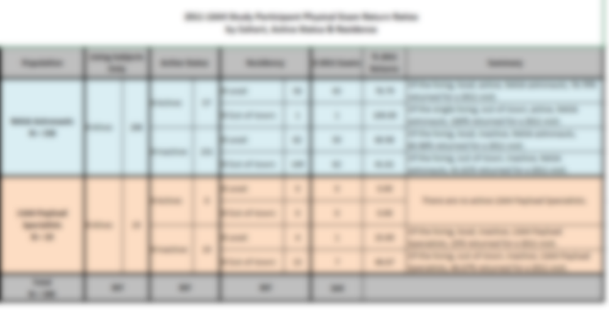
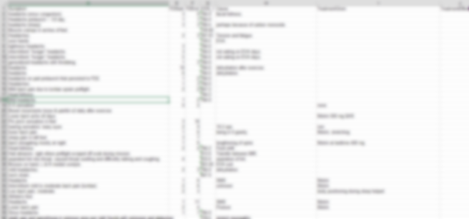
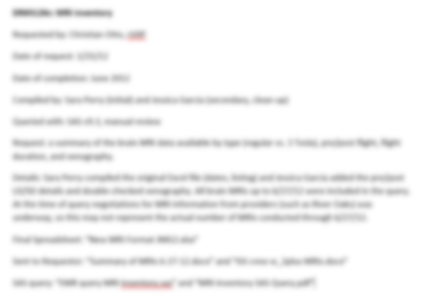
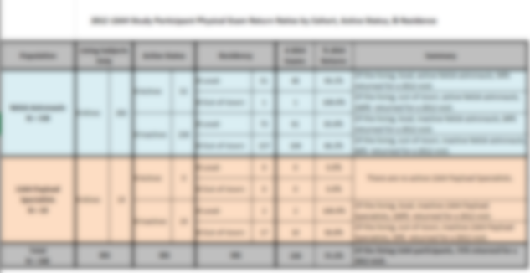

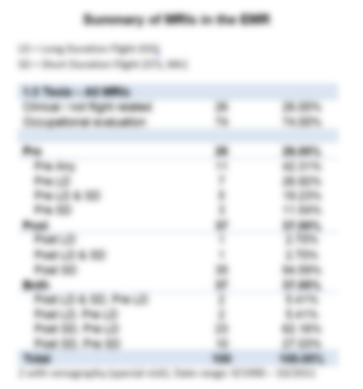
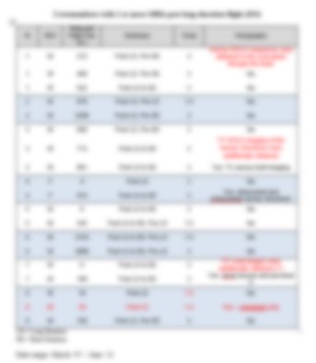
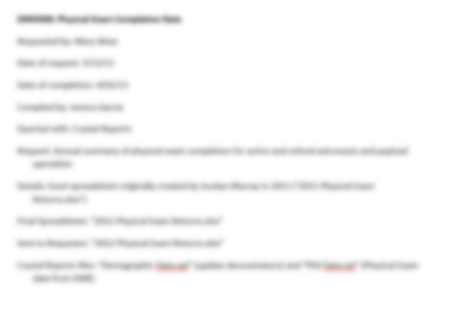
2 Excel Files
1 Word Document
2 Crystal Reports
1 Excel File
3 Word Documents
1 SAS program
1 Excel File
1 Text Document
If each DR averages 3 files, then potentially:
FY14: 222 files
FY13: 432 files
FY12: 357 files
FY11: 243 files
______________
Total: 1254 files
Notes:
The “Completed Data Requests” folder on scratch (created 5/17/11) contains 3 folders. Two are examples from Jessica, one other from Sara. The format is open to interpretation as Jessica labeled her folder with DR#s and Sara’s contains no context for the data set nor DR#. Additionally, the data in Sara’s spreadsheet doesn’t seem to correlated well with the name of the folder/files; her “Readme” file contains no contextual information.
Nobody is every going to sift through thousands of files to potentially find useful information. Most Epis would just start from the beginning and pull the data fresh. The file- and folder-based system isn’t amenable to data sharing without a way to easily query supporting documentation or look for specific column names.

