Slide 1
Life Sciences Data Archive
DeeDee Thomas
LSDA Project Lead (JSC)

Slide 2
  Project Description and Scope
The LSDA is a collection of NASA’s life sciences research data and information, consisting of human, animal, microbe, and plant studies conducted from 1958 to present. The LSDA has archive offices at ARC and JSC and the KSC office has recently been reestablished.
  The ARC office has primary responsibility for the preservation of plant, microbe and animal research information and data, and has the added responsibility of maintaining the Biospecimen Sharing Facility.
  The JSC office has primary responsibility for the preservation of human research information and data. The JSC office also has the additional responsibility of maintaining the central databases, the public website, and associated data management infrastructure.
  The KSC has primary responsibility for the preservation of the plant studies.

Slide 3
  Project Description and Scope
The LSDA is also a NASA JSC Institutional Review Board (IRB) approved repository. The purpose of the LSDA Repository (LSDA-R) is to enable the distribution of archived human research data and information beyond the purpose for which the data was originally collected.
  The LSDA-R and the Lifetime Surveillance of Astronaut Health Repository (LSAH-R) house the evidence base for the Human Health and Performance Directorate (HH&P).
  Collectively, the repositories provide reusable data to researchers and establish permanence of NASA’s research and medical data collections.
The LSDA-R also encompasses the Biospecimen Sharing Program (BSP), managed at ARC, which provides the scientific community with access to NASA's inventory of non-human biological materials from organisms that have either flown in space or have been included in related ground control studies.

Slide 4
  Stakeholders and Supported Projects
The primary customers of the LSDA are the Human Health and Performance Directorate (HHPD) at JSC and the Space Biosciences Division at ARC, and their research communities.
  LSDA supports these organizations by collecting, maintaining, and distributing the data generated by the various NASA-sponsored life sciences flight and ground-based projects.
  LSDA personnel work with the researchers and sponsors to determine the scope of the data and information to be archived.
  Other customers include the Crew Health and Safety office, the Human Space Flight Program offices, and the general research community.
  JSC Institutional Review Board
Within the HHPD, we directly support the following projects:
  Human Research Program and its Science Elements
    Behavioral Health and Performance, Exploration Medical Capability, Human Health and Countermeasures, Space Human Factors and Habitability, and Space Radiation
  The International Space Station Medical and Flight Analogs Projects (ISSMP and FAP)
  The Program Science Management and International Science Offices
  The Lifetime Surveillance of Astronaut Health (LSAH) Project

Slide 5
Archiving Requirements
LSDA has worked with HRP to communicate the requirement to archive early and often:
  Applies to NASA-funded investigations and is explicitly stated in the following Documents:
    Solicitation documentation
    Proposal Award Letters
    Authority to Proceed Letter (for directed research)
  Data Submission Agreements (DSA):
    The DSA establishes an agreement between the LSDA, HRP Element Scientist or Space Biology Project Manager, and the investigator on the data format and timeframe for data submittal to NASA.
    The DSA is initiated as soon as possible after the research is funded.
  Recognition of the Investigators’ Right of First Publication
    Investigators should be aware that any results published in peer-reviewed scholarly publication that are based on research that directly arises from federal funds must be submitted to NASA as part of their grant or contract obligation.

Slide 6
LSDA Data Management System
DevTool
  Primary Data Entry Modules: Mission, Experiment, Personnel, Hardware, Biospecimens, Subjects, Datasets, Documents, and Photo Gallery
  Load ID Tool – Primarily used for Archivist to migrate content from the pre-production systems to the public website.
  Crew Consent Tracking Tool
    Used to generate repository consent documentation
    Linked to the experiment and personnel modules
Life Sciences Data Warehouse
  Secure Data Submittal and Distribution Tool
  Recently modified to accommodate ISSMP International Data Sharing
  Includes the Bar Code Database
Public Website
  Main distribution mechanism for unrestricted data and information
  Data Request Module
    Publicly Available – requests received from across the globe
    Submittals routed to the DevTool for initial vetting
    Legitimate requests transferred to the SharePoint-based data request tracking tool

Slide 7
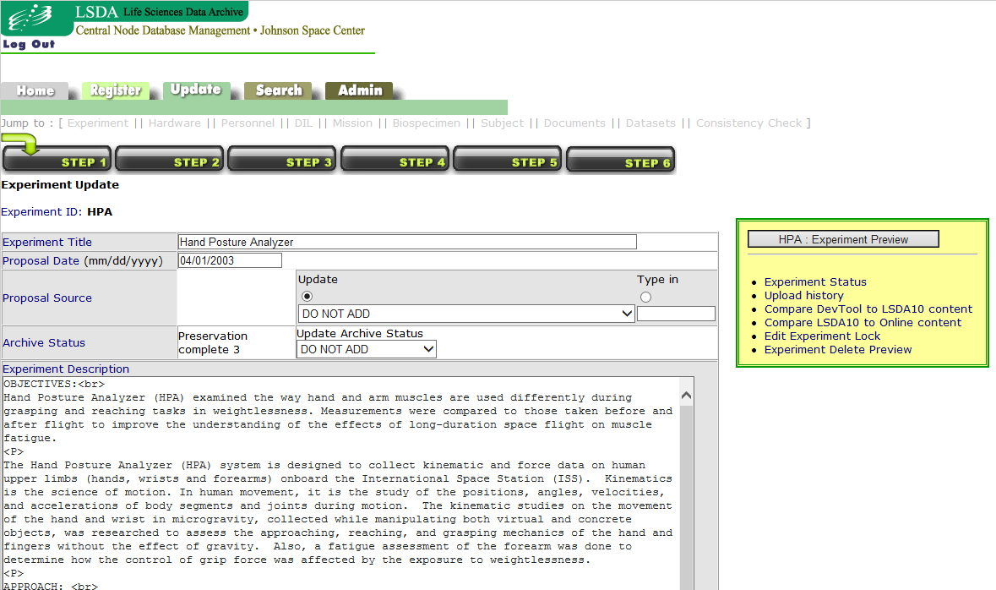
DevTool (Data Entry Interface)

Slide 8
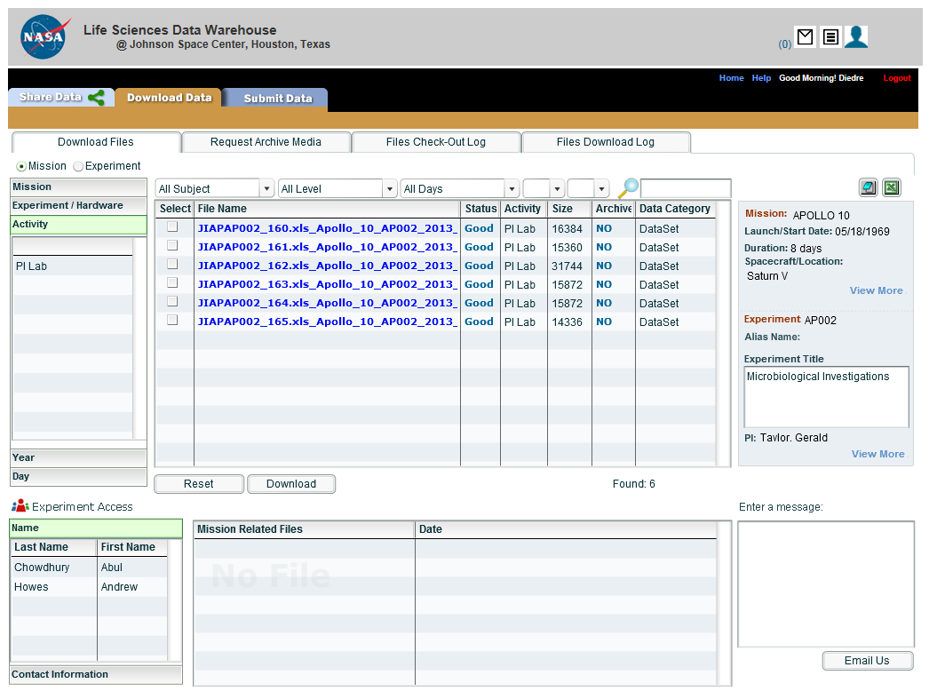
Life Sciences Data Warehouse

Slide 9
    LSDA IT Applications
Experiment Data Flow
Mission/Experiment
Metadata Entry
LSDA
Public Access
DevTool
rLSDA
Restricted Access
Flight Mission/Experiment Metadata
TSC
Flight Telemetry Data
Experiment Data Files (Restricted)
LSDW
(Restricted Access)
Data Producer
(PI, labs, etc.)
Experiment Data Files (Restricted)
Data Producer
(Off-site Facility )
Ancillary data files (Restricted)

Slide 10
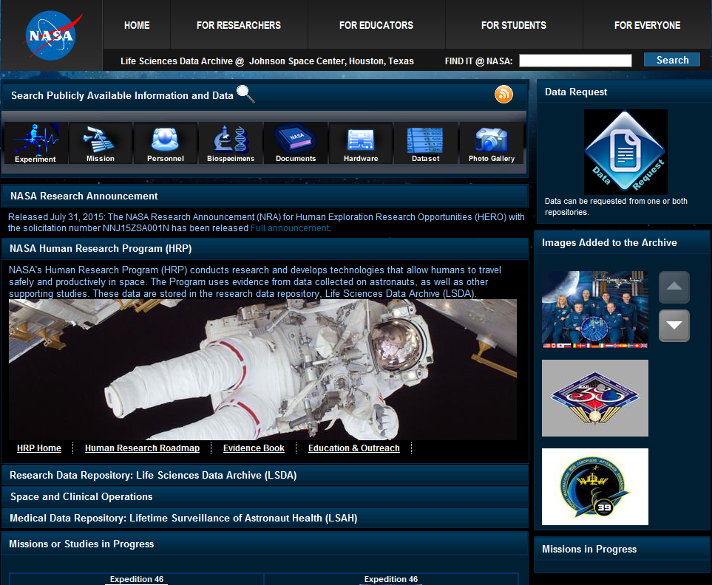
LSDA Public Website (https:\\lsda.jsc.nasa.gov)
Archivists:
Peggy Delaney
Tracie Finkle
Charlie Warren
IT Systems and Software:
Abul Chowdhury
Jeannette Darcy
Daniel Febus
Andrew Howes
Tim Watlington
Technical Monitors:
Mary Van Baalen (Archive and Distribution)
Ken Jenks (Systems)

Slide 11
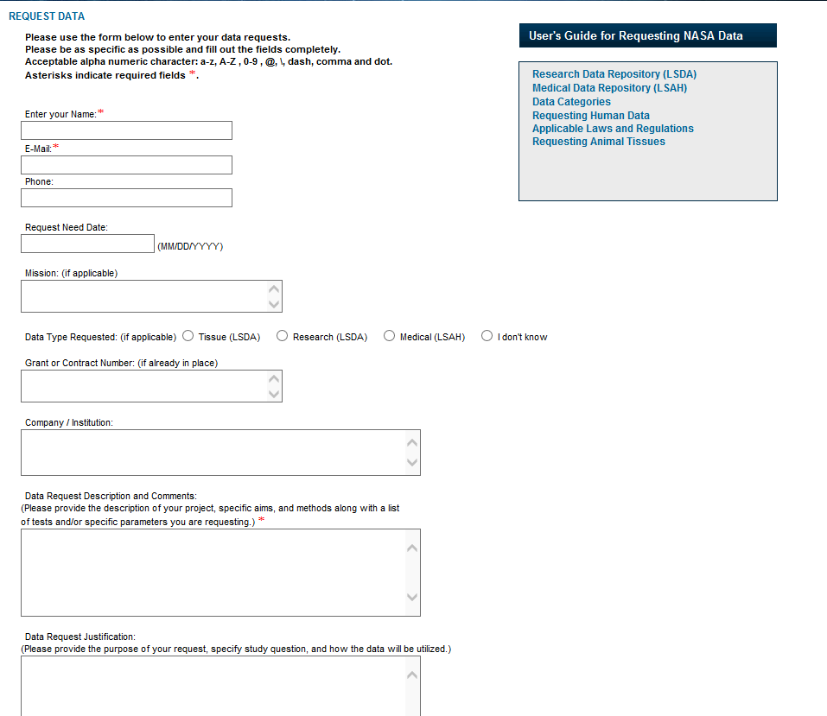
Data Request Portal

Slide 12
Reuse of Archived Data
LSDA and LSAH work jointly on Requests for Research and Medical Data
  The data request portal is accessible to the general public from the LSDA public website (https\\:lsda.jsc.nasa.gov)
  Requesters are vetted to ensure release of data is to legitimate researchers or students working on research projects
  Established two working groups to review the requests to ensure the right data is being released
    Evidence Base Working Group (civil servant and contractor members)
      EBWG is the clearinghouse for all incoming data requests
      Releases public or un-attributable data
      Facilitates data requests through approval processes to release
    LSAH Advisory Board (all civil servant members)
      Reviews all requests for attributable data (except clinical care)
      Other requests forwarded to the board by EBWG
      Requests where NASA policy is not yet determined
  Works closely with the IRB to document the proposed study and the data to be released, and in what format (de-identified, coded, or attributable)
  Subjects are consented by repository personnel for reuse of their medical and research data (genetic data and human samples are excluded)

Slide 13
Categories of Data Release
Clinical Care
  NASA Physicians requesting data for direct care of patient(s)
Occupational Surveillance
  Identify trends in data or adverse health outcomes related to spaceflight and spaceflight training
    Examples: CO₂ exposure and medical outcomes; Visual Impairment/Intracranial Pressure (VIIP) syndrome characterization
Operational Investigations
  Address specific NASA programmatic or decision support needs
    Example: EVA suit injury – ISS Program refurbishing NBL suits, asked for analysis of de-identified injuries and association with pivoted vs. planar Hard Upper Torso (HUT)
Research
  Generally hypothesis-driven investigations
Notes:
IRB review of research proposals

Slide 14
  Next Steps
Key Issues
  Data privacy in the age of Omics and subject consent
  Curation and use of human biospecimens
  Location of human Omics data archive and the increased storage capacity requirements
  Search capabilities and data analytics capabilities
Questions
  What is NASA’s plan for housing the volume Omics data?
  What analytics tools are Genelab researchers using? Who has access to these data and tools?
  Is dbGaP being considered a possible storage site for human spaceflight Omics data?
Desired Take Away from this TEM
  Learn who the Data Systems players are and their goals
  Understanding of the scope of Genelab
  Development of a strategic plan for integration of repositories
  Sharing of Lessons Learned
  Format of Omics data for archive and searching purposes
Future Plans
  Continued improvements to data accessibility
  Incorporation of studies funded under the new HRP Translational
  International Data Sharing

Slide 15
Relevant Websites
NASA Plan for Increasing Access to the Results of Scientific Research: http://www.nasa.gov/sites/default/files/atoms/files/206985_2015_nasa_plan-for-web.pdf
LSDA public website: https://lsda.jsc.nasa.gov
Human Research Program: http://www.nasa.gov/hrp/
HRP Human Research Roadmap: http://humanresearchroadmap.nasa.gov/
Task Book: https://taskbook.nasaprs.com/Publication/welcome.cfm
NIH database of Genotypes and Phenotypes (dbGaP): http://www.ncbi.nlm.nih.gov/gap

Slide 16
Backup Slides

Slide 17
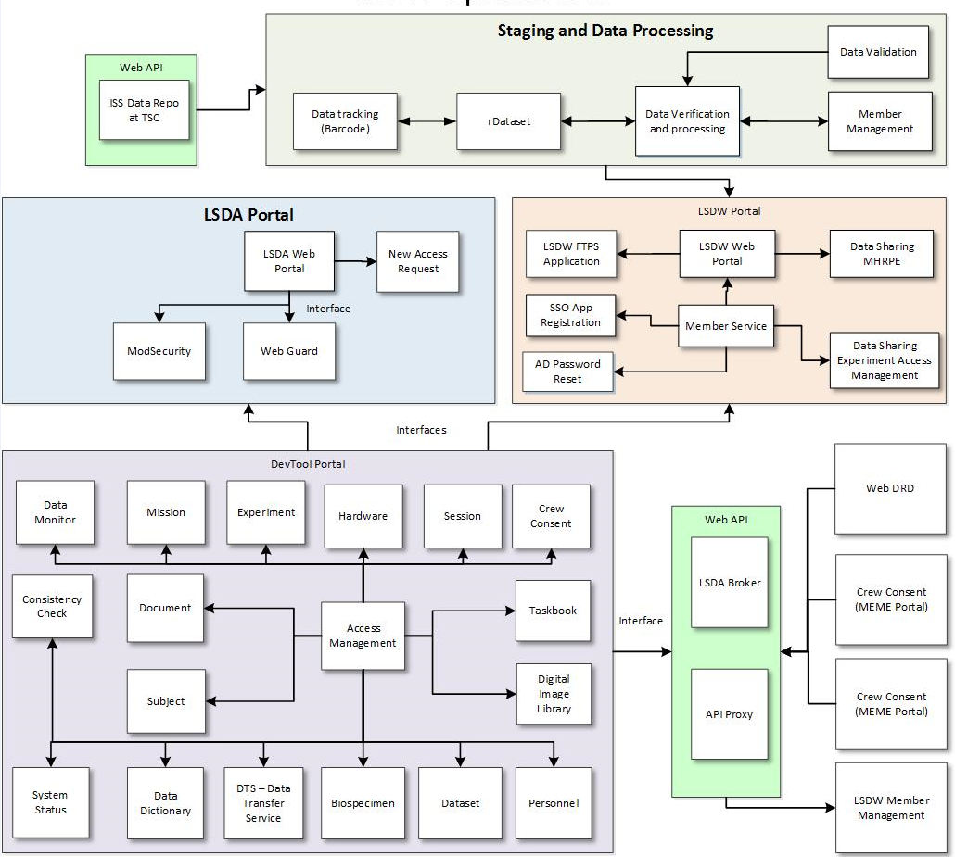
LSDA Operations

Slide 18
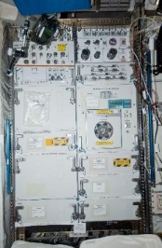

  TSC Operations
ISS
HRF Rack
HRF PC
Experiment Data via Common Software by TSC Ops Team
Space Station Computer (SSC)
HRF Health & status
Via ISS RT Telemetry
Experiment Data via DCT Downlink by MedOps Team
Experiment Photo and Video Data via OCA Downlink by OC at the POIC
White Sands
HOSC / POIC
JSC MCC
JSC TSC
TSC Restricted DCT folder
TSC Restricted OCA folder
JSC TSC WebMirage DB and Archive
JSC LSDA DB and Archive Warehouse

