Slide 1
Software Helen Stewart Logistics, Agenda, and Purpose

Slide 2
Logistics
LSDA, ALSDA, GeneLab, Human Research Program, Space Radiation Lab, Space Life & Physical Sciences Research and Applications Program & ISSP Space Flight Payload Projects
Emergency Exits
Center Map
Lunch
Schedule

Slide 3
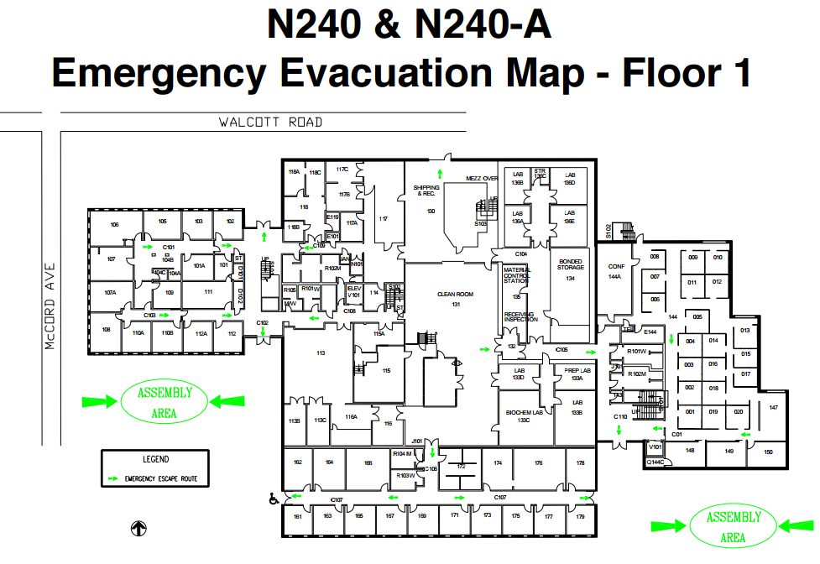
LSDA, ALSDA, GeneLab, Human Research Program, Space Radiation Lab, Space Life & Physical Sciences Research and Applications Program & ISSP Space Flight Payload Projects

Slide 4
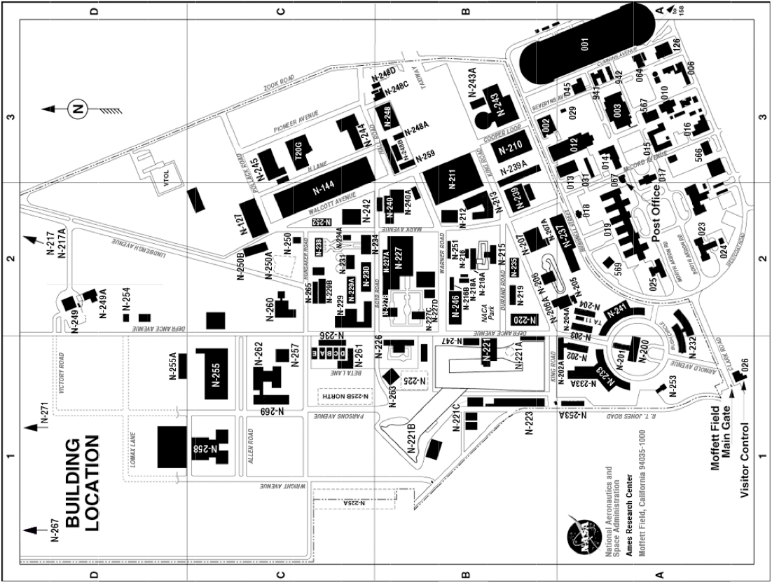
LSDA, ALSDA, GeneLab, Human Research Program, Space Radiation Lab, Space Life & Physical Sciences Research and Applications Program & ISSP Space Flight Payload Projects

Slide 5
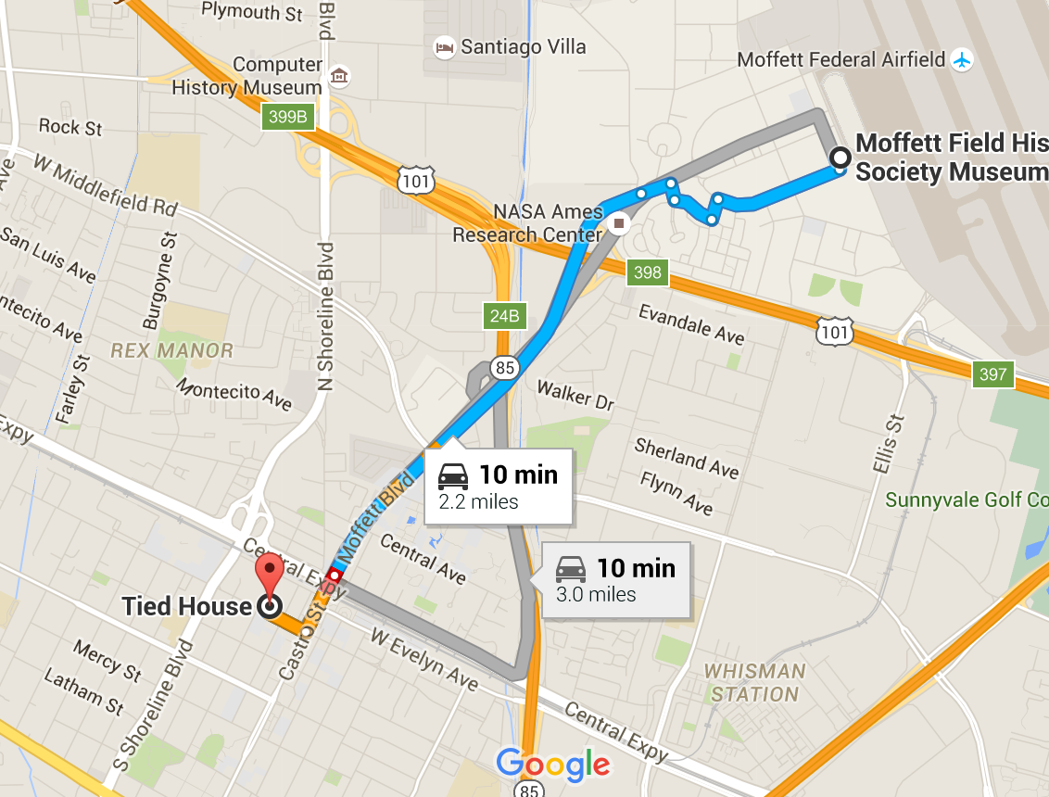
Lunch and After Hour Gathering
LSDA, ALSDA, GeneLab, Human Research Program, Space Radiation Lab, Space Life & Physical Sciences Research and Applications Program & ISSP Space Flight Payload Projects
12:00Lunch. Attendees pre-order lunch from
https://www.specialtys.com/Location.aspx?Store=SJ05
Food will be picked and brought to Bld 240a Conference Room
After Hour Gathering at
Tied House: tiedhouse.com/

Slide 6
Schedule for Conference Day 1
LSDA, ALSDA, GeneLab, Human Research Program, Space Radiation Lab, Space Life & Physical Sciences Research and Applications Program & ISSP Space Flight Payload Projects
Thursday January 14, 2016
Time | Agenda | Location | Comments
9:00 – 10:15 | Welcome Introductions, Safety Briefing, Lunch Ordering. Purpose & Meeting Goals | Maxi Conference room in N240A (all sessions) | Stewart, Helen Smith, Steve
10:15 – 10:30 | Introduction and Goals of Genelab |  | Skidmore, Mike
10:30 – 10:45 | JSC Life Sciences Data Archive (LSDA) |  | Thomas, DeeDee Delaney, Peggy
10:45-11:00 | ARC LSDA, ISOC, Collaborative Life Sciences Repository(CLSR) Overview |  | Stewart, Helen Chan, Anthony
11:00 - 11:15 | Break
11:15-11:30 | KSC LSDA Introduction and Goals |  | Richards, Stephanie
11:30-11:45 | Translational Research Introduction and Goals |  | Mains, Richard
11:45-1:00 pm | Lunch | Attendees pre-order lunch from Specialty’s https://www.specialtys.com/Location.aspx?Store=SJ05 Food will be picked up and brought to the conference room
1:00-1:15 pm | Westprime/Infozen |  | Raghava, Ravi
1:15-1:30 pm | Lifetime Surveillance of Astronaut Health (LSAH): Introduction and Goals |  | Van Baalen, Mary
1:30-1:45 pm | Radiation Research Introduction and Goals |  | Wu, Honglu
1:45-2:00 pm | Architecture Systems Working Group (ASWG) Introduction and Goals |  | Johnson-Troop, Kathy Carnell, Andy
2:00-2:15 pm | Bioinformatics and ExMC |  | Shaw, Tianna Lindsey, Tony
2:15-2:30 pm | ALSDA/Genelab Concepts to Date |  | Berrios, Dan Wood, Alan
2:30-3:00 pm | Discussion of Key Topics |  | All
3:00-3:15 pm | Break
3:15-4:30 pm | Wrap up/Actions/Forward Planning
4:30 pm | ISOC Tour | Bldg N244
6:30 pm | Group Dinner | Tied House http://tiedhouse.com

Slide 7
Schedule for Conference Day 2
LSDA, ALSDA, GeneLab, Human Research Program, Space Radiation Lab, Space Life & Physical Sciences Research and Applications Program & ISSP Space Flight Payload Projects
Friday January 15, 2016
Time | Agenda | Location | Comments
9:00 – 9:15 am | Introductions, Welcome and Meeting Goals | Maxi Conference room in N240A (all sessions) | Stewart, Helen
9:15-9:30 am | Introduction to Tissue Sharing |  | Stewart, Helen French, Alison
9:30-9:45 am | Biospecimen Culling |  | Rask, Jon Chakravarty, Kaushik
9:45-10:00 am | Genelab Sample Sharing |  | Marcu, Oana
10:00-10:15 am | Rodent Research Tissue Sharing |  | Choi, Shungshin
10:15-10:30 am | Human Health & Countermeasures (HHC) Tissue Sharing Program |  | Ronca, April
10:30-10:45 am | Radiation Research Tissue Sharing |  | Wu, Honglu
10:45-11:15 am | Discussion of Tissue Sharing and Biobanking Convergences
11:15-12:00 pm | Wrap up/Actions/Forward Planning
1:00-1:30 pm | Tour of Biospecimen Storage Facility | N236 | Limit 5
1:30-2:00 pm | Tour 2 of Biospecimen Storage Facility | N236 | Second group if needed

Slide 8
Next Steps.
LSDA, ALSDA, GeneLab, Human Research Program, Space Radiation Lab, Space Life & Physical Sciences Research and Applications Program & ISSP Space Flight Payload Projects
Vision
What Started this Conversation
Key Issues
Desired take away from this TEM
Products from this TEM
Questions

Slide 9
Vision
LSDA, ALSDA, GeneLab, Human Research Program, Space Radiation Lab, Space Life & Physical Sciences Research and Applications Program & ISSP Space Flight Payload Projects
Multi-program and multi-center agreement on architecture standard interfaces and Tissue Sharing (Biobanking): Collaboration between the Human Research Program (HRP), Space Biology Program (SLPs), and International Space Station Program (ISSP)
Common architecture of applications and interfaces across the Centers, including data dictionaries (metadata syncing), and application Interfaces for real-time and near real-time access of data for principal investigators (PIs) and the public; and to move away from legacy IT systems and software.
Facilitate the use of information technology and bioinformatics analysis and decision tools to data collected from Translation Research to benefit human exploration.
Support the White House Policy on Open Science - “Increasing Access to Results of Federally Funded Scientific Research”

Slide 10
What Started this conversation?
LSDA, ALSDA, GeneLab, Human Research Program, Space Radiation Lab, Space Life & Physical Sciences Research and Applications Program & ISSP Space Flight Payload Projects
LSDA and GeneLab started Interface discussions in order to provide supporting data with OMICs results.
With this dialog it was recognized that there was a need to cross link for broadening awareness on GeneLab OMICS vs. Life Sciences Data and biospecimen availability for science experiments nationally and internationally.
Support for the National Labs and Commercial Space
NASA is in the process of commercializing LEO as the Agency turns its attention to deep space exploration. In order to effectively support this handover of knowledge and experience accumulated over the past 50 years, a foundation is needed for that support effort to provide the expertise gained from the life science work accomplished by NASA.
Both NASA and commercial research will benefit from greater access to research data and results from space investigations
This combined with the OSTP directive to make government research available to the public provides a clear mandate to build this foundation.
This TEM is the first in a series of workshops to build this integrated foundation.
Notes:
Note: We all are responsible for NASA’s end product (Science and Research end products). We need to all ensure that we can produce this data timely and ensure that it is easily accessible to the public and other stakeholders.

Slide 11
Key Issues to Meeting Agency Goals:
LSDA, ALSDA, GeneLab, Human Research Program, Space Radiation Lab, Space Life & Physical Sciences Research and Applications Program & ISSP Space Flight Payload Projects
Develop strategy and approach to interface more efficiently and effectively with the Federal Data .gov endeavor for increasing access to scientific results.
Effective approach between our projects in meeting:
White House Policy Feb. 22, 2013 “Increasing Access to Results of Federally Funded Scientific Research” – Policy can be found at https://www.whitehouse.gov/sites/default/files/microsites/ostp/ostp_public_access_memo_2013.pdf
Get organized to all get linked and interfaced for placement on Access and Utilization of NASA Science Data pages http://www.nasa.gov/open/science-data-access.html Meeting NASA Open Science Initiatives
Build a Standard for NASA Biobanking (Tissue Sharing Program)
Meeting NPD 7100.1A Curation of Institutional and Science Collections
NPR 7100.1A is still in draft (HEOMD working with Centers that have Institutional Science Collections and Center Chief Scientists on final draft).
Architecture Interface discussion series on solutions in order to meet goals of HEOMD & SMD Science Initiatives
Well interfaced architecture across the agency supporting Space Biology, ISSP, and HRP to ensure support with science translational research tools, bio-informatics decision tools, and continued new innovations to assist in making science more readily available to the public, national lab partners, government partners and international partners.
White paper on goals, gaps, and plan for future collaboration
Common markup language, dictionaries, architecture applications, and decision tools
Develop Agency Standard on Biobanking (including tissue sharing)
Common approach on Tissue Sharing (Curation, Culling, and Distribution Procedures for Sharing)
Workshop Series in Building Bridges across our Collaborative Institutional Scientific Collections
Potential Desired Takeaways from this TEM:

Slide 12
Product / deliverables from this TEM:
White Paper; to include:
Common Goals
Common Gaps
Plan/Approach on architecture integration and Tissue Sharing
Stakeholders
Schedule for implementation
Challenges
Funding augmentation (if needed for FY17, then would need to be ready for this year’s PPBE (submits probably by February or is this something that would be addressed in next year’s PPBE for FY19)

Slide 13
Questions?

