Slide 1
WESTPrime
Ravi Raghava
WESTPrime Overview and Service Offerings

Slide 2
WESTPrime is a secure, high-performance, multi-tenant environment that is hosted in Amazon’s public and private cloud facilities.
  What does that mean to NASA?
Rapid Deployment – AWS infrastructure and software can be deployed instantaneously
Cost Savings – Infrastructure is on-demand, scalable, and shared across multiple tenants
Secure – FedRAMP and NASA Security and Compliance; Continuous monitoring and backup, disaster recovery solutions are provided

Slide 3
WESTPrime Service Offerings
Platform as a Service (PaaS) | Software as a Service (SaaS) | Custom Services
Standardized Linux Stacks (multiple flavors of *nix supported) Standardized Windows Stacks Support for Relational and NoSQL databases Trialboxes available at no cost for 30 days | Drupal WordPress Blogs and Wikis Live Steaming Services Content Delivery Network DevOps Trialboxes available at no cost for 30 days | Customized Application Stacks Customized Trialboxes Full Cloud Migration Services Architecture, Design & Readiness Assessments
Migrate
Host
Operate
Design
Develop
Deploy
WESTPrime
Notes:
RK - High level overview of Cloud, advantages and how NASA is leveraging it. Comments on how using WPC versus MSFC AWS is beneficial? ROI and learning curve?

Slide 4
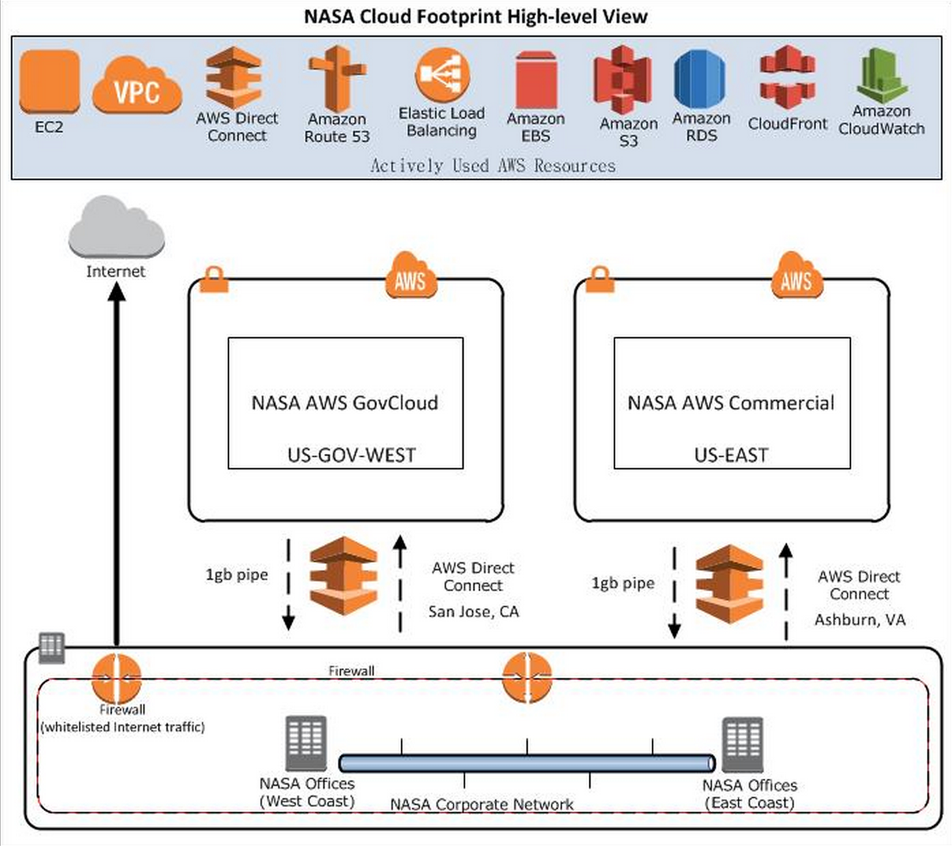
WESTPrime Environment in AWS
Host Applications with ITAR, PII or SBU (Moderate Level) in GovCloud
Host any internal or public facing applications, complex systems with High Availability in Commercial or GovCloud
High-speed network connectivity between NASA and WESTPrime
Several service offering choices

Slide 5





  WESTPrime Case Study - Life Sciences & GeneLabç
Life Sciences File Share running File Cloud is hosted in GovCloud
Leverages EC2 and Amazon S3
Connected from NASA to WESTPrime through DirectConnect
GeneLab App currently in development uses Docker and leverages S3.
GeneLab App hosted in Commercial Cloud
CLSR
bucket
Amazon S3
Amazon S3
web app
server
web app
server
web app
server
…
web app
server
EC2 instance
EC2 instance
security group
security group
EC2 instance
EC2 instance
Dev Env
Prod Env
security group
security group
Dev Env
Life Sciences File Share App
Running FileCloud in Gov Cloud
GeneLab App running Docker
in Commercial Cloud
WESTPrime

Slide 6
  WESTPrime Security
Security functions are off-loaded from customers.
Fully managed security stack and monitoring.
Fully managed application security program.
  Static code analysis.
  Dynamic app scans by team of experts.
  Secure development support.
Compliance as a Service:
  Fully managed ATO for apps leverages existing compliance team/work.
Secure Architecture, Engineering, and Development support

Slide 7
  WESTPrime Point of Contacts
Pam Hanes – Service Executive
Ian Sturken – Web Services Office Manager
Okechukwu Mezu – Requirements Lead
Steven Oh – WESTPrime Program Manager
Ravi Raghava – Enterprise Cloud Architect

Slide 8
Questions?

