Slide 1
NASA Life Sciences Translational Research:
Relevance to the “Open Science” ARC GeneLab/LSDA/Biobank Data Flow
Collaborative Life Sciences Data TEM - NASA ARC
Jan 14-15, 2016
Richard Mains/Mains Associates/Wyle
April Ronca, Josh Alwood, NASA ARC/
Space BioSciences Division
Notes:
I can think of no other practical way for NASA to increase its benefits from translational research than creation of a LSTWG. It requires formation of a focused, supportive collaborative cross-disciplinary team that can share information in an ongoing way. And the team will need to regularly share that information with others including profiling the translational benefits that are produced.

Slide 2
Translational Research at NASA?
NASA is increasingly seeing the value of translational research that captures basic biological knowledge and facilitates its potential application to medical operations for safer human space exploration.
New Omics-based knowledge, the availability of model organisms and epigenetic sciences allows basic research results to be more readily applied to human challenges.
Notes:
The space biology cell and animal research areas are the highest priority translational research knowledge generators. But, Space Biology has many other areas that contribute to human space exploration such as; plant research (food production), microbial research (disease mitigation), reproduction/development (future human settlements), and radiation exposure (mitigate pathology risks). So, these broader translational benefits that are not necessarily direct physiological countermeasures need to be included as part of the rationale for increased collaboration.

Slide 3
Decadal Survey is a Key Driver
The 2010 NAS Decadal Survey (DS) drove establishment of the Space Life & Physical Sciences Division within HEOMD and identified translational research goals.
The DS Translational Research Panel recommended:
- Cross-disciplinary research (biol, phys, engr) with a focus on capturing high-value data, ensuring relevance of results to space- based and earth-based applications, and advancement of translational outcomes whenever possible.
- Develop centralized data networks from ground and space studies to ensure results can be leveraged by other NASA, other gov, and international teams to maximize value.
Notes:
Following through on this proposal before the next ASGSR Conf in Nov (in DC) will be an important acknowledgement that NASA intends to act on this. Ideally there would be a paper presented on the LSTWG at that event and the abstracts are due by July 1st. It could include the key elements in the article submitted to Microgravity.

Slide 4
Recent NASA TR Activity
NASA’s Space Biology and Space Biomedicine (Human Research) entities co-sponsored:
- Artificial Gravity Workshop (WS) at ARC, 2014
- Translational Research Roadmap WS, 2014
- ASGSR Translational Research Panels, 2015
Translational Research Institute CAN released by JSC, proposals due Jan 8, 2016. Focus on translational of results from terrestrial biomedical research to NASA space exploration.
Notes:
Following through on this proposal before the next ASGSR Conf in Nov (in DC) will be an important acknowledgement that NASA intends to act on this. Ideally there would be a paper presented on the LSTWG at that event and the abstracts are due by July 1st. It could include the key elements in the article submitted to Microgravity.

Slide 5
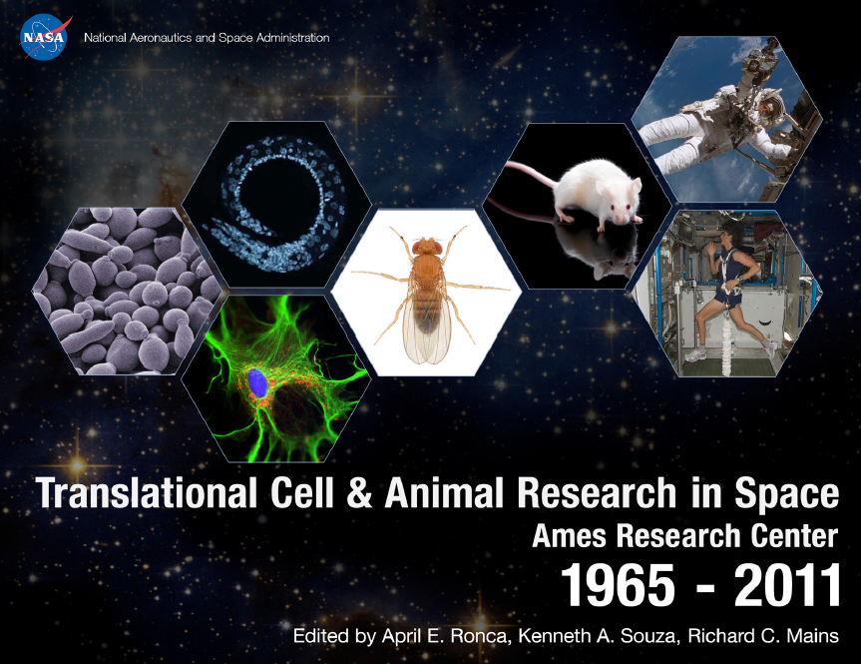
ARC Translational Research Report
(NASA Special Publication, 450+ pages, in press)

Slide 6
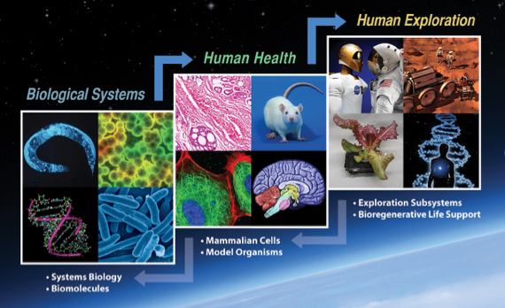
Life Sciences Translational
Research Pathway

Slide 7
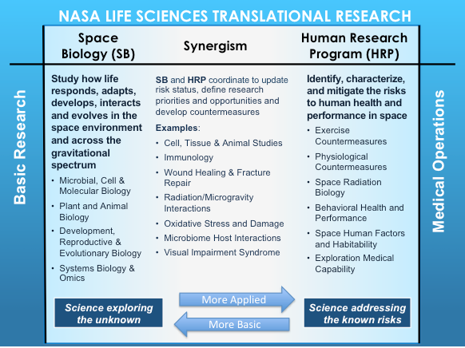
Space Biology & Human Research Collaboration Areas

Slide 8
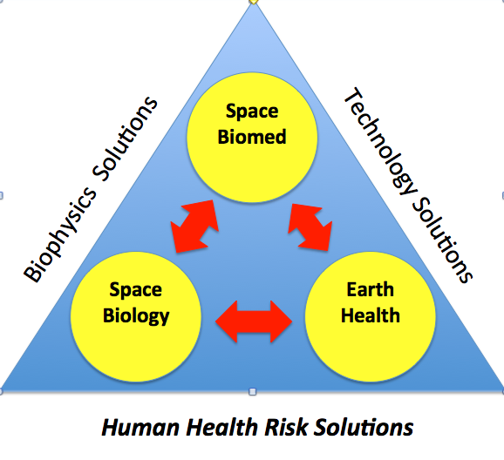
Translational Research Triangle

Slide 9
NASA Translational Example - 1
Vision problems observed in crew members after long-duration spaceflight.
- problems first reported by crew postflight
- eye morphology changes seen in rodents after spaceflight analogous to observations in crew
- ground-based rodent studies underway to further
study effects with tail suspension
- Lower Body Negative Pressure tests planned for astronauts on ground and inflight in attempt to lower cranial blood pressure
Notes:
This is a crude description but I was trying to emphasize the two-way integration in the NASA life science world between the three key translational elements (SB, HR and Earth Med).

Slide 10
NASA Translational Example - 2
Bone and muscle loss due to spaceflight countered by drug treatment.
- drug prevention of losses seen in ground drug studies with rodents
- results confirmed in rodents during microgravity spaceflight
- use in astronauts confirmed results but potential secondary effects need further inflight with rodents
- FDA approval in process for use in Earth-based medical applications to counter losses during best rest and aging

Slide 11
Convergence of Open Science Data Flow & Translational Research
“Open Science” with increased researcher teaming and data sharing is driving collaboration by NASA IT-related systems (GeneLab, LSDA, Biobanks, etc.).
Translational research needs are increasing within NASA life and physical sciences and is part of the evolving SLPS Strategic Plan.
The “Data Flow” TEM is a milestone event that can help bring these two strategies together.
Notes:
Maybe another outcome of the WG could be assessment of research priorities and platform options based on the reality of too little ISS crew time. I note on the ASGSR 2015 draft agenda that they have a whole half-day set aside to discuss microgravity research on non-ISS platforms. This is important for the WG to address too.

Slide 12
References
• National Research Council, “Recapturing a Future for Space Exploration: Life and Physical Sciences Research for a New Era”, 2011. Found at http://www.nap.edu/catalog/13048/recapturing-a-future-for-space-exploration-life-and-physical-sciences
• Micheel, C.M., S.J. Nass, G. Omenn, Eds; Evolution of Translational Omics; Lessons Learned and the Path Forward”, IOM, NAS, 2012. Found at, http://www.nap.edu/catalog/13297/evolution-of-translational-omics-lessons-learned-and-the-path-forward.
• International Workshop on Research and Operational Considerations for Artificial Gravity Countermeasures. NASA, ARC, Feb. 19-20, 2014. Chairs: W.H. Paloski and J.B. Charles, NASA TM-2014-217394. Found at http://ston.jsc.nasa.gov/collections/TRS/_techrep/TM-2014-217394.pdf.

Slide 13
References (cont.)
• “Translational Cell & Animal Research in Space: NASA Ames Research Center, 1965-2011”, Eds: A. E. Ronca, K. A. Souza, and R.C. Mains, NASA/SP-2015-625, in press (2015).
• Alwood, J., A.E. Ronca, R.C. Mains, J.D. Smith, T.S. Goodwin, “From the Bench to Exploration Medicine and Back to Earth: NASA Life Sciences Translational Research for Human Exploration and Habitation Missions”, in press (2016).

