Slide 1
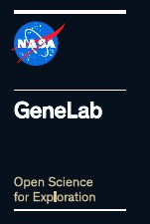
GeneLab Sample Sharing
Collaborative Life Sciences Data Technical Exchange Meeting
NASA Ames Research Center
January 14-15, 2016
Oana Marcu
GeneLab Project Scientist

Slide 2
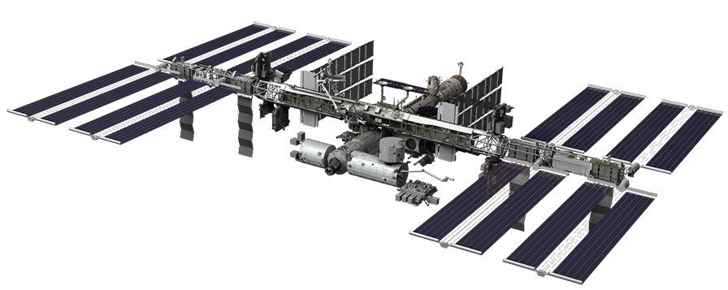
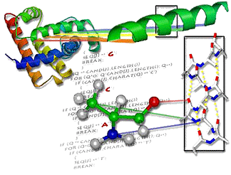

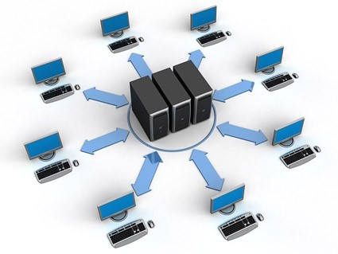
GeneLab ConOps
Recovery
Material sent back to earth for processing in either investigators lab or in GeneLab. Controls (ground and/or flight) processed at the same time.
Sample Processing
Extracted DNA, RNA, protein and/or metabolites sent to validated omics center to generate sequence, transcript, protein expression or metabolite data
Implementation
Experimental protocol performed in space and tissues harvested.
Data Sharing
Data shared with larger scientific community. Results feedback to GeneLab and other databases accelerating scientific discovery by leveraging a larger community.
Data Collection & Curation
Launch
Data returned to investigator or GeneLab for analysis. Raw data uploaded into GeneLab database for pubic viewing.
Experiment is defined, prepared and launched according to requirements.
Next Generation Research
Data Submission
Iterative research solicitations for data analysis using GeneLab datasets enable new hypotheses and next generation flight research.
Data uploaded into GeneLab database for public access
Modeling and Validation
Investigator wet lab validation and computational modeling,
GOAL: maximize and extend the return from ISS experiments

Slide 3

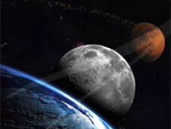
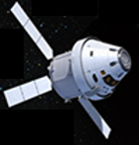
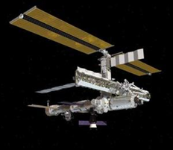
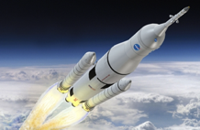
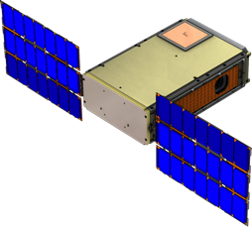
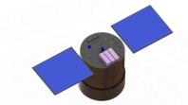
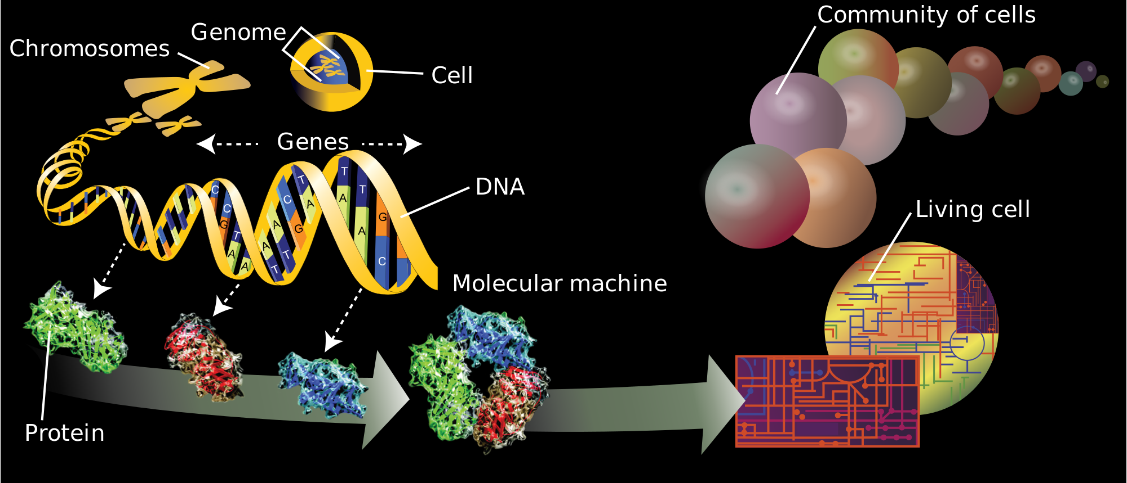
Life Beyond LEO Science Campaign
Mars
L2
LEO
Moon
Earth

Slide 4
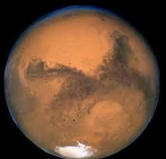
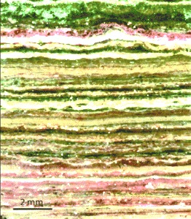

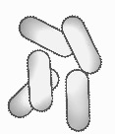
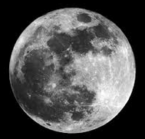
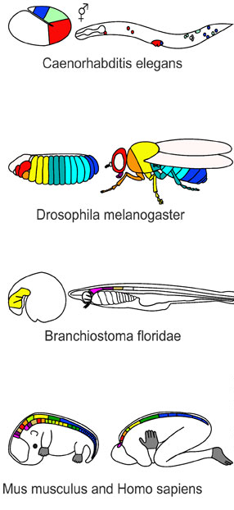
Multi-omics across tissues, organisms, exposure
Life beyond LEO
Microbes/communities, Plants
What are the
networks-pathways-molecules
common/specific to
organisms-organs-cells
that are responsive to
microgravity and radiation?
Translational research
Existing Spaceflight/Ground
Omics Datasets
Existing Spaceflight/Ground
Omics Datasets
Existing Spaceflight/Ground
Omics Datasets
Existing Spaceflight/Ground
Omics Datasets
Existing Spaceflight/Ground
Omics Datasets
Existing Spaceflight/Ground
Omics Datasets
Science Augmentation/
Sharing Experiments
Science Augmentation/
Sharing Experiments
Science Augmentation/
Sharing Experiments
Science Augmentation/
Sharing Experiments
Science Augmentation/
Sharing Experiments
Science Augmentation/
Sharing Experiments
Model Organism
Reference Experiments
(microbial, plants, C. elegans, Drosophila, mouse, cell lines etc.)
Model Organism
Reference Experiments
(microbial, plants, C. elegans, Drosophila, mouse, cell lines etc.)
Model Organism
Reference Experiments
(microbial, plants, C. elegans, Drosophila, mouse, cell lines etc.)
Model Organism
Reference Experiments
(microbial, plants, C. elegans, Drosophila, mouse, cell lines etc.)
Model Organism
Reference Experiments
(microbial, plants, C. elegans, Drosophila, mouse, cell lines etc.)
Model Organism
Reference Experiments
(microbial, plants, C. elegans, Drosophila, mouse, cell lines etc.)
Data Mining &
Analysis
Upcoming NRAs
Data Mining &
Analysis
Upcoming NRAs
Data Mining &
Analysis
Upcoming NRAs
Data Mining &
Analysis
Upcoming NRAs
Data Mining &
Analysis
Upcoming NRAs
Data Mining &
Analysis
Upcoming NRAs
Innovation &
Tool Development
Upcoming NRAs
Innovation &
Tool Development
Upcoming NRAs
Innovation &
Tool Development
Upcoming NRAs
Innovation &
Tool Development
Upcoming NRAs
Innovation &
Tool Development
Upcoming NRAs
Innovation &
Tool Development
Upcoming NRAs

Slide 5
Multi-omics in an integrated database
Mochida et al. Plant and Cell Physiology, 2011, Advances in Omics and Bioinformatics Tools for Systems Analyses of Plant Functions
Existing Spaceflight/Ground
Omics Datasets
Existing Spaceflight/Ground
Omics Datasets
Existing Spaceflight/Ground
Omics Datasets
Existing Spaceflight/Ground
Omics Datasets
Existing Spaceflight/Ground
Omics Datasets
Existing Spaceflight/Ground
Omics Datasets
Science Augmentation/
Sharing Experiments
Science Augmentation/
Sharing Experiments
Science Augmentation/
Sharing Experiments
Science Augmentation/
Sharing Experiments
Science Augmentation/
Sharing Experiments
Science Augmentation/
Sharing Experiments
Model Organism
Reference Experiments
(microbial, plants, C. elegans, Drosophila, mouse, cell lines etc.)
Model Organism
Reference Experiments
(microbial, plants, C. elegans, Drosophila, mouse, cell lines etc.)
Model Organism
Reference Experiments
(microbial, plants, C. elegans, Drosophila, mouse, cell lines etc.)
Model Organism
Reference Experiments
(microbial, plants, C. elegans, Drosophila, mouse, cell lines etc.)
Model Organism
Reference Experiments
(microbial, plants, C. elegans, Drosophila, mouse, cell lines etc.)
Model Organism
Reference Experiments
(microbial, plants, C. elegans, Drosophila, mouse, cell lines etc.)
Data Mining &
Analysis
Upcoming NRAs
Data Mining &
Analysis
Upcoming NRAs
Data Mining &
Analysis
Upcoming NRAs
Data Mining &
Analysis
Upcoming NRAs
Data Mining &
Analysis
Upcoming NRAs
Data Mining &
Analysis
Upcoming NRAs
Innovation &
Tool Development
Upcoming NRAs
Innovation &
Tool Development
Upcoming NRAs
Innovation &
Tool Development
Upcoming NRAs
Innovation &
Tool Development
Upcoming NRAs
Innovation &
Tool Development
Upcoming NRAs
Innovation &
Tool Development
Upcoming NRAs

Slide 6
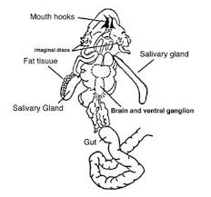
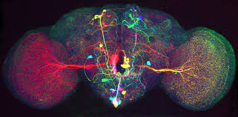
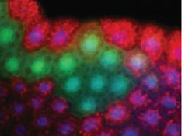
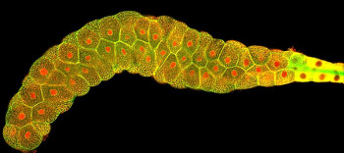
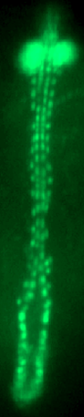
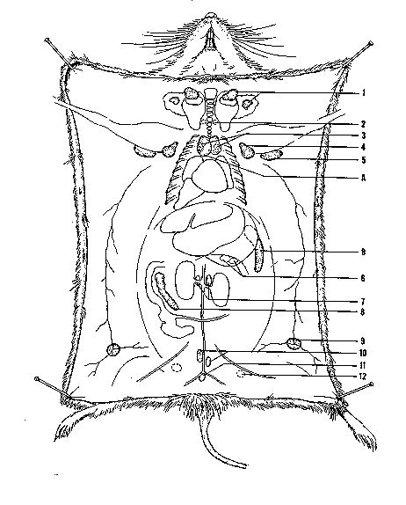
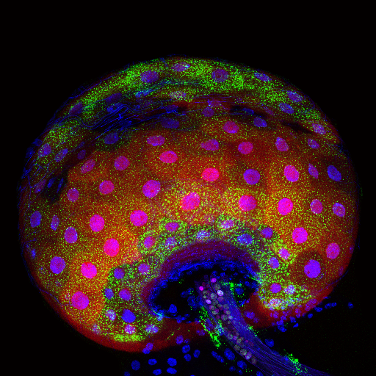
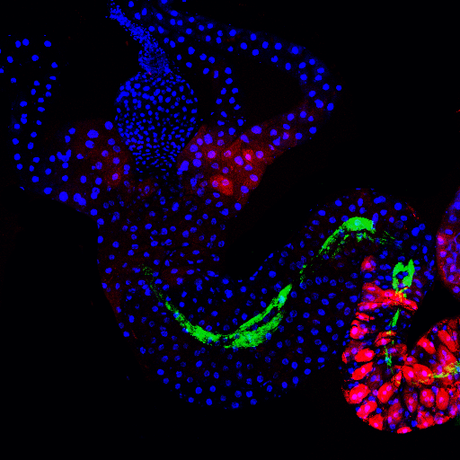
How does GeneLab get tissues and generate data?
Engaging the scientific community
Existing Spaceflight/Ground
Omics Datasets
Existing Spaceflight/Ground
Omics Datasets
Existing Spaceflight/Ground
Omics Datasets
Existing Spaceflight/Ground
Omics Datasets
Existing Spaceflight/Ground
Omics Datasets
Existing Spaceflight/Ground
Omics Datasets
Science Augmentation/
Sharing Experiments
Science Augmentation/
Sharing Experiments
Science Augmentation/
Sharing Experiments
Science Augmentation/
Sharing Experiments
Science Augmentation/
Sharing Experiments
Science Augmentation/
Sharing Experiments
Model Organism
Reference Experiments
(microbial, plants, C. elegans, Drosophila, mouse, cell lines etc.)
Model Organism
Reference Experiments
(microbial, plants, C. elegans, Drosophila, mouse, cell lines etc.)
Model Organism
Reference Experiments
(microbial, plants, C. elegans, Drosophila, mouse, cell lines etc.)
Model Organism
Reference Experiments
(microbial, plants, C. elegans, Drosophila, mouse, cell lines etc.)
Model Organism
Reference Experiments
(microbial, plants, C. elegans, Drosophila, mouse, cell lines etc.)
Model Organism
Reference Experiments
(microbial, plants, C. elegans, Drosophila, mouse, cell lines etc.)
Data Mining &
Analysis
Upcoming NRAs
Data Mining &
Analysis
Upcoming NRAs
Data Mining &
Analysis
Upcoming NRAs
Data Mining &
Analysis
Upcoming NRAs
Data Mining &
Analysis
Upcoming NRAs
Data Mining &
Analysis
Upcoming NRAs
Innovation &
Tool Development
Upcoming NRAs
Innovation &
Tool Development
Upcoming NRAs
Innovation &
Tool Development
Upcoming NRAs
Innovation &
Tool Development
Upcoming NRAs
Innovation &
Tool Development
Upcoming NRAs
Innovation &
Tool Development
Upcoming NRAs

Slide 7
Sources of Samples
BSP/TSP
Archived
Tissues
PI-Driven
Spaceflight/Ground Experiments
GeneLab
Reference
Experiments
PI Lab
Augmentation
(GeneLab adds to PI experiment)
Sharing
(PI shares with GeneLab)
Dedicated (to omics)
Sample
Tissue Sharing
GeneLab
Tissue
Extract
Open Access
Tissue
Extract
DATA/METADATA
DATA/METADATA
LSDA
GLDS
NASA/ESA/JAXA
Other Databases

Slide 8

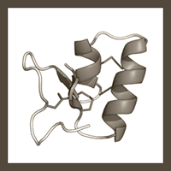
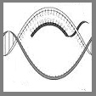
Example 1
Collaboration with NRA-Awarded PI Investigation
SAMPLE SHARING
SAMPLE AUGMENTATION
Study
BRIC-20
Study
BRIC-19
PI: Dr. Sarah Wyatt
PI: Dr. Simon Gilroy
Dataset
Dataset
Transcriptomics
Proteomics Soluble
Proteomics Membrane
Col-0 Ecotype Transcriptomics
Cvi-0, Ler-0 and Ws-2 Ecotype Transcriptomics
PI processed the samples, GeneLab is hosting and sharing data

Slide 9
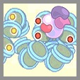
Example 2
Collaboration with NASA validation/CASIS flights
SAMPLE SHARING
SAMPLE SHARING
Study
RR-1 NASA
Study
RR-1 CASIS
Validation flight
PS: Dr. Ruth Globus
PI: Dr. Sam Cadena
Dataset
Dataset
Transcriptomics
Epigenomics
Proteomics
Transcriptomics
Epigenomics
Proteomics
GeneLab processed the samples, GeneLab is sharing data & samples
(RNA extract shared with PI)

Slide 10
Example 3
Collaboration with PI /BSP – legacy samples
SAMPLE SHARING
Study
SpaceX < 8
Dataset
Transcriptomics
µArray
Transcriptomics
RNASeq
Proteomics
PI/GeneLab process samples, GeneLab shares data and/or samples
Good example of the need/desire to do deeper sequencing,
which can drive the need for sample storage

Slide 11
Questions ?

