Slide 1
Space Life Sciences Research - Data & Biosample Archiving Shared data/metadata, methods, goals, user strategies & challenges? Collaborative Life Sciences Technical Exchange Meeting NASA ARC, May 31, 2018
Richard Mains
Mains Associates/KBRwyle
Berkeley, CA

Slide 2
Purpose of TEM - 2
Help leverage LEO knowledgebase across Space Life Sciences toward path to Deep Space
Foster a data archiving community at ARC
Share knowledge by meeting periodically
Identify common issues
Leverage resources
Increase value to archive users
Increase long-term sustainability of archives

Slide 3
What’s Space Life Sciences?
HQs Life Sciences Capabilities Lead, Craig Kundrot, identified four historical SLS elements when he assumed his post (2016)
ARC has activity emerging or underway in each
- Planetary Protection
- Astrobiology
- Space Biology
- Human Research

Slide 4
SLS Element Definitions - 1
Planetary Protection: study of, methods used to ensure that future landers and human explorers don’t contaminate planets with Earth life. Issue rising in priority due to projected increase in commercial landers and Astrobiology’s pursuit of bio-signatures beyond Earth.
Astrobiology: cross-disciplinary study of origin, evolution, distribution and future of life in the universe. Astrobiology Institute funded, ARC team, studies complex molecules of relevance to life (past, current, future) wherever they may appear.
Notes:
.

Slide 5
SLS Element Definitions - 2
Space Biology: study of model organisms transported from Earth to space and to planets (and in ground analogs) and exposed to micro/variable-g, high-radiation, under artificial life support. Mainly study effects on adaptation, growth, development and reproduction. Significant interest in microbial ecology and plant space agriculture. A very small plant payload (1 kg) has been proposed by an ARC team for transport to lunar surface via a commercial lander.

Slide 6
SLS Element Definitions - 3
Human Research (crew health/performance): similar to Space Biology except focus mainly on human subjects. Study physiology, behavior, performance, short & long-term health issues and development of countermeasures to high-risk changes. A Space Biology/Human Research collaboratory effort is underway at ARC in areas of Translational Research.

Slide 7
Some Common Issues - 1
Some “Big Data” Era Challenges with Users:
- Data flows; from raw, processed, analyzed to summarized
- Data flow types; real-time and at rest
- System includes; people, process, technology, infrastruct
- Roles; engineers, data scientists, archivists, end users
- Users want information access online. Must be relevant
- Users have a wide range of expertise. User friendly access
- Users hate complex searches. Provide results examples?

Slide 8
DATA
Archivist
Elicits from end users on required presentation, assesses, collects, organizes, preserves, maintains control over, and provides access to records and archives determined to have long-term value. The records maintained by an archivist can consist of a variety of forms, including letters, diaries, logs, other personal documents, government documents, sound and/or picture recordings, digital files, or other physical objects.

Slide 9
Some Common Issues - 2
“Big Data” within NASA SLS Community:
Research data comes with information, and turns into knowledge, and with luck, science insights. All useful.
Open Gov, Open Science, Open Data requirements for NASA drive need for easy user access and high-value content.
Data access by users requires relevant associated metadata to be useful.
NASA resources to support increased user access are minimal now.
New innovative methods needed to streamline process, leverage resources and demonstrate archive benefits for all user types.

Slide 10
Other Common Issues?
“Big Data” impacts across NASA SLS Community
Common data/metadata display formats - keep it simple
Cross-linkage between user web access to SLS archives
Sharing of info on user access issues and concerns
A shared and searchable SLS publications database?
Lessons learned/feedback from software tool users
Our shared SLS product types (publications, data/biobank archives, payload technology database, conference support, education/outreach, tech xfer, etc.)
Advocacy efforts for the archives (funding, user buy-in)

Slide 11
SLS Archives Value?
NASA Provides Access to Research Results:
- Broad knowledge sharing and data/biosample reuse
- Wide range of R&D products (highest priority items?)
- Physical and digital archives (value requires funding)
- Internal and external products (often transitional)
- NASA meets public access requirements for results, data, biosamples, with potential single-point access to various archives via SLPSRA site (an Open Science Portal?).

Slide 12
Supplemental Graphics
Some strategies and options from Helen Stewart on accessing archives, configuration options, concept for an open science portal to archives and metadata linkage between LSDA and Genelab.
All topics for discussion…

Slide 13
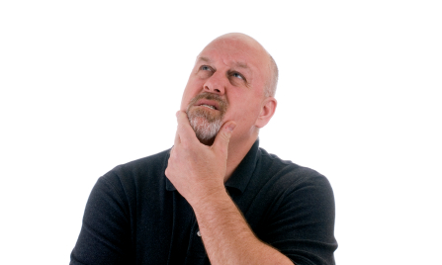
Space Biology
Human Research
Physical
Sciences
Public web sites
NSPIRES
Call for Proposals
GeneLab Cloud
Physical Sciences Informatics (PSI)
GeneLab
Life Sciences Data Archive
LSDA/ALSDA
SLPS NASA Task Book
Collaborative Life Sciences
Repository (CLSR) Internal Cloud
Space Biology & HRP
Missing links:
from SLPS to Space Bio & LSDA
From NSPIRES to LSDA, GeneLab & Physical Science
NASA Private web sites
Red Lines = Missing Links
Black Lines = Existing Links
?
How to associate across necessary data for proposing or for open science for those not in the know?
1) NRAs for New Open Science initiatives not surfacing on HEOMD & SLPS websites?
2) PSI referenced on SLPS site but not LSDA
3) Space Biology site only references GeneLab
Grant Student Research for Proposal
Brilliant Innovative Proposal Concept

Slide 14
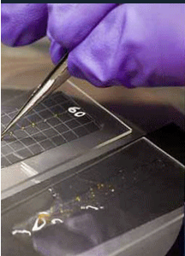
Collaboration of ISSP OZ, SLPS Human Research and Space Biology Programs support ARC ISOC, ARC LSDA and ARC Biobank to support the Science Community
What are the differences between the SLPS Data Archives? Sciences Repositories –Puzzle
ISOC operations
LSDA/ALSDA-CLSR
JSC/ARC/KSC
GeneLab
ARC
Public: Lab: genomic data, RNA & protein expression, & metabolic profiles, interfaced with existing databases like ALSDA for expanded research, offering tools to conduct data analysis. An online lab for scientists, researchers, teachers & students to collaborate.
Public: HRP and Space Biology Publishable investigation data & Curation
of Institutional Science Collection of space flight payload & ground control biospecimen.
Funded by ISSMP, SLPs SB & HRP program elements
Non Public:
Investigative and Preparation Period of research in ALSDA/CLSR
Laboratory
Public: Biobank
Biobank (SBP and HRP)

Slide 15
Proposed Configuration
Space Biology
Human Research
Physical
Sciences
NSPIRES
Call for Proposals
SLPS Website of Repositories
toolbox for proposers & educators
SLPS NASA Task Book
Pointer to SLPS Cloud
GeneLab
Life Sciences Data Archive
LSDA/ALSDA
Physical Sciences Informatics (PSI)
Repository metadata cross linking
Data Analytics Tools for Science Community
Mitigation of missing links:
from SLPS to Space Bio & LSDA
From NSPIRES to LSDA, GeneLab & Physical Science
How to associate across necessary data for proposing or for open science for those not in the know?
Great!
1) SLPS NRAs & Open Science initiatives now surfacing on HEOMD & SLPS websites.
2) One place to go to see the big picture
3) How to plan for competing your ideas and how to educate in the Repository..
Grant Student Research for Proposal
Brilliant Innovative Proposal Concept

Slide 16
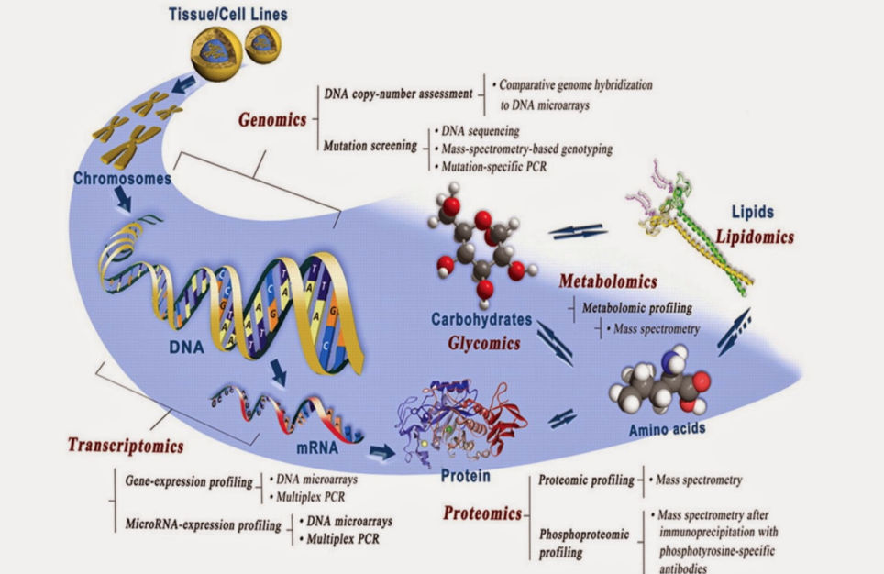
What needs to have cross linked metadata pointers
between repositories
Life Sciences Data Archive
GeneLab Omics Samples
Origin of the species, procured from
experience & behavior (flight and ground)
Constraints species were stowed in e.g., habitats, cassettes, trays, etc.
Procedures, experiment lab notebook data observations, trends, video,
telemetry of environmental conditions, and results derived and published.

