Slide 1
Open Data Overview
Information-centric decision making with secure access to the right information at the right time.
Jason Duley
5/31/2018
OCIO

Slide 2
About
HQ OCIO leading the Open Innovation Team
Implement OMB Mandates on Open Data
Maintains the Open Data Registry
Continue to support API programs
Spearhead community engagement with Open Source NASA code
Under the Agency Information Management Program
Heading development of a Digital Object Identifier Registry as a central agency-wide mechanism to mint DOIs

Slide 3
What is Open Data
NASA Missions/Projects/Programs create and publish data making it available to the public as Open Data
no ITAR, SBU, PII is made available
Open Data is made available on domain specific sites (e.g.: GeneLab, EOSDIS, NASA3D) as the authoritative source
Data is now available for use in academia, STEM, citizen science projects, Hackathons, entrepreneurship, etc.

Slide 4
Open Data Curation
NASA maintains a Public Data Listing commonly referred to as the PDL
The PDL is a machine-readable metadata descriptor that contains "pointers" to existing NASA datasets
Datasets are described using a federal government-wide standard - Project Open Data v1.1

Slide 5
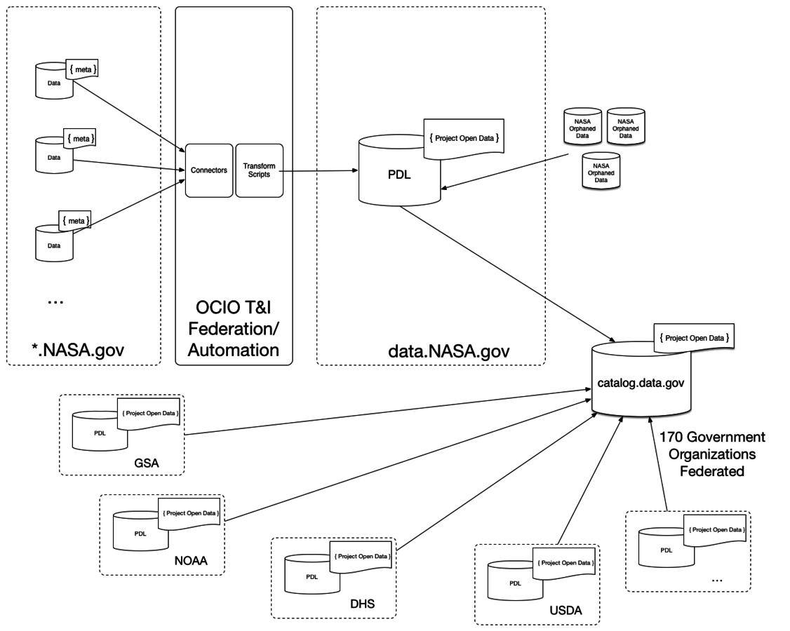
Federating Open Data Records

Slide 6
Data.nasa.gov
NASA Open Data Portal provides:
A dataset metadata registry
Dataset hosting
API Wrappers/API Key Infrastructure
Visualization
Citizen Engagement / Feedback

Slide 7
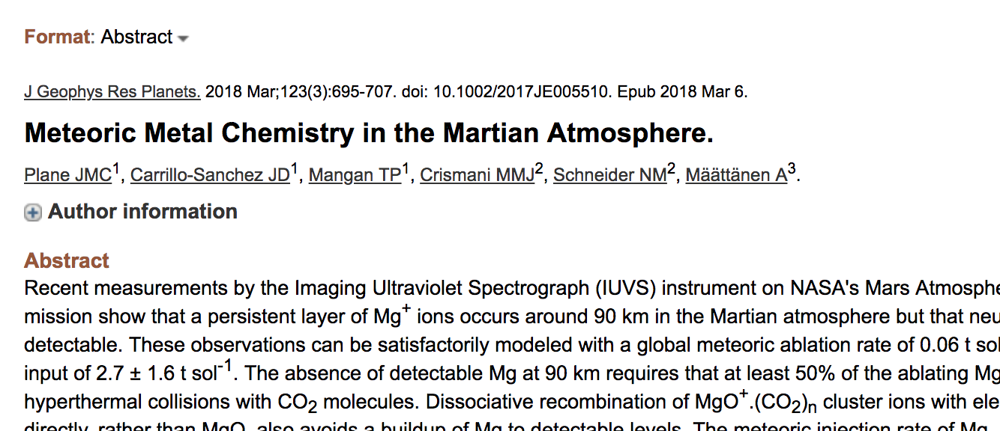
Digital Object Identifiers
A Digital Object Identifier (DOI) is a unique alphanumeric string used to identify content and provide a persistent link to its location(s) on the Internet
Can be associated with datasets, publications, code, even identify instruments or entities
Some metadata is frequently associated with the DOI link
Widely used, including NIH (PubMed) and most publications, also by Planetary and other NASA divisions

Slide 8
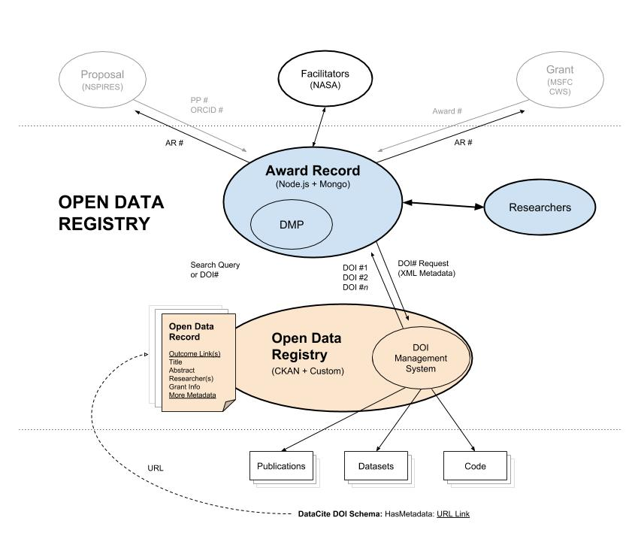
DOI Architecture
Award
(NSSC)

Slide 9
Collaboration Opportunities
Federate datasets from Life Sciences authoritative source websites and collections in Open Data Catalog
Work with exposing Life Sciences datasets as APIs
Hosting Life Sciences datasets on data.nasa.gov
Work with dataset owners to adopt DOIs for Datasets metadata
Establish new clients for the Digital Object Identifier Registry for minting DOIs

